Slide 1


Social Work course redesigning and rethinking in alignment with the elements of authentic e-learning.
Dr. Mabvira, Agrippa
Prof. Zimba, Zibonele

Slide 2
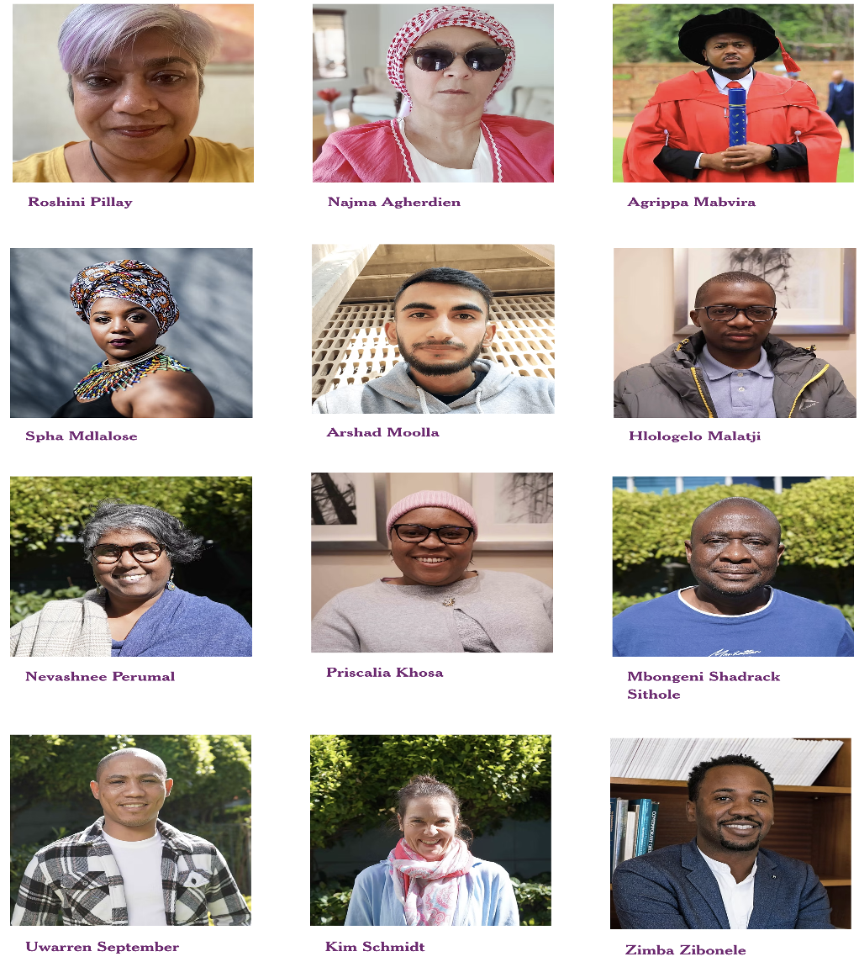
Introduction
Aim: redesign social work modules with authentic, technology-enhanced learning.
Motivated by:
Pedagogical innovation
Decolonisation
Social transformation

Slide 3
Authentic learning elements
Authentic context and task that reflects how knowledge is used in the real-world
Collaboration and independence over a sustained period
Multiple roles and perspectives
Expert performance, modelling and multiple sources of information
Reflection
Articulation through debate, role-play, discussion and presentations
Scaffolding and integrated assessment
Socioemotional learning

Slide 4
Research Objectives and Methodology
Objectives:
Challenges and benefits of authentic e-learning.
Theoretical frameworks for authentic e-learning.
Recommendations for course redesign.
Methodology: Systematic review of data (2019–2024) from Google Scholar, EBSCOhost, and Sabinet.

Slide 5
Key Findings: Challenges and Benefits of Authentic E-learning
Benefits:
Enhanced engagement, international collaborations, better career preparation, decolonial tool
1
Challenges:
Digital divide, lack of policy support, resistance to change
2

Slide 6
Recommendations for Curriculum Redesign Content:
Integrate problem-based learning (PBL) and digital tools.
1
Develop policies to support innovative frameworks.
2
Foster flexibility and inclusivity in course delivery.
3

Slide 7
Leveraging Technology for Authentic E-learning
Integration of ICT and mobile learning applications.
Expansion of broadband access to bridge the digital divide.
Informal digital skills use and digital transformation.

Slide 8
Authentic Assessment Strategies
Shift from traditional exams to real-world tasks and projects.
Examples: Case studies, simulations, and portfolio assessments.

Slide 9
Enhancing Quality in Higher Education
How authentic e-learning improves learner engagement and knowledge retention.
Preparing students for professional careers through real-world relevance.

Slide 10
Conclusion and Call to Action
Summary of key recommendations.
Main insight of the findings – Key Takeaways
Call to action for educators, curriculum designers, and policymakers to embrace authentic e-learning.

Slide 11


Thank you
Project website
https://www.social-work-education-sa.org/
Acknowledgements
This work was supported by the National Research Fund under Grant [numberSRUG2204264860].

Slide 12
References
Bozalek, V., Gachago, D., Alexander, L., Watters, K., Wood, D., Ivala, I., & Herrington, J. (2013). The use of emerging technologies for authentic learning: A South African study in higher education. British Journal of Educational Technology, 44(4), 629-638.
Gerrand, P., & Pillay, R. (2024). Writing-intrusive social work courses adapted for emergency remote teaching and learning: Experiences of first-year students and their writing fellows. In L. Dison, M. Prozesky, A. Ferreira, A. Essien, & T. Giorza (Eds.), Pedagogic innovation beyond disruption (pp. 139-154). SUN PReSS.
Hall, A., & Herrington, J. (2010). The development of social presence in online Arabic learning communities. Australasian Journal of Educational Technology, 26(7), 1012-1027. http://www.scopus.com/inward/record.url?eid=2-s2.0-78650763537&partnerID=40&md5=48fe07f1c42a44e94f53cb9102810432
Herrington, J., & Kervin, L. (2007). Authentic learning supported by technology: Ten suggestions and cases of integration in classrooms. Educational Media International, 44(3), 219-236.
Herrington, J., Reeves, T., & Oliver, R. (2010). A guide to authentic e-learning. Routledge.
Mantashe, L. X. (2023). Online pedagogy: A changing higher education pedagogy and an emerging lecturer habitus. The Independent Journal of Teaching and Learning, 18(2). https://hdl.handle.net/10520/ejc-jitl1-v18-n2-a3
Motaung, L. B., & Makombe, R. (2021). Tutor experiences of online tutoring as a basis for the development of a focused tutor-training programme. The Independent Journal of Teaching and Learning, 16(2). https://hdl.handle.net/10520/ejc-jitl1-v16-n2-a9
Osman, R., & Petersen, N. (2010). Students' engagement with engagement: The case of teacher education students in higher education in South Africa. British Journal of Educational Studies, 58(4), 407-419.
Pillay, R. (2017). Crafting a meso practwice course using elements of authentic learning for undergraduate social work students in South Africa [Master's thesis, University of the Western Cape].
Pillay, R., Khunou, G., & Mophosho, M. (2023). Reflection skills in social work. In R. Pillay, S. Mkwananzi, & S. Moonsamy (Eds.), Transforming teaching and learning experiences for helping professions in higher education (pp. 227–243). BRILL.
Rowe, M. (2012). Blended learning in physiotherapy education: Designing and evaluating a technology-integrated approach [Doctoral dissertation, University of the Western Cape].
Safodien, M. (2021). Social work 4.0? The Fourth Industrial Revolution and social work education: A South African perspective. Social Work/Maatskaplike Werk, 57(3), 257-271. https://dx.doi.org/10.15270/52-2-946
Salmon, G. (2002). E-tivities: The key to active online learning. Routledge.
Schön, D. (1983). The reflective practitioner: How professionals think in action. Basic Books.
Schrenk, N., Alves, K., Van Dam, D., & Schrenk, B. (2021). Reflecting on best practices for online learning in a post-COVID-19 world. Online Learning, 25(4), 486-504.
Teräs, H. (2016). Design principles of an authentic online professional development program for multicultural faculty [Doctoral dissertation, University of Tampere].

