Slide 1
Identifying and supporting children with developmental delays and/or disabilities in rural child and youth care centres
Presented by: YOLANDE HEYNS
Social Worker in Private Practice

Slide 2
Background

Slide 3
Career start at Bethany house trust

Slide 4
Development of the Ecosystemic Protocol for the Management of Children with Mental Health Problems (ECO-MACH)
Encounters with children presenting
with mental health problems

Slide 5
Advantages of implementing the eco-mach
Provides a step-by-step guideline for identifying and supporting children with mental health problems
Assists in early identification of disorders or behaviour problems
Streamlines the support of children with mental health problems
Promotes the mental health of children
Empowers staff
Ensures collaborative practice between all role-players on all ecosystemic levels

Slide 6
Regarding the newest development

Slide 7
Career start at crossroads cycc

Slide 8
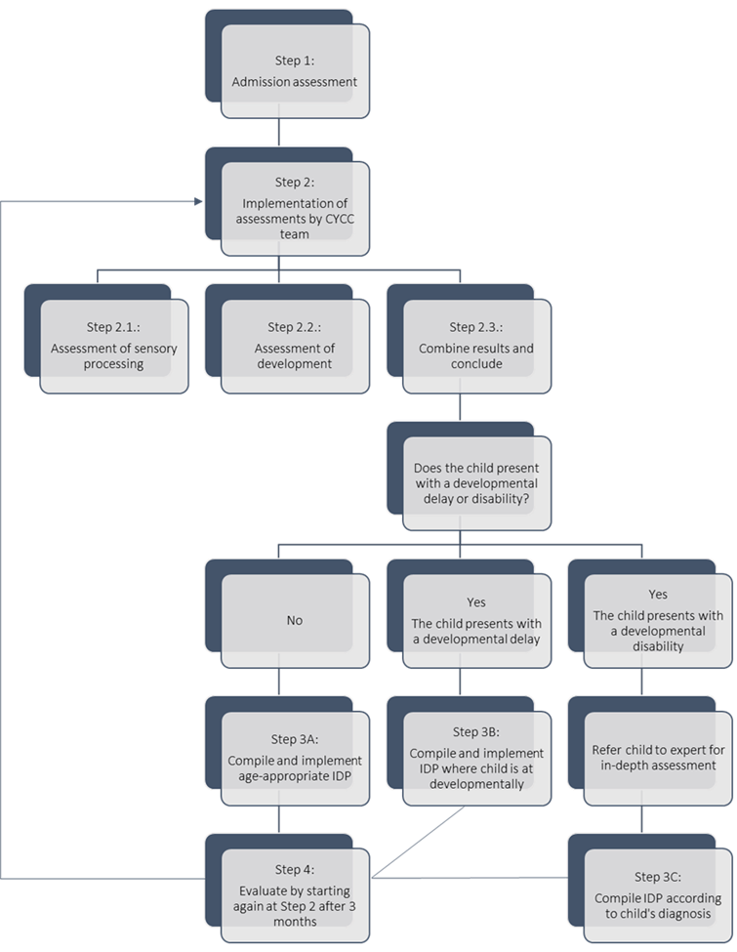
Development of the Ecosystemic Assessment and Intervention Protocol (ECO-AIP)
Encounters with children presenting
with developmental problems rather than mental health problems

Slide 9
Step 1 – Admission assessment
Complete when child is admitted
Contains:
Identifying information
Medical history
Social history
Family background
Developmental history

Slide 10
Step 2 – Implement assessments 4 Weeks after admission

Slide 11
Step 2.1. – Sensory integration assessment
Completed by CYCC team after observation of child’s reactions to sensory input.
NOT a diagnostic assessment, but a CHECKLIST to provide clues on whether or not child has a problem in one or more sensory area.
There are 12 statements under each of the seven senses. Staff indicates:
ALWAYS (10 points) if child does what the statement says
SOMETIMES (5 points) if the child does it occasionally
NEVER (0 points) if the child does not do what is stated.
The total score is calculated for each sense on a summary page (see next slide).
Score above 20 should raise concern, and close monitoring until follow up evaluation.
Score above 30 necessitates investigation by an expert.

Slide 12
Example of sensory assessment

Slide 13
Example of sensory assessment

Slide 14
Step 2.2. – Developmental assessment
Completed by CYCC team after observation of child’s play, interaction, school work, relationships, senses, and daily functioning.
NOT a diagnostic assessment, but a CHECKLIST to provide clues on whether a child has reached age-appropriate developmental milestones.
Find milestones page applicable to child’s age.
There are 5 milestones under each developmental area. Staff indicates:
YES (10 points) if the child can do the skill
SOMETIMES (5 points) if the child is just learning the skill
NEVER (0 points) if the child cannot do the skill.
The total score is calculated for each developmental area on a summary page (see next slide).
A score in the not-coloured area (low), indicates healthy development.
A score in the lightly coloured area (relatively low), indicates probability of a delay.
A score in the dark coloured area (high), might indicate a disability.

Slide 15
Example of developmental assessment

Slide 16
Example of developmental assessment

Slide 17
Step 2.3. – Conclude & Decide

Slide 18
Step 3 – Compile and implement IDP

Slide 19
Step 3 – Compile and implement IDP

Slide 20
Step 4 – Evaluate

Slide 21
Benefits of ECO-AIP in rural CYCC
Lends structure and guides the work of CYCC TEAMS
Changes the operational procedures of the CYCC as an organisation
Increased knowledge of all CYCC staff
Increased awareness and ability to identify developmental delays or disabilities
Able to implement age-appropriate and individual-specific stimulation activities to optimally develop the child
Improved developmental health of all children in all developmental areas

Slide 22
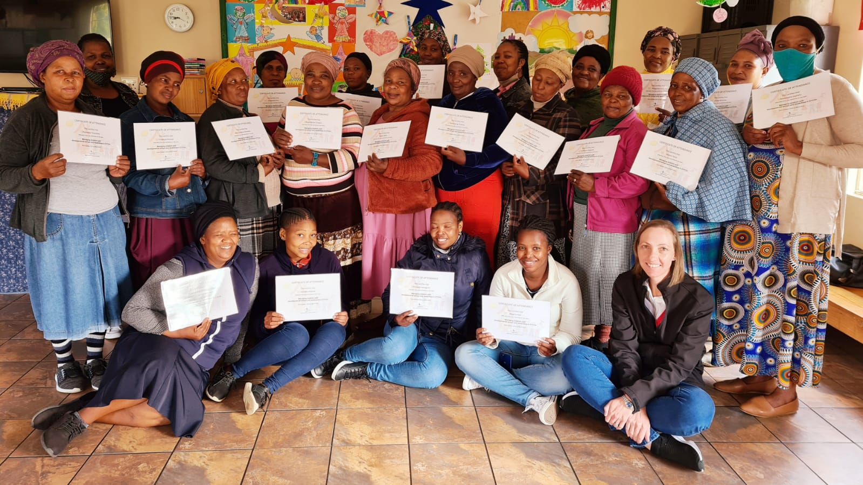
Training & Licensing

Slide 23
Questions Please contact me if you would like to receive training in these protocols
Yolande Heyns
yolandeallers@gmail.com
082 907 2212

