Slide 1
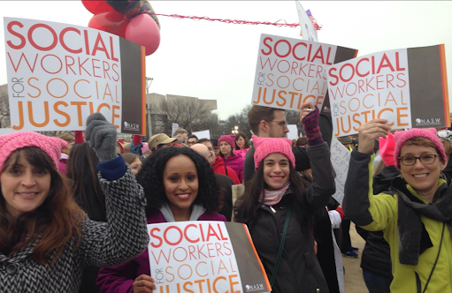
THE WHAT, WHY AND HOW OF CAPACITATING SOCIAL SERVICE PROFESSIONALS ON THEIR ROLES IN SOCIAL PROTEST ACTIONS

Slide 2
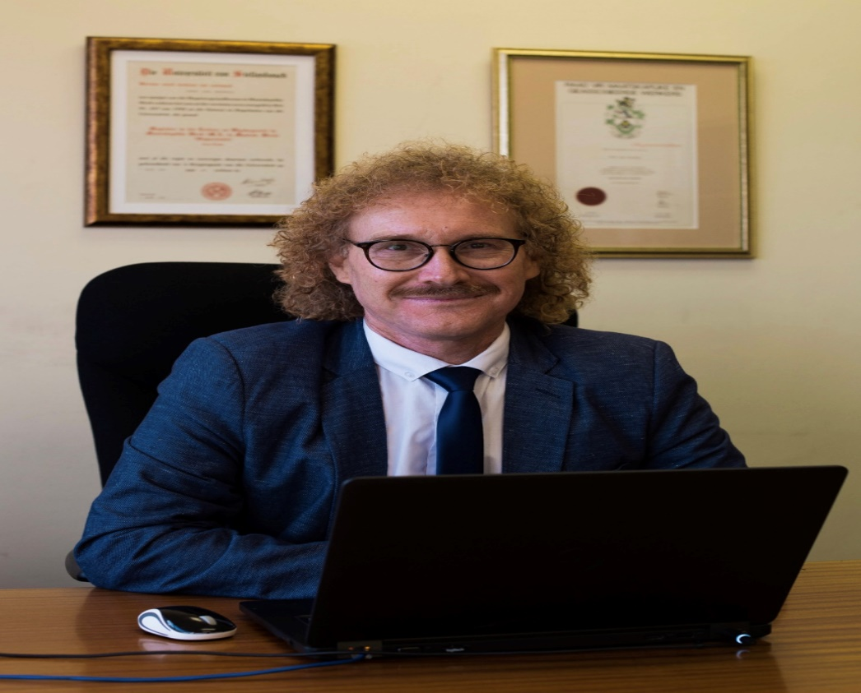
Dr. Nyasha Hillary Chibaya nyashahillary@yahoo.com Department of Social Work University of Stellenbosch South Africa Professor Lambert Engelbrecht lke@sun.ac.za Department of Social Work University of Stellenbosch South Africa

Slide 3
PRESENTATION OVERVIEW
Introduction and rationale
Problem statement
Goal
Research methodology
Findings
Conclusions
Recommendations

Slide 4
Introduction and rationale
Social work, human rights, Social Justice
Radical social work, critical consciousness, social action
Social work legislation and policies
- Global social work definition
- Global agenda
- Global social work statement of ethical principles
- South African council for social service professions’ ethical code

Slide 5
Problem statement
Social actions by social workers in defence of welfare states across the globe
Similar actions by social workers in south Africa scant despite high incidences of protest actions in the country and poverty for the majority
Ethical dilemmas regarding participation or lack thereof in social protest actions

Slide 6
Goal
TO GAIN AN INFORMED UNDERSTANDING OF THE PERCEIVED ROLES OF SOCIAL WORKERS IN SOCIAL PROTEST ACTIONS

Slide 7
Research methodology
QUALITATIVE APPROACH
Descriptive, exploratory, instrumental case study designs
SNOWBALL AND PURPOSIVE SAMPLING TO RECRUIT 27 PARTICIPANTS FROM 4 SAMPLING COHORTS
SEMI-STRUCTURED ONLINE AND TELEPHONIC INTERVIEWS
REFLEXivE THEMATIC ANALYSIS

Slide 8
Findings
Should social workers be involved in social protest actions?
SWM-P4 “I think yes because we are sitting close to the fire. I think social workers in a certain way we should because we see social problems firsthand”
What protest actions should social workers be involved in?
SWNI-P6 “Remember we stand for social justice. we stand for equal rights to ensure that the community is taken care of and is empowered. So, I cannot really say this one and not get involved in the other one”
How should social workers be involved in social protest actions?
- COVERT INVOLVEMENT
SWI-P1 “You could do this through social media. For example, through an informed Facebook post. I can remember the Black Lives Matter movement went viral because of social media”
- Overt involvement
RSWE-P1 “Social workers can be involved in marches and rallies in non-violent ways”

Slide 9
Findings
Influences behind social workers’ involvement in social protest actions
- Field of practice
SWNI-P6 “With involvement, in most cases it will be because we are designated into whatever focus, for instance I am a child protection social worker. So if anything has to do with children, this is what I stand for, this is what I do on a daily basis”
- Employing organisation
SWM-P7 “I think involvement comes down to feeling strongly about a matter and that motivates you. Especially if your organisation allows and encourages you to do so”
- Personal affiliation
SWM-P8 “I think it can also be the amount of cases that we get, the reports we get, we see these things first hand. We are also just people and it becomes an emotional thing. Seeing children get raped and abused is unbearable. I think that motivates you to make it better for the kids out there”
- Higher education
RSWE-P1 “Your higher education background also determines whether or not you will be inclined to get involved in social protests. The core knowledge focus of your bachelors influences your critical thinking in terms of the profession and its interventions”

Slide 10
Findings
Influences informing social workers’ non-involvement in social protest actions
- Dominance of neoliberal capitalism
SWM-P1 “All they give us are more forms, documents, registers and papers that we have to complete for them to keep track of all these children”
- Reliance on state funding and donations
SWM-P4 “But also, realistically we need money to be able to do that. So we can't be stupid and mess it up even more”
- Hopelessness
SMW-P8 “If we look in general at how people protest, how they ask for things, how there are obvious lack of resources but nothing is done. That's like a demotivation for you not to put yourself out there”
- Threats and fear of personal and professional harm
SWNI-P3 “I think a fear of losing your job. I think a lot of people don't want to show their face or protest for fear of jeopardising relationships with people who are important in the sector, and their own livelihood”
- A disjointed social work fraternity
SWM-P4 “There are also apparent discrepancies in our profession. We are not truly united so this might have a bearing. I mean we are not all paid the same, so not everyone really feels the need to go the extra mile and fight for people’s rights”

Slide 11
Findings
Roles and their fulfilment
- Mobiliser
SWI-P2 “I think it should be centered around awareness and preparing the community about the protest you are going to be doing. I think we take for granted that everybody is going to know about a protest. I think we can use social media to create Facebook groups to reach as much people as we can”
- Organiser
SWNI-P3 “When organising I think it involves ensuring the protest is well thought and planned out, ensuring memorandums are articulating demands clearly, administration and logistics of the protest”
- Counsellor
SWI-P2 “As a counsellor, I think firstly it has to be someone with formal training in counselling and debriefing”
- Social broker
SWI-P5 “You play a role of broker by linking people with resources. As I said earlier, the people are here protesting, blocking roads, but there is no one to listen to them. So you link them with resources, direct them to proper channels that will help in resolving their grievances”

Slide 12
Findings
Roles and their fulfilment
- Lobby
SWI-P4 “We should also lobby for changes at a social developmental level. We attend a lot of stakeholder meetings. We meet with different people, whether it is business people, whether it's government officials. So we should advocate for various human rights issues during these meetings”
- Leader
SWNI-P7 “I think we can help community members with how they can go about protesting in a way that is not counterproductive. Like with the violence, there is no point in destroying the same building and vehicles we are going to need tomorrow”
- Advocate
SWM-P4 “Advocacy stands out, to give a voice to those who don't have a voice, or do not know how to get the message through”
- Educator
SWM-P5 “Educating the people on protesting in a humane manner. I am talking now constructive ways of bring up problems to the council and not the pointless violent insurrections”

Slide 13
Findings
ETHICAL DILEMMAS
- Competing loyalties
SWNI-P3 “If say you are protesting against the government and you work for DSD who is the government. That's kind of a conflict of interest in some regard. So, they can put pressure from the top to say, your social workers marched against us, we want them out”
- Value conflict
SWM-P4 “You see, the thing is with our organisation we are apolitical, we do not belong to a union. So that influences participation in protest actions”
SWI-P1. I remember during the GBV protests, we spoke to our boss and who told us that we had a right to go to the protest if we wanted to. But at the same time, she reminded us that we would be doing a disservice to the people we were supposed to be working with on the day.”

Slide 14
Conclusions
to authentically engage in social activism for social change in a way not tied to political agendas or indeed organisational constraints, several considerations and reforms have to be made. The affiliation of social work and the state needs to be redefined to allow for genuine human rights and social justice activism
To navigate safety and ethical predicaments, social work institutions should respectively, provide clear protection and support systems that foster ethical practice
In determining an informed course of action and role, social work practitioners must critically and continually engage with the contextual realities, the discursive concepts of human rights and social justice, and social work ethics

Slide 15
Recommendations
- FRONTLINE SOCIAL WORKERS
though the range of roles discussed parallel traditional social work intervention roles, they hold different nuances in social action contexts. This primarily warrants social workers to be well acquainted with social work knowledge constitutive of social change. Broadly, this includes theories, ideologies and principles of radical social work, human rights and social justice
- SOCIAL WORK MANAGERS
Social work managers are responsible for the administration and management of social service organisations, and are in contact with key stakeholders. In the view of neoliberal ideals that serve to curtail critical thinking and critical action, they ought to challenge the implementation of policies and directives that hinder social activism, and are dissociated from contextual realities
- SOCIAL WORK EDUCATORS
Social action in social work interventions is inextricably complex; social work educators should ensure undergraduate curriculums cover theories and application of radical social work, human rights, social justice and social work ethics
- SOCIAL WORK INSTITUTIONS
The ethical code of the SACSSP should address the role of social workers more explicitly in social protest actions. Social work organisations (DSD included), should be more explicit in their Human Resources policies about the roles of social workers in social protest actions owing to the uniqueness of the social work profession. both DSD and NGOs, should be more specific about expectations and/or limitations of social workers’ involvement in social activism for human rights and social justice.

Slide 16
Thanks for listening
Dr. Nyasha Hillary Chibaya
Nyashahillary@yahoo.com
Professor Lambert Engelbrecht lke@sun.ac.za

