Slide 1



OVERCOMING CHALLENGES TO ACCULTURATION: INSIGHTS AND SUGGESTIONS FROM IMMIGRANT ADOLESCENT LEARNERS IN SOUTH AFRICA.
PRESENTERS
AGRIPPA MABVIRA
DR. POPPY MASINGA
DR. ROSHINI PILLAY

Slide 2

OVERVIEW
  Definition of Key Concepts
  Research Methodology
  Challenges to acculturation
  Recommendations
  Roles that can be played by Social Workers in Implementing the recommendations

Slide 3




KEY CONCEPTS
  ACCULTURATION
  IMMIGRANT
  ADOLESCENCE

Slide 4


METHODOLOGY
  Qualitative Study
  Participatory Action Research
  Purposive sampling strategy
  Photovoice and focus group discussions
  SHOWED method
  Pseudonyms will be used for the sake of anonymity

Slide 5

CHALLENGES TO ACCULTURATION
  We understand challenges to acculturation as referring to the obstacles, difficulties and complexities that individuals or groups may encounter as they engage in the process of adapting to and integrating into a new cultural environment.
  In our study we noted that challenges can arise from differences in values, norms, customs and expectations between the original culture and the culture being adopted.

Slide 6
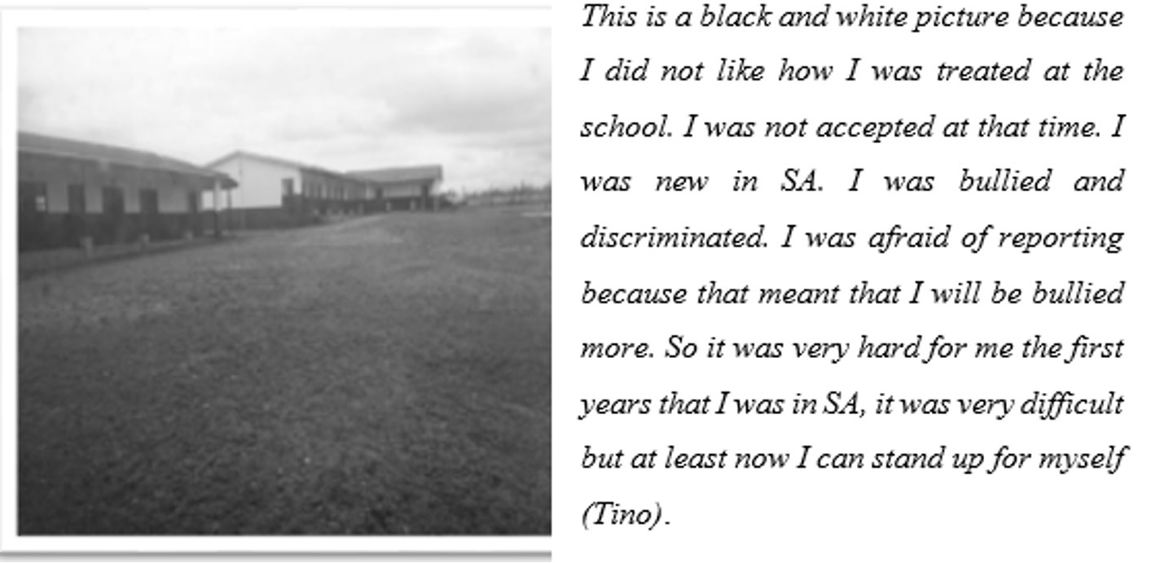
DISCRIMINATION AT SCHOOL

Slide 7
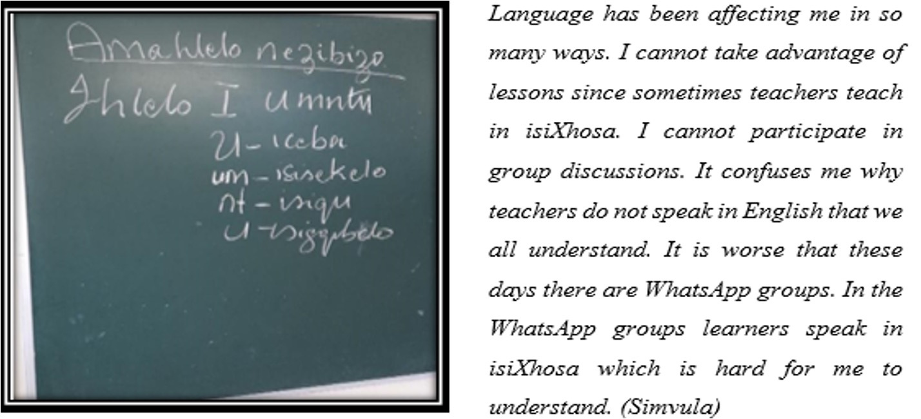
LANGUAGE BARRIER

Slide 8
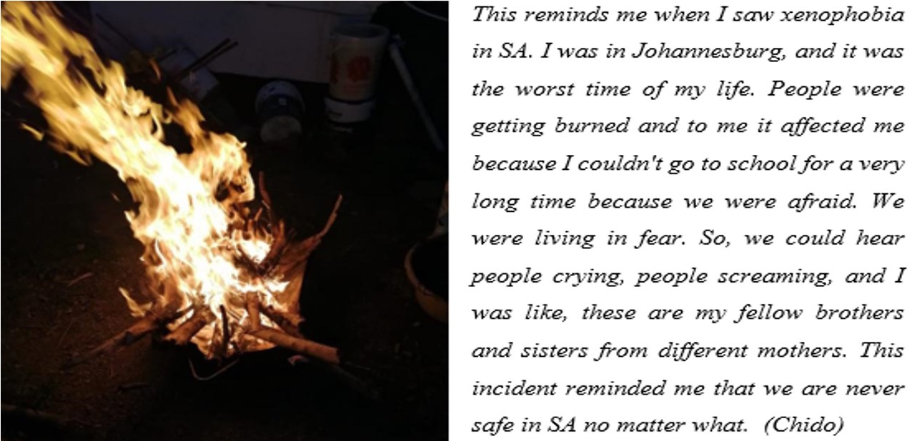
FEAR OF XENOPHOBIA (1)

Slide 9
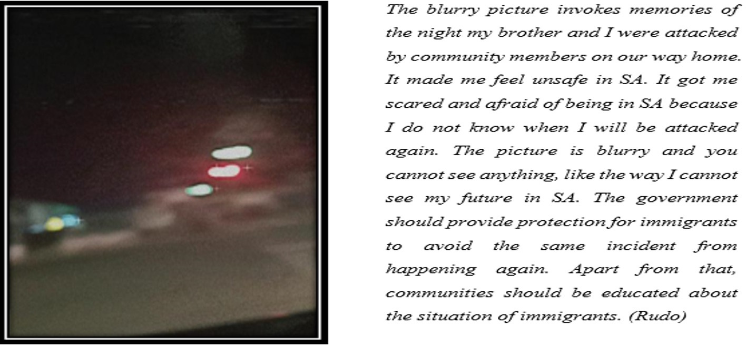
FEAR OF XENOPHOBIA (2)

Slide 10
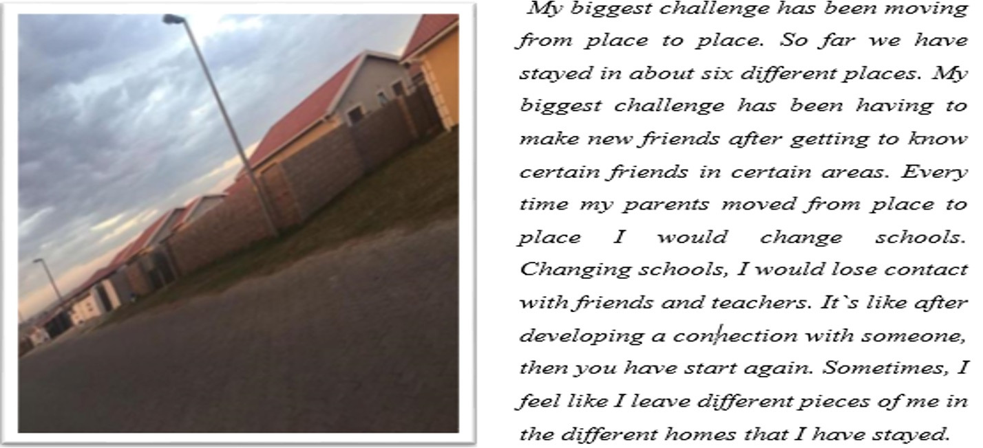
CONSTANT RELOCATION

Slide 11

ACCULTURATION GAP
Co-researchers reported that the acculturation gap that existed between themselves and their parents was a significant challenge.
Some co-researchers mentioned that parents were of the conviction that becoming too familiar with the South African culture was an abandonment of cultural values from the home country.
Co-researchers reported that fearing to disappoint their parents was hindering acculturation.

Slide 12

RECOMMENDATIONS BY LEARNERS
1.
Train educators, students and staff
2...
Language Support
3...
Targeted interventions against xenophobia
4.
Cultural Sensitivity & Inclusion
5.
Media
6.
School Governing Bodies

Slide 13

Role of social workers in implementing recommendations
  Social workers can collaborate with grassroots organisations, human rights groups, and community leaders to develop anti-discrimination campaigns, organise cultural exchange events, and build coalitions that work towards social justice and equality.
  There is also a need for intervention programmes, that target strengthening of family relationships, to prevent family conflict that emanates from acculturation related dynamics such as acculturation gap.

Slide 14

IMPLEMENTING THE RECOMMENDATIONS
  Social workers can provide culturally sensitive and strengths-based support
  Social workers can engage in open and non-judgmental discussions with parents
  Social workers should continue engaging in advocacy efforts

Slide 15

BUILDING RESILIENCE AND CAPITALISING ON AGENCY
  Cultural Competency Training
  Mentorship Programs
  Peer Support Groups
  Goal Setting and Future Planning
  Building Resilience Through Art and Expression

Slide 16
Thank You
Your support and interest in the challenges faced by immigrant adolescents and their potential solutions means a lot to us. Together, we can make a positive impact in their lives and promote a more inclusive society.

