Slide 1
2023 ASASWEI CONFERENCE
An Indigenised Parenting Skills Development Programme
Guided by Ubuntu-Based Principles
Presenters
Ms Kgomotso Ntlatleng
Ms Thando Msimango
Dr Poppy Masinga
27 – 29 September 2023

Slide 2
Table of Contents
SA context and overview of the Parenting Skills Development Programme
Theoretical Framework
Research Methodology
Description of Indigenised Programme and Core Principles
Lessons learned

Slide 3
Overview
South Africa is referred to as a "rainbow nation" (Buqa, 2015).
Observation in practice - need for decolonialised approaches.
Indigenised approaches - explore differences and to try new ways of thinking or doing (Steinberg, 2014).
The most effective social services for indigenous people and communities utilise decolonised community-determined approaches focusing on community goals, values, and strategies (Baskin, 2003; Cross, 1996 in Tamburro, 2013).
Focus attention on decolonising and indigenising the curriculum, training and SW practice.
Parenting skills development programme - mutual aid system for navigating parenting terrain.

Slide 4
The Collective Fingers Theory (CFT)
The Collective Fingers Theory (Mbigi 1997, p.32) draws from the principles of Ubuntu.
That “a thumb although it is strong cannot kill aphids on its own; it would require the collective cooperation of the other fingers” (Mbigi 1997, p.33).
The fingers represent core African values, which when internalized and nurtured can promote a collective culture.

Slide 5
Core Values
The five core values of Ubuntu as identified by Mbigi (1997, p.33) are applicable in the CFT:
Survival - rely on each other for existence despite differences.
Spirit of solidarity - working together and cooperatively to achieve a common goal.
Compassion – ability to understand other people’s challenges and problems.
Respect - high regard for rights, values and beliefs for others, irrespective of diversity. Respect promotes harmony and peace.
Dignity – Treat other with "Dignity" can earn you respect.
Group members, like fingers, need to work cooperatively to achieve any aspired goal.

Slide 6
Research Methodology
We used an Integrative Review methodology to systematically review and produce qualitative syntheses from the existing literature (Whittemore & Knafl, 2005) on group work practice within the decolonised African contexts and the value of the Ubuntu philosophy.
We conducted this conceptual study to identify relevant literature needed to support our arguments for decolonising and indigenising group work practice.
We applied the Google search engine to access literature on indigenisation of social work curriculum, ubuntu principles, and group work practice theories relevant for our practice contexts.
We used our practice experience from working in diverse contexts, the voices of our service users and our general observations about the value of Multiculturalism.

Slide 7
Why Ubuntu-Based Principles?
§We Work in diverse contexts.
We are long past the age of only using traditional Western oriented theories and principles.
We work in diverse contexts within the SA context.
As a result, the need for African-centred/decolonial theories, approaches and principles.
The Indigenized approach that places emphasis on values of human solidarity, empathy, human dignity.
Is a transformative approach that can foster understanding of self and others among group members.
Builds positive relationships; encourage cooperation and respect.
Values collectivism and not individualism; reciprocity, and interconnectedness of all beings.
Holds that a person is a person through others (Council of Social Workers, 2012).
Therefore, sharing knowledge & skills is critical in a Parent Skills Development programme.
r African-centred/decolonial theories, approaches and principles.
§Place emphasis on values of human solidarity, empathy, human dignity

Slide 8
Significance of Ubuntu Bowl
Apply the CFT & Ubuntu principles through the use the Ubuntu Bowl in Group Work practice.
When an Ubuntu practising social worker is confronted with a problem, she does not seek to analyse the problem into components or parts, but rather, she will ask: “in what larger context does the problem resides” (Mayaka & Truell, 2021).
Hence, the need for mutual aid groups.
Ubuntu Bowl is commonly used in African Cultures for sharing common challenges and solutions.
Encourage members to consult each other and use the Ubuntu Bowl to solve common problems (Wilson, 2020, p.64).

Slide 9
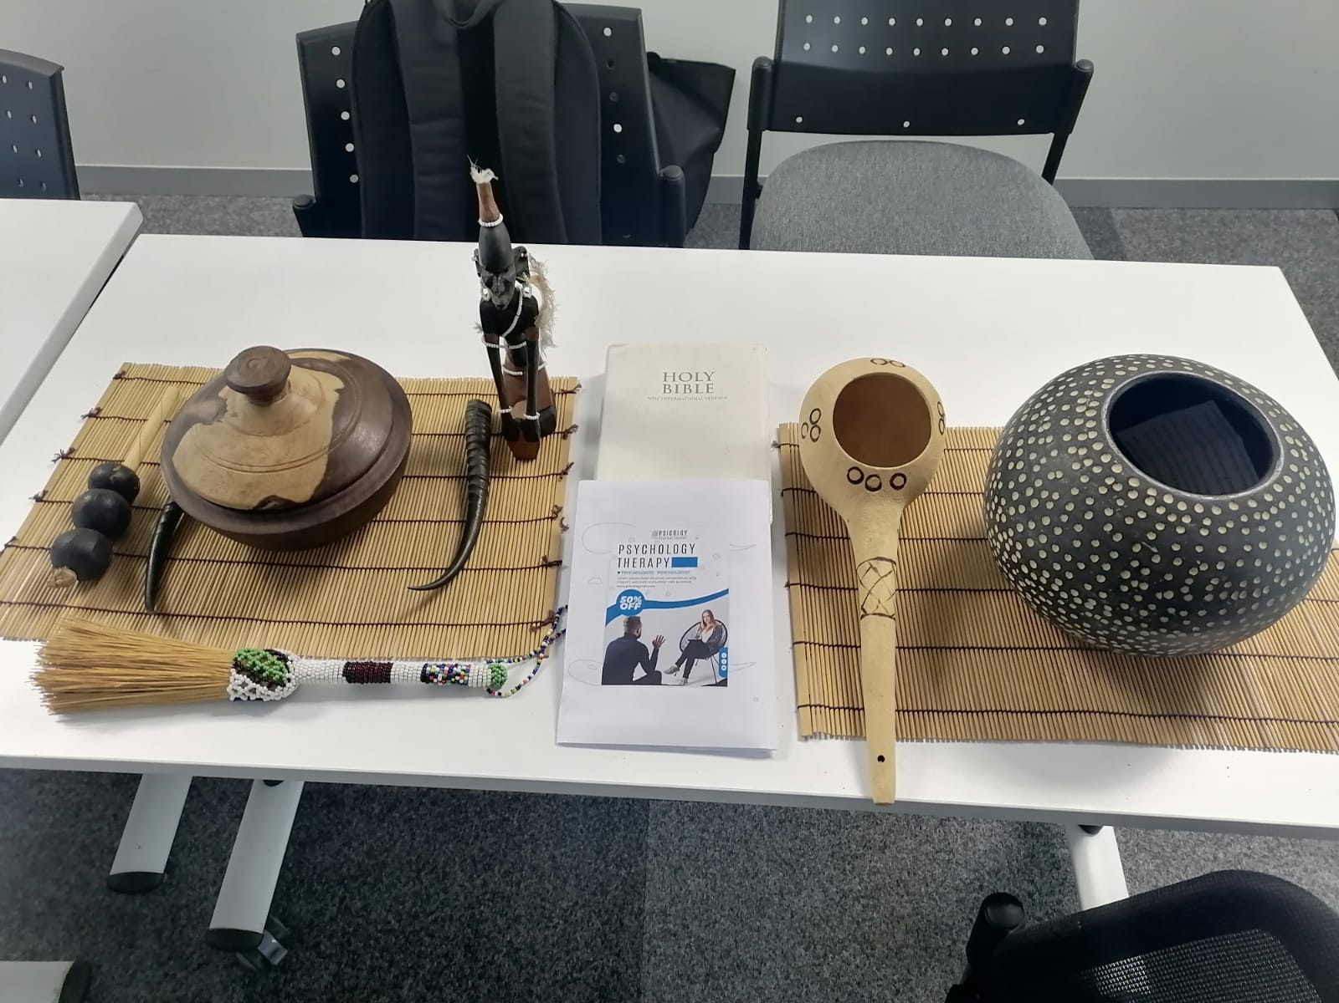
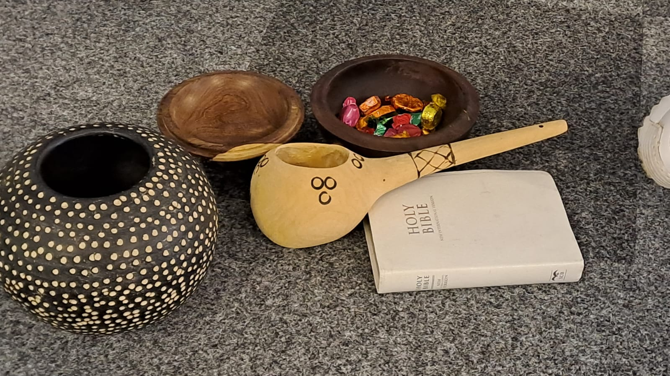
How parenting sessions are run
Indigenised parenting skills development programme...where differences are embraced!

Slide 10
Lessons Learned
To be context relevant and effective, SW curriculum and training broadly and Group Work curriculum and practice in particular, should be decolonised and indigenised.
An indigenised approach to group work practice is transformative and empowering to both the practitioner and service users.
Group Work practitioners need to be culture sensitive and multi-culturally competent.
It is NB to embrace the core African values:
Ubuntu
Respect for diversity
Solidarity
Communalism
Sharing
Compassion
Dignity

Slide 11
Resources
Podcast: Link: Social Work Khuluma Podcast, 18 Sep Social Work Khuluma | EP9| Decolonizing and Indigenizing Group Work Techniques · VOW FM 88.1 - iono.fm

Slide 12
References
Buqa, W. (2015). Storying Ubuntu as a rainbow nation. Verbum et Ecclesia, 36(2), 1-8.
Maistry, S. (2021). South Africa's Comorbidity: A Chronic Affliction of Intersecting Education, Economic and Health Inequalities. Education as Change, 25(1), 1-21.
Mayaka, B., & Truell, R. (2021). Ubuntu and its potential impact on the international social work profession. International Social Work, 64(5), 649-662.
Mbigi, L. (1997). Ubuntu: The African dream in management. Leadership and Organization Development Journal, 18(6):290-294.
Steinberg, D. M. (2014). A Mutual-Aid Model for Social Work with Groups. Routledge.
Tamburro, A. (2013). Including decolonization in social work education and practice. Journal of Indigenous Social Development, 2(1).
Watkins, J. M., & Holmes, J. (2013). Council on Social Work Education. In Encyclopedia of Social Work.
Whittemore, R. and K. Knafl. 2005. “The Integrative Review: Updated Methodology.” Journal of Advanced Nursing 52 (5): 546–53. https://doi.org/10.1111/j.1365-2648.2005.03621.x
Zvomuya, W. (2020). Utilization of ubuntu bowl in social work processes: The way to go towards attainment of social development in Africa. African Journal of social work, 10(1), 63-68.

Slide 13
The End

