Slide 1
Child Sexual Abuse: Indicative of social inequality and a failure to translate policy into practice
Dr Tasneemah Cornelissen-Nordien
Notes:
COVER SLIDE | Option 1b
The ”PRESENTATION TITLE” and “Sub-heading” text are editable

Slide 2
AIM OF THE RESEARCH
To understand how relevant policy and legislation provide service providers with a mandate to render empowerment services for child sexual abuse

Slide 3
Research question
How familiar are service providers with the policy and legislative frameworks which guide service provision for child sexual abuse?

Slide 4
Research methodology
Ethical clearance attained from the Departmental Ethical Screening Committee (DESC) of the US
Qualitative research approach
A combination of exploratory and descriptive research designs

Slide 5
Sample
Purposive sampling
20 service providers from 6 NPOs, Western Cape
    Registered social workers
    Registered auxiliary social worker
    Rendering services to sexually abused children

Slide 6
Gate keeping
Consent of participants attained
Semi-structured interview schedule as research instrument
Face to face interviews
Interviews recorded
Thematic analysis of data

Slide 7
Ecological Perspective:
Theoretical framework
3 Levels of Ecological perspective
  Micro level
  Messo level
  Macro level

Slide 8
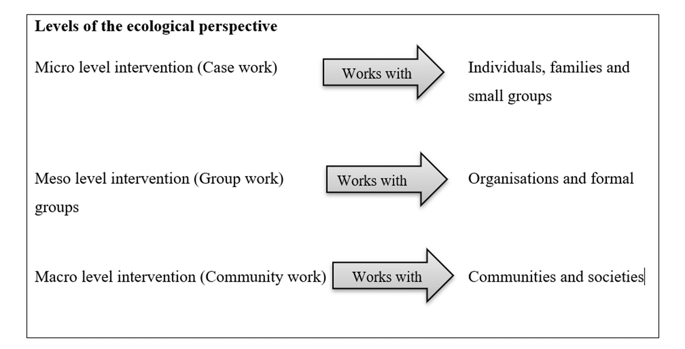
Social inequality
Levels of the ecological perspective related to empowerment services
Source: Miley, O’Melia & DuBois (2014)
Notes:
The ecological perspective is a set of nested structures. Each of which relate to each other on the various levels. This interaction can across different systems and resources can assist service providers to plan and execute service provision for child sexual abuse.
It should be specifically noted that demography & social back are risk factors for CSA. Both of which are indicative of social inequality. Lack of resources on each level
Social inequality exist on all 3 levels:

Slide 9
Results: Views of service providers
Policy and legislation are far removed for the realities of practice and insufficient resources impede service delivery

Slide 10
Emerging theme & Sub-themes
Services providers familiarity with policy and legislation specifically related to child sexual abuse | The Children’s Act 38 of 2005
 | General views of policy and legislation related to child sexual abuse
 | Implementation of policy and legislation related to child sexual abuse

Slide 11
Theme
Services providers familiarity with policy and legislation specifically related to child sexual abuse
Notes:
Service providers were asked which policies and legislative frameworks they were familiar with to guide service provision for CSA.
With about 60 per day being sexually abused, one would expect that service providers are well acquainted with the array of policy and legislation guiding service provision, but this research highlighted otherwise

Slide 12
Legislation or Policy | Number of participants who indicated familiarity with the said document
Children’s Act, No 38 of 2005 | 20
Criminal Law (Sexual Offences and Related Matters) Amended Act No 32 of 2007 (New Sexual Offences Act) | 19
White Paper for Social Welfare (RSA, 1997) | 12
Children’s Amendment Act No 41 of 2007 | 11
Domestic Violence Act No 116 of 1998 | 11
Framework for Social Welfare Services (RSA, 2013) | 11
National Policy Guidelines for Victim Empowerment (RSA, 2009) | 07
Sexual Offences Courts: National Policy Framework (RSA, 2012) | 07
Integrated Service Delivery Model (RSA, 2006) | 05
National Plan of Action for Children in South Africa (NPAC) (2012-2017) (RSA, 2012) | 05
Service Charter for Victims of Crime (RSA, 2004) | 02
Sexual Offences Courts: National Strategic Plan Draft (2016-2020) (RSA, 2016) | 02
n=20
Notes:
Findings indicate that services providers are largely unfamiliar with particularly policy documents which are meant to guide their service delivery for CSA

Slide 13
The Children’s Act 38 of 2005
Participants shared their views of the implementation of the legislation

Slide 14
Narratives:
I work with children, so the Children’s Act, entails everything to do with children how to go about uhm … and how to preserve the best interest of the child to look out for the child, like your decisions must be guided by that. (Participant 5)

Slide 15
About the Children’s Act I can say with just the one clause that we use …. Actually, two uhm … Where you know that the child is abused and you must report and also the one, where if a certain environment is not conducive for the child to live in then there must be an investigation.
(Participant 15)

Slide 16
Service providers highlight the disconnect between micro and macro practice
… we follow the Children’s Act as to how we provide the service, but we can do the best we can, but certainly there is a gap … no child should be waiting on services so there should be more people, like we currently two social workers, so there should be more social workers. We don’t have enough human capacity to fulfil all this roles cause I mean, it’s like one person has to do two people’s jobs … (Participant 11)
Notes:
The views of participants emphasise the difficulties service providers experience with implementing the laws such as the Children’s Act No 38 of 2005, as they are restrained by a lack of resources which include a lack of human capacity to adequately render services. These findings reiterate the need for increased resources as is explained by UNICEF (2013)

Slide 17
To provide the services and there should be funds allocated so that we could provide the service … There’s certainly a gap. We don’t have the manpower to render the service. The Act is clear, it’s very wonderful, but in practice, there’s not manpower to do it. Yes … the manpower and the funding to implement the Act is needed.
(Participant 1)
Notes:
Findings indicate that the lack of resources, thus indicating the disconnect between micro and macro level practice.
It must be noted that the Children’s Act is only 1 of several documents that guide practice

Slide 18
General views on policy and legislation to CSA
Other than the Children’s Act, participants were unable to offer specific views on specific implementation of specific policy/legislation related to service provision for CSA
Notes:
This is of great concern, given that the criteria for inclusion was that participants had to be rendering services to children who had been sexually abused

Slide 19
Narratives
We need to understand how it [policy and legislation] impacts children, children’s rights for example, their human rights, their rights in the court, their rights in terms of the law, because we dealing with all of that within the court process as well. Uhm … because they need to be educated about those things [laws]. Laws also helps us to determine what actions need to be taken. So, whether a referral is required maybe to take this further, we need to know what we need to do, in terms of our brief for the child. Ja, also it helps us to educate families, parents, children. It’s a big part of what we do actually.
(Participant 19)
Notes:
This narrative is of particular interest, as it displays the understanding of the importance of policy and legislation, and at the same time highlight the disconnect between micro and macro practice. As the majority of participants show very little insight into what is available to guide their services for CSA

Slide 20
Implementation of policy & legislation for CSA
Findings indicate that not just are some service provider seemingly unaware of the array of policies and legislative frameworks related to CSA, but they also indicate difficulty in implementing it.

Slide 21
Narratives
… we are trying to implement all these policy, but strategically we don’t even have things in place, because this policies is coming from on top, but in the end of the day it is people on the ground that must now implement it without proper training, without proper resources … (Participant 11)
We don’t have enough human capacity to fulfil all these roles … (Participant 1)
… I mean we have, you know, all the legislation in place, plus more that I have no idea of … (Participant 20)
Notes:
These views from service providers highlight what has been highlighted in previous studies eg by Richter & Dawes (2008) that despite progressive legislation children are continuing to be sexually abused

Slide 22
Conclusions
The importance of the Children’s Act 38 of 2005 is highlighted
  Amendment Act not noted by any of the service providers
General lack of specific clarity as how legislation is implemented
  Eg Sexual Offence Act and other related sexual offence policies
Service providers highlight a lack of resources
  Human and financial resources
More needs to be done to empower service providers to render effective, efficient services to those affected by child sexual abuse

Slide 23
Recommendations
Policy
Training is required to translate policy into practice at all levels
Training should be specifically geared to service providers to implement
Collaboration between various sectors including government, NGO, training institutions
Policy makers to understand practice and the available resources
Government to make resources available

Slide 24
Recommendations
Practice
Increased awareness amongst service providers and society at large about polices related to CSA
Training to all stakeholders rendering service to children about various policy and legislation related to CSA and the implementation thereof
  Teachers
  Social service providers
  Police

Slide 25
Thank you

