Slide 1
How to grow rice on a desert: The irony of imported social work epistemology and praxis in Africa
Sophia Thabane
National University of Lesotho

Slide 2

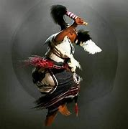
INTRODUCTION I
As Africans we have an intricate relationship with nature: the earth, water, the moon.
We believe in the healing power of the earth.
We revere & seek ancestral guidance and/or indigenous knowledge in all spheres of our lives including health particularly, mental health.

Slide 3
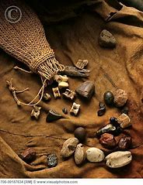
INTRODUCTION II
However, there appears to be a disconnect between imported and indigenous knowledge in mental health epistemology, pedagogy, praxis.
African Mental Health Patients and their families do not disclose their use African knowledge to Western practitioners.
We do not openly discuss use of indigenous knowledge among themselves.

Slide 4
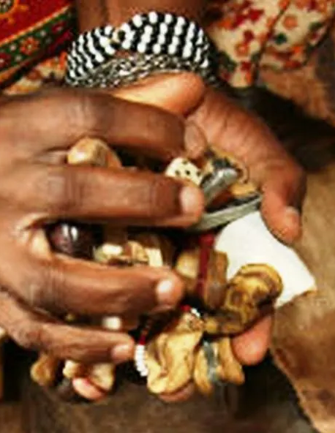
AFRICAN INDIGENOUS KNOWLEDGE
Practices such as appeasing and/or paying homage to ancestors, inviting and/or communicating with ancestors through ho-thoasa/lefehlong seem propitious in managing psychological conditions such as GAD.
I understand Traditionalists to have the competence to shift clients’ incapacitating thoughts and guide them towards alternative thoughts (through symbolism).

Slide 5

THE IRONY
Regardless, prevailing social work epistemology, pedagogy, praxis still highlight Western casework for treatment of mental disorders.
These do not always yield desired outcomes, have high dependency, relapses, & pose challenges of acceptability/stigma.

Slide 6

GAD is an ongoing distressing, sometimes even socially paralysing fear or worry without identifyiable cause. Management is symptomatic.
Depression is erratic production of brain chemicals. It can be caused by neurological over-exertion. Treatment includes oral administration of replacement chemicals and rest.

Slide 7
The conditions & others can be managed (better) through indigenous know-how.

Slide 8
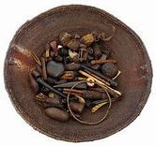
GAD - INDIGENOUS APPROACHES I
GAD: a condition of being overwhelmed & constantly worried.
What of indigenous symbolism could help organize thoughts ?
What if indigenous symbolism could constantly reassure people that they/or a supernatural factor were in control?

Slide 9
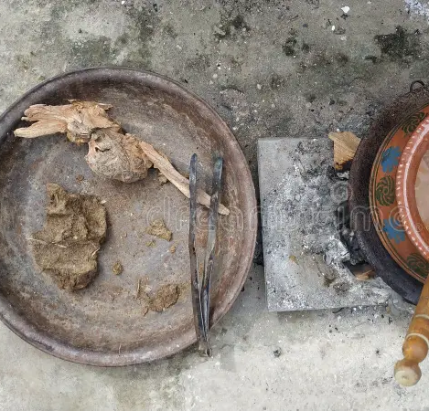
DEPRESSION
- INDIGENOUS APPROACHES II
DEPRESSION: Erratic chemical production/mind,body’s cry for help.
What if there were indigenous African herbs which could relax patients’ bodies enough to enable regular production of brain chemicals?
What could be the benefits of lefehlong?

Slide 10

I DON’T HAVE ANSWERS.
CLARION CALL FOR RESEARCH/EPISTEMOLOGY
HARMONISE INDIGENOUS & IMPORTED KNOWLEDGE
  PEDAGOGY
  PRAXIS
  PRAXIS NETWORKS

Slide 11
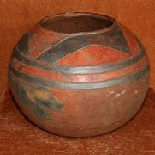
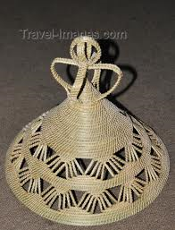
KE EA LEBOHA.

