Slide 1
The improvement of the psychosocial health and well-being of children: Lessons from the Thari-programme
Prof Roelf Reyneke
University of the Free State

Slide 2
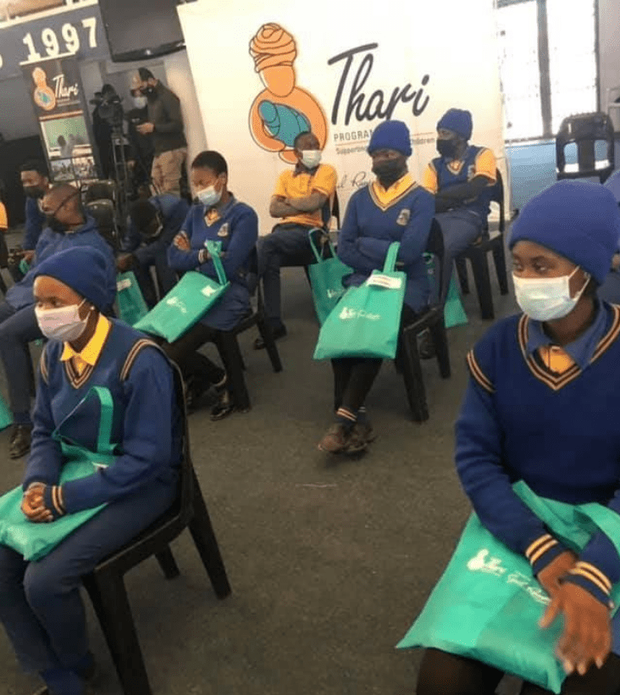
Background
Adopt-a-school foundation
Thari-programme – address violence and other social ills
Services provided by Child and Youth Care workers and social workers
4 Primary and 4 Secondary schools
Botshabelo – Free State
Started in 2017 – evaluated in 2022
Exploratory sequential mixed method case study design (QUAL/quan)

Slide 3
Theory of change

Slide 4
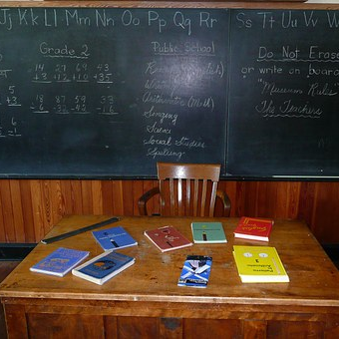
Research participants
Principals Educators (SBST) Child and Youth Care workers Thari management Thari social worker Stakeholder forum members

Slide 5
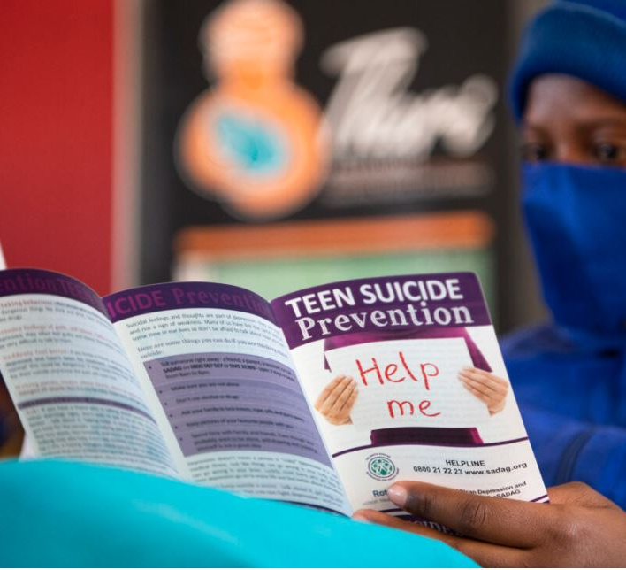
Results (focused on for this paper)
Children’s behavioural challenges
Changes seen in schools

Slide 6
Themes and subthemes
Theme | Subthemes
Child behavioural problems experienced by participants | Volatile behaviour
 | Gangs and substance abuse
 | Bullying
 | Class disruption and poor school attendance
 | Adolescent sexual and reproductive health issues
Changes are seen in schools | Change in the school culture
 | General contributions the programme made to schools
 | Safer schools

Slide 7
Behavioural problems: Subthemes and description
Subthemes | Description
Volatile behaviour | Aggression by learners; anger rooted in adverse childhood experiences (ACEs)
Gangs and substance abuse | Children from disadvantaged or dysfunctional family backgrounds more inclined to affiliate with gangs; substance abuse; violence in schools
Bullying | Poverty, anger, gangs contributing to bullying; physical fighting, offensive language in the classroom
Class disruption and poor school attendance | Learners with learning difficulties disrupt classes, also on the playground Poor attendance: Home visits, psychosocial services
“those children who misbehaved at school or who are bullying others. When the Thari counsellor visited their homes, they changed their behaviour” (Tina – Principal PS).

Slide 8
Behavioural problems: Subthemes and description
Subthemes | Description
Adolescent sexual and reproductive health issues | Teenage pregnancy leading to high dropout Pregnancies because of rape and gang rapes Sexually transmitted diseases (HIV/AIDS) Sexual abuse and harassment
“Teenage pregnancy leads to a high rate of dropouts at our schools. This is one of the challenges. Some of the learners, after being pregnant, do not come back to school” (Terror – SBST SS).

Slide 9
Changes seen in schools: Subthemes and description
Subthemes | Description
Change in the school culture | Educators and learners “happier” SBST & CYCWs making learners feeling safe Educators sending learners to CYCW when misbehaving (improving relationships and less frustration for educators and learners) Improved discipline in the schools Psychosocial support contributing to emotional well-being and positive behaviour Less conflict and disruptions in class Schools becoming safer for learners and educators
“somebody is saying, you know, when we think of Thari we just get happy. And also, the response you get from staff, whoever, everyone just responds with that happiness” (Rita – Thari manager).

Slide 10
Changes seen in schools: Subthemes and description
Subthemes | Description
General contributions the programme made to schools | Addressing relationship problems – learners and staff Improving of the School Based Support team – improved learning and well-being of learners Learner support – reading; writing; homework Engaging and supervised activities (safe parks) – reduced gang activities Poor performing schools now well-performing schools
“Our SBST became more functional because we now meet. After referring a case to Thari, they will ask us to meet them so that they may give us feedback on the learner, or the learners. We meet now and again because of Thari, our kids are now more functional” (Didi – SBST PS).

Slide 11
Changes seen in schools: Subthemes and description
Subthemes | Description
Safe schools | Psychosocial services – addressing behavioural issues, leading to safer schools Support learners with medical problems and how to cope – less anger Less sexual offences – prevention programmes Decrease in gang activity Safe spaces for learners (Safe parks & activities during break) Home visits and support to parents and learners with behavioural problems
“They add value. For example, during breaks, instead of learners sitting in the classrooms, fighting, stealing from one another, they go to the Safe Park. They play games there. So, it helps to reduce the misbehaviour from the learners (Soviet – Principal PS).

Slide 12
Recommendations
Social services professionals should be deployed to schools
The Thari model should be expanded to other schools, especially Township and rural schools

Slide 13
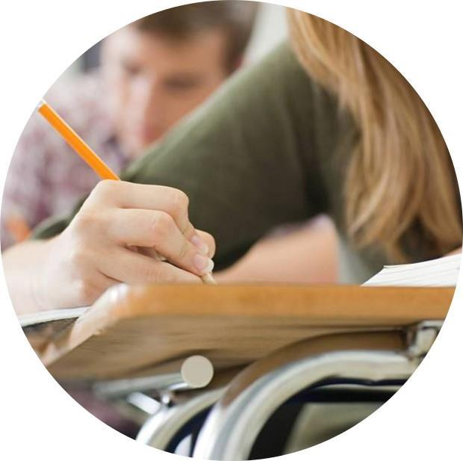
Thank you
Prof Roelf Reyneke
Department of Social Work
University of the Free State
reynrp@ufs.ac.za
Something to consider:
The University of the Free State now offers a Masters in School Social work

