Slide 1

EMOTIONAL POVERTY OF OLDER PERSONS IN RESIDENTIAL FACILITIES

Slide 2
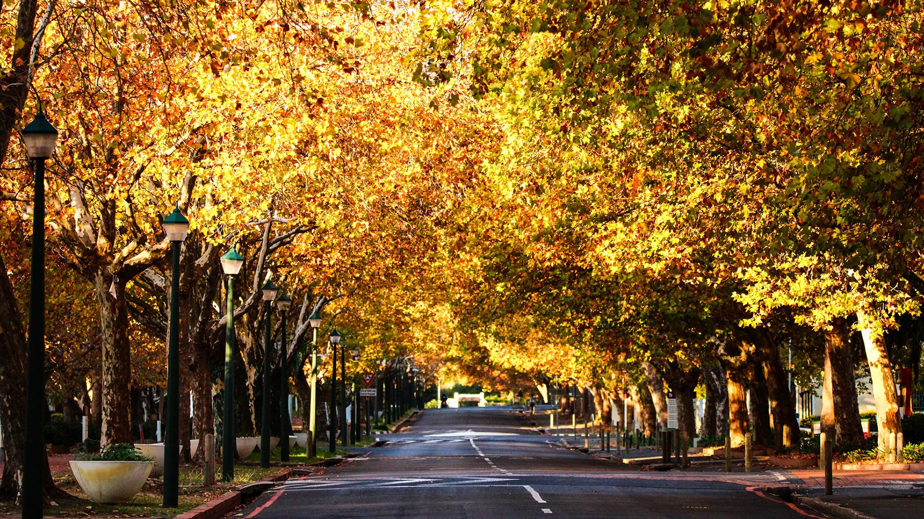
PRESENTERS:
Ms Melanie Human
Dr Ilze Slabbert
Photo by Stefan Els
Notes:
COVER SLIDE | Option 2
The ”PRESENTATION TITLE” and “Sub-heading” text are editable
Replace the background image by right-clicking on the slide, then choose Format Background > Insert a picture or texture fill. Select a new picture of your choice.
*Remember to add an image attribution for e.g., Photo by Stefan Els

Slide 3
INTRODUCTION
Older people are sometimes referred to as the ‘forgotten generation’.
However, recent statistics indicate that worldwide the population is rapidly ageing.
Older people require specialised attention and support.
Social workers should not neglect this group and explore ways to improve their wellbeing, including the reduction of poverty.
(WHO, 2022)

Slide 4
Poverty should be seen as a multifaceted concept.
Poverty refers to the lack of the means necessary to meet basic personal needs such as food, clothing, shelter and significant relationships.
The emotional side of poverty is often overlooked.
(Borrico & Arias, 2018).

Slide 5
For the study conducted, emotional poverty is described as a condition in which an older person is lacking in the basic needs for a minimum standard of wellbeing including biological, psychological and social aspects, with specific focus on social wellbeing.
(UNESCO, 2019)

Slide 6
There are certain indicators of emotional poverty namely:
Loneliness;
Feelings of depression;
Isolation;
When focusing on older persons, it must be remembered that especially a lack of love and support could result in emotional poverty.
(Payne, 2018)

Slide 7
The goal of the study was to gain more insight into emotional poverty of older persons in residential facilities.

Slide 8
THEORETICAL BACKGROUND
The biopsychosocial perspective was utilised as a theoretical framework for this study.
Regarding older persons the biological aspects would include age and physical health.
The psychological aspects include aspects such as mental health and wellbeing.
The social aspects cover aspects such as social support and relationships.
(Adler, 2009)

Slide 9
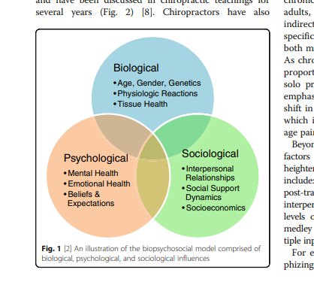

Slide 10
RESEARCH METHODOLOGY
This study adopted a qualitative approach with an explorative and descriptive nature.
Two cohorts took part in this study, namely 20 older persons (OP) and 10 social workers (SW).
Face to face interviews were conducted to obtain the data.
Interviews were audio recorded and transcribed.

Slide 11
The data was analysed by categorising it into themes and sub-themes.
Data verification was done by ensuring the dependability, transferability, credibility and conformability of the study.
Ethical clearance was obtained for this study.
(Strydom, 2021; Creswell and Poth, 2018)

Slide 12
THEMES
Five themes were identified for this presentation namely:
Theme 1: Loneliness
Theme 2: Isolation (Covid-19)
Theme 3: Depression
Theme 4: Losses
Theme 5: Role of social worker

Slide 13
THEME 1: Loneliness
Most participants indicated feelings of loneliness as indicated by the narratives below:
“Yes, you get lonely. Something upset me the other day and I just wanted to cry, and I did cry. I am a great believer that if you want to cry, you must cry and just let it out. I was tearful the whole day, because I am lonely.” OP 5
“I am very alone here. My family doesn’t want to come. Yes, sometimes I feel lonely and needs someone to talk to…..I sit in the chapel and read and learn about Jesus. I don’t have friends here….Yes, I am alone, but I trust God.” OP 13

Slide 14
Loneliness often occurs when a person’s social network is not sufficient to satisfy the individual’s needs.
It is noteworthy to recognise that people can also feel lonely in a crowd, for instance in a large residential facility older persons could experience loneliness.
Loneliness becomes an issue of serious concern when it settles in long enough to create a constant, self-reinforcing circle of negative views, feelings and behaviours.
(Cacioppo & Patrick, 2008; Gray & Worlledge, 2018).

Slide 15
THEME 2: Isolation
Participants indicated the following regarding isolation specifically during Covid-19:
“Oh…oh…Covid ….it was bad. Night and day. It took the strong ones and the weak ones and was an equalizer. We were so cut off from the world.” OP 15
“We lost 21 residents and 2 staff member due to Covid It was an extremely difficult time. The staff stayed in to assist.” SW 3

Slide 16
“You know, it is interesting that during Covid residents felt isolated, but now that there is no restriction several residents are still isolated and alone. They cannot go out on their own and rely on family members to take them out and family members don’t do this.” SW 9
The Covid-19 pandemic caused severe insecurity for those in need of long-term care and their families, regarding measures to avoid the infection, quarantine and isolation measures.
The Covid-19 pandemic has disproportionately impacted older persons with unprecedented rates of infection, hospitalizations and death.
(Möhring, Zinn & Ehrlich, 2023).

Slide 17
THEME 3: Depression
Several participants indicated their feeling of depression:
“I feel unhappy and depressed, because everyone is looking at you ……that is why I actually don’t want to be around people. The sister asked me yesterday why am I sitting in the room. I told her…..Sister; I don’t want to be inside and sitting there between all the residents.” OP 5
“So yes, I suffer from depression today. I have been put on anti-depressants and I saw a psychologist….let met tell you. My life is a complete, complete, complete rubbish of a rubbish and I suffer from the violation of it. The divorce, I had a stroke, I had cancer…..but the thing is this. There is never acknowledgement given to how I feel by my children.” OP 8

Slide 18
Literature confirms that several older persons in residential facilities experience feelings of depression and anxiety .
A risk factor that could also play a role is reduced family contact.
Many older persons in residential facilities have limited contact with their families.
(Earl & Marais, 2023)

Slide 19
THEME 4: Losses
All participants I Cohort 1 experienced different levels of losses as seen by the narratives below.
“My husband’s death was a very big loss. In one year, I lost my husband, mother and brother. But another huge loss was to leave the Village where we were staying. It is a lovely place. That was a huge loss.” OP 12
“My son passed away a month ago. Oh, it is such sad thing. ……Look, when your parents die, it is normally on a high age and then you accept it because you can’t live forever. But a child’s death is another story…” OP 15
“The stroke and the loss of my arm’s functioning. I also had shingles. And of our 10 brothers and sisters, there are only three left. Two in one week died from Covid.” OP 19

Slide 20
Loss has a direct impact on older persons’ wellbeing as they are confronted with several forms of losses.
Older people may undergo a loss of a beloved spouse or friends, as well as the loss of their own house and garden.
When thinking of the loss of self, things like loss of mobility, loss of hearing and loss of memory can be identified which again emphasises possible emotional poverty.

Slide 21
Research indicates that relocation to a residential facility is a huge change and a process that can take months to adjust to.
Certain conditions can support a positive relocation such as being in control of the moving process and maintaining connections with friends and family.
(Cooney, 2012; Lee, Simpson, & Froggatt, 2013; Sussman & Dupuis, 2014)

Slide 22
Theme 5: Role of the social worker
Below is a description of some of the roles social workers fulfil in residential facilities:
“I gave a talk yesterday on the Older Persons Act and I think it is good to have a different, softer perspective compared to the medical staff. I think we are often the opposite of the medical background…..I am quite serious about education. I do the human resources as well. Social workers can do everything.” SW 1
“We motivate them to come for the exercises and for the concerts. We motivate independency. I often drink tea with them and try to involve them in this manner.” SW 5

Slide 23
“The social worker is also involved in advanced care directives and living wills and to help with power of attorney, thus facilitating the process.” SW 6
“I continuously use my skills……..By informing them of their rights and many times I will also be the residents’ advocate to change things if it is possible.” SW 10

Slide 24
Social workers play a very important role in residential facilities.
Linking older persons and their caregivers to available resources is a very relevant duty of social workers.
Following a holistic assessment, social workers can link people to resources needed to facilitate health care.
Awuviry-Newton et al., 2020

Slide 25
CONCLUSIONS AND RECOMMENDATIONS
It can be concluded that older persons in residential facilities often experience emotional poverty.
Social workers can play a meaningful role to address feelings of loneliness, isolation and depression.
It is recommended that more research be conducted in the Gerontology field from a social work perspective.

Slide 26
The whole process of an older person moving to a residential facility needs to be assessed holistically and the older person needs to be supported through the whole process.
Social workers are in the ideal position to be able to provide such holistic support and social work intervention with regards to transition support needs to be highlighted and encouraged.

Slide 27
A biopsychosocial perspective needs to be followed during intervention with older persons.
A multi-disciplinary approach should be followed to ensure the wellbeing of older persons.
The Department of Social Development should take the population increase of older persons into consideration and investigate ways to provide for this needs of older persons.

Slide 28
BIBLIOGRAPHY
Adler, R.H. 2009. Engel’s biopsychosocial model is still relevant today. Journal of Psychosomatic Research, 67(6):607-611.
Awuviry-Newton, K., Tavener, M., Wales, K. & Byles, J. 2021. The roles and capacities of social workers in the lives of older adults seeking healthcare and their caregivers in Ghana. Health and Social Care in the Community, 29(4):877–888.
Borrico, C. & Arias, E. 2018. Association of perception of aging of senior citizen to level of awareness. Journal of Aging Science. 06(01). DOI: 10.4172/2329-8847.1000186.
Cacioppo, J.T. & Patrick, W. 2008. Loneliness: Human nature and the need for social connection. . Available: https://books.google.com/books?hl=en&lr=&id=w8pWZ2AGI4MC&oi=fnd&pg=PR9&dq=
Cooney, A. 2012. “Finding home”: A grounded theory on how older people “find home” in Long-term care settings. International Journal of Older People Nursing, 7(3):188–199.

Slide 29
Earl, E.J. & Marais, D. 2023. The experience of intergenerational interactions and their influence on the mental health of older people living in residential care. PloS one, 18(7):e0287369–e0287369.
Gray, A. & Worlledge, G. 2016. Addressing loneliness and isolation in retirement housing. Ageing and Society. 38. 1-30.
Möhring, Zinn & Ehrlich, 2023. Family care during the first Covid-19 lockdown. European Journal of Ageing, 20(1): 15
Sussman, T and Dupuis, S. 2014. Supporting residents moving into long-term care: Multiple layers shape residents’ experiences. PUBMED, 57(5):438-59.
Strydom, H. 2021. Sampling techniques and pilot studies in qualitative research, in C.B. Fouché, H. Strydom & W.J.H. Roestenburg (eds.). Research at Grassroots. Pretoria: Van Schaik.

Slide 30
United Nations Educational Scientific and Cultural Organization. 2019. [Online]. Available: http://www.unesco.org. [2020, January 21].
World Health Organization. 2022. Active Ageing, A Policy Framework. Geneva: World Health Organization.

Slide 31
THANK YOU
ENKOSI
DANKIE
Photo by Stefan Els
Notes:
COVER SLIDE | Option 2
The ”PRESENTATION TITLE” and “Sub-heading” text are editable
Replace the background image by right-clicking on the slide, then choose Format Background > Insert a picture or texture fill. Select a new picture of your choice.
*Remember to add an image attribution for e.g., Photo by Stefan Els

