Slide 1
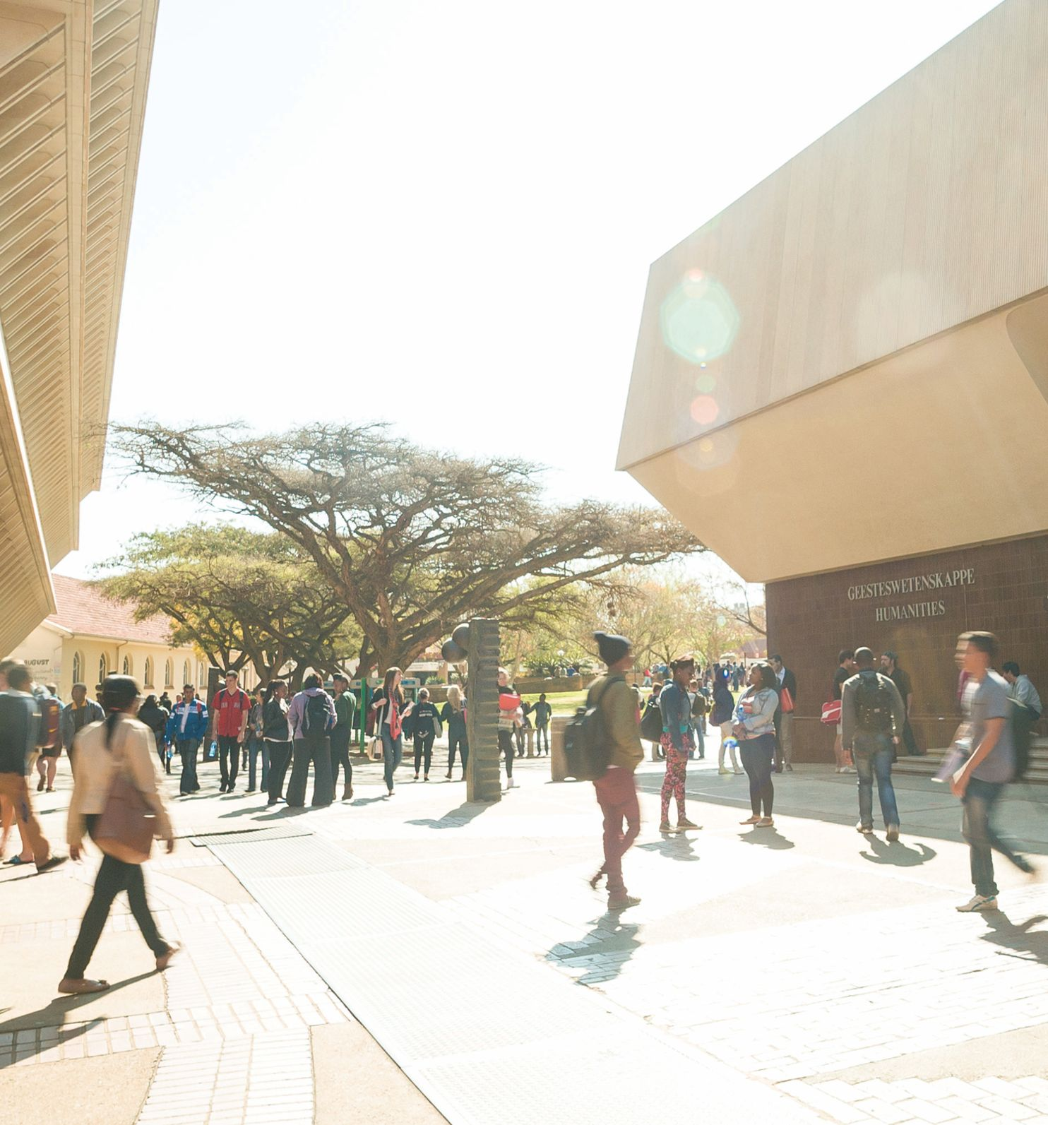
Gender-based violence experiences among women living with physical impairments: Towards integration of services to meet the needs of vulnerable women
Yeukai Muruzi & Priscilla Gutura
ASASWEI Social Work Conference 23

Slide 2
Presentation layout
Introduction and background
Goal and objectives of the study
Research methodology
Study findings
Conclusions
Recommendations

Slide 3
Introduction and background
Gender is a socially formulated role instilled through socialisation
Gender inequality & conservative norms cause GBV (Graaff & Heinecken, 2017)
Though a country with progressive legislation, SA is still battling GBV.
Disability is a risk marker of GBV (Valentine et al., 2019)
Women with disabilities are exposed to GBV, more than women without disabilities and men with disabilities
There is less representation of women with physical impairments in GBV research in SA

Slide 4
Goal and objectives of the study
Goal:
To explore & describe gender-based violence experiences among women with physical impairments in Tshwane Metro, Pretoria
Objectives:
to explore forms of gender-based violence women with physical impairments experience
To ascertain risk & protective factors for GBV against women with physical impairments
To recommend social workers’ multi-disciplinary collaborations in GBV initiatives to protect women with physical impairments

Slide 5
Research methodology
Research approach: qualitative
Research design: case study
Type of research: applied
Sampling strategy: purposive sampling
Sample: 12 women with physical impairments living in Tshwane Metro
Data collection: semi-structured open-ended interviews
Data analysis: thematic analysis
Data quality: Trustworthiness
Ethical considerations: informed consent, avoidance of harm, confidentiality & anonymity, voluntary participation, permission to conduct the study

Slide 6
Socio-demographic information
 | Age | Race | Home language | Marital status | Highest qualification | Employment status | Type of impairment
1 | 26 | Black | Zulu | Single | Tertiary level | Employed | Cerebral palsy
2 | 22 | Black | Tsonga | Single | Grade 12 | Unemployed | Visually impaired
3 | 38 | White | English | Single | Tertiary level | Employed part time | Cerebral palsy
4 | 36 | Black | South Sotho | Single | Grade 11 & ABEIT | Unemployed | Visually impaired
5 | 33 | Black | Tsonga | Single | Grade 12 | Unemployed | Visually impaired
6 | 33 | Black | Sepedi | Married | Tertiary level | Employed | Paraparesis
7 | 35 | Black | Zulu | Single | Tertiary level | Employed | Cerebral palsy
8 | 25 | Black | Xhosa | Single | Grade 12 | Unemployed | Visually impaired
9 | 30 | Black | Xhosa | Single | Grade 12 | Unemployed | Visually impaired
10 | 28 | Black | Sesotho | Married | Grade 12 | Self-employed | Visually impaired
11 | 22 | Black | Zulu | Single | Grade 12 | Unemployed | Visually impaired
12 | 33 | Black | Sesotho | Single | Grade 11 | Unemployed | Hemiplegia

Slide 7
Study findings
Theme | Subtheme
Forms of gender-based violence | Emotional abuse, sexual, structural violence, financial and physical violence
Risk factors | Stereotypes associated with physical impairments Non-disclosure of the experienced violence
Protective factors | Seeking professional help Disclosing experienced violence Self-acceptance of one’s condition

Slide 8
Theme 1: Forms of gender-based violence
Emotional abuse
11 participants were exposed to emotional abuse
4 experienced emotional violence linked to disability stigma & 7 experienced emotional related disturbance emanating from other forms of abuse
One participant experienced emotional related disturbance due to sexual abuse:
I was very scared, emotionally I was always alert because… even if I talk about it, I had nothing to prove because I was not raped (sexual assault). So I felt helpless as well, like there was no hope. I felt like I was not enjoying my childhood the way I was supposed to. Everything was just… I was just deeply scarred. It was all emotional (participant 8, with visual impairment).

Slide 9
Theme 1: Forms of gender-based violence
Sexual violence
Eight participants experienced sexual violence. Five sexually assaulted and three raped
I have experienced sexual assault or usually people would refer to it as rape. I think twice, yes twice. The first was through a friend I knew and the second was through someone I couldn’t identify because of my disability of course (participant 11, with visual impairment).
I think I was about eight or nine years, I was raped by a brother who is my aunt’s child. So he was like a brother to me. The family never spoke anything about it, like nothing ever happened but then that still lives with me you know. But now it comes to how do my own mother like a person who is supposed to protect me let things like that slide? (participant 6, with paraparesis)

Slide 10
Theme 1: Forms of gender-based violence
Financial abuse
Six participants were exposed to financial abuse
Through misuse of the grant money, over reliance of family on the grant and asking for help to transfer money in public places
I have had an incident where I asked someone to help me to transfer some money. So, what they did is they would first transfer to themselves and then do the actual transfer I have asked. Leave the second sms after they have taken their own. Our lives are very expensive (participant 5, with visual impairment).
The expectation at home is that I contribute towards household needs. I never thought of it as financial abuse before. But now I can’t necessarily do everything that I wish to do like on a personal level. Even if there an advert for a job or any opportunity, I can’t try it because I need to first think of the needs of the house before I look at my own needs (participant 2, with visual impairment)

Slide 11
Theme 1: Forms gender-based of violence
Structural violence
9 participants experienced structural violence in the school environment, health care facilities and workplace.
I got a job on gumtree and called for the interview and got the job. It was a very small admin job, I already had a degree and everything. I think they were paying four or five thousand Rand. So I asked why they wanted a 86 person with a disability and he answered and said, “Well, because we can pay them less.” (participant 3, with cerebral palsy).
I applied for employment at my current employer. I passed the interview and then after that, it was my first day at work. The supervisor who was supposed to be my supervisor at that moment was not aware of my disability. So when she first saw me, she was angry because in her mind I could not perform the duties because of my disability (participant 7, with cerebral palsy).

Slide 12
Theme 1: Forms gender-based of violence
Physical abuse
Three participants experienced physical abuse. One as an adult and the other two during childhood.
After my mother passed on, my maternal aunt started living with me. She physically abused me, beating me. The process it would obviously leave me wounded because she would hit me in places where no one would see the wounds or the bruises (participant 8, with visual impairment).

Slide 13
Theme 2: Risk factors associated with experiencing gender-based violence
Stereotypes associated with physical impairments
Assumptions, labels and discriminatory practices that risk gender-based violence victimisation. One participant mentioned how physical impairments are assumed to mean mental illness:
For me one of the biggest thing people often think when you have a physical disability is you are also impacted in a mental way. People with physical disabilities doesn’t necessarily mean mental disability. It’s a wrong assumption, people with disabilities are still people. You got to put the person first, look at a person holistically (participant 3, with cerebral palsy).

Slide 14
Theme 2: Risk factors associated with experiencing gender-based violence
Non disclosure of the violence experienced
Non-disclosure can result in perpetuation of victimisation.
So, when it happened (sexual assault) I spoke to my aunt the next day when she came back. She said I mustn’t say anything to anyone about it and days went on. Academically as well at school I started slowing down. He didn’t stop by then, he kept on doing it for days and weeks, it lasted. Up until I lashed out and broke down at school, attempting to commit suicide (participant 8, with visual impairment).

Slide 15
Theme 3: Protective factors
Protective factors can enable prevention of further victimisation and promote coping.
Obtaining professional help
The teachers became aware of the situation (repeat sexual assault). They called aunt in and spoke to her about it and they took the case to the police station. So, I started feeling like it was not my fault because all along I kept on blaming myself thinking it’s my fault (participant 8, with visual impairment).

Slide 16
Theme 3: Protective factors
Disclosing violence experienced
Luckily for me I spoke to my supervisor and they took the matter up because it was starting to bother me. Whenever he could come in the office if I am alone, he would try to kiss me and so forth. So I handled the situation very well and early. I reported him and then it stopped there (participant 7, with cerebral palsy).
Self acceptance of one’s condition
I think the first one is the attitude you carry yourself with. If you carry yourself with an attitude of I am confident and I am not passive, I am more of an assertive person. That already scares away a lot of people from mistreating you (participant 10, with visual impairment).

Slide 17
Conclusions
Gender based violence among women with physical impairments is an existing reality
They suffer double risk of gender based violence due to gender and disability
Thus making them more vulnerable to severe forms of GBV
There are risk factors that increase the likelihood of violence
However, protective factors prevent further victimisation & promotes coping
Protective factors can influence development of strategic responses or measures to address GBV among this cohort

Slide 18
Recommendations
GBV multi-sectorial response strategies ought to be inclusive of women with physical impairments
Increased representation in GBV research and policies
Social work family assessments and education
Public education that challenge and demystify stereotypes associated with gender and disabilities.

Slide 19
THE END
Thank you for your attention

