Slide 1
International Social work Conference 27 – 29 September 2023 ELANGENI HOTEL
ASASWEI
ASSOCIATION OF SOUTH AFRICAN SOCIAL WORK EDUCATION INSTITUTIONS

Slide 2
TOPIC: Employee Health and Wellness Performance Indicators for the Gauteng Department of Health
Presenters: P V Seodi and Prof WJH Roestenburg
Dissertation submitted in fulfilment of the requirements for the degree Master of Social Work at the North-West University
orcid.org/ 0000-0003-0427-751X

Slide 3
BACKGROUND
The study was conducted at Gauteng Department of Health(GDOH) facilities,
The study focuses on the identification of programme performance Indicators, as there are no prescribed indicators that the government and private sector in South Africa are reporting on.
GDOH has a total staff component of 78 000, ranging from medical professors to unskilled workers.
The workplace environment is complex, and employees face various environmental, health and wellness challenges.
such as workplace trauma, violence, staff shortages, HIV and AIDS, and increasing occurrence of workplace disputes and conflicts. Gauteng Provincial Government, (2008).

Slide 4
PURPOSE
The study was to establish the best performance indicators for GDOH by means of a pilot study within three health care business units namely (unit A, B & C).
This study did not involve the total population.
The purpose of this article was to investigate whether a range of objective workplace indicators together with subjective factors work engagement and psychological capacity significantly predicted the general well-being of employees at three Healthcare facilities at the GDOH.

Slide 5
STUDY DESIGN
The researcher explored the relationships amongst biographical data, objective indicators of EH&W programme performance and perceived (subjective) social wellbeing of three business units identified in the organisation, Units A, B and C.
The study approach and design was Quantitative and used a Cross Sectional Survey-Design and exploratory
The researcher was not concerned with the generalisation of the results to all the employees, but rather to the business units being selected.
The researcher obtained three sample groups from three business units for comparison purposes and for purposes of collecting indicator data.
Business Unit A was selected on the basis that it is a unit that is under-resourced and under-performing as per the performance indicators outlined in the design. Business Unit B was considered on the basis that it is average resourced and lastly Business Unit C, was identified as a well-resourced unit as per the performance criteria
We performed Structural Equation Modelling by means of IBM AMOS 21 statistical software.

Slide 6
RESEARCH QUESTIONS
This study utilized a survey to get relevant data from sampled population.
The survey was done by means of quantitative questionnaire. Data was collected over a period of three months.
through an electronically administered questionnaire by means of an e-mailed link. to those who had departmental e-mail addresses,
The researcher then used the web-interface to distribute the SurveyMonkey questionnaire.
A paper based questionnaire was also distributed to all the employees who did not have computers and a recognised or a departmental email address.
The participants who showed an interest they were requested to complete informed consent form prior to data collection.
Within each business unit all employees as population, were eligible for participation.
The sampling was all-inclusive. Employees who were at work within the allocated period were included, and all job levels were represented.

Slide 7
METHODOLOGY AND APPROACH
The three business units were selected-budget spending on the internal wellness programme.
They were divided into a low-budget (A), medium budget (B) and high-budget (C) category.
For example, budget size could be determined by the number of wellness events held annually,
whether the unit could afford to appoint a Wellness Coordinator and whether provide direct services such a Wellness Clinic Services and Workplace interventions were affordable.
The study utilised a survey instrument -three constructs of measurement, namely Psychological Capacity, Work Engagement and General Well being.
Psychological capacity was measured utilizing the PCQ-24 (PsyCap), Work engagement using the Utrecht Work Engagement instrument (UWES) and well-being using the Psychological General Well-being Scale (PGWBI).

Slide 8
METHODOLOGY AND APPROACH
These are set of performance indicators data that were obtainable per business unit:
Budget allocation per business unit as well as EH&W direct and indirect costs per unit.
Presence of a wellness coordinator or not.
The number of preventative programmes presented over a period of one year
Work attendance figures versus absenteeism (ratios are included),
Staff attendance records of wellness events,
Number of cases seen by the EH&W, number of successful case closures.
Number of HIV/Aids cases counselled during a period.
The accuracy of data was significantly different from one unit to the next, indicating the following variations :-
Employees actively utilising the wellness programme in business Unit C as it appears to have the most resources (wellness coordinator, wellness centre and there are two nurses in the clinic).
We hypothesized that the Wellness Programme budget had a significant impact on how the Wellness Programme was structured,

Slide 9
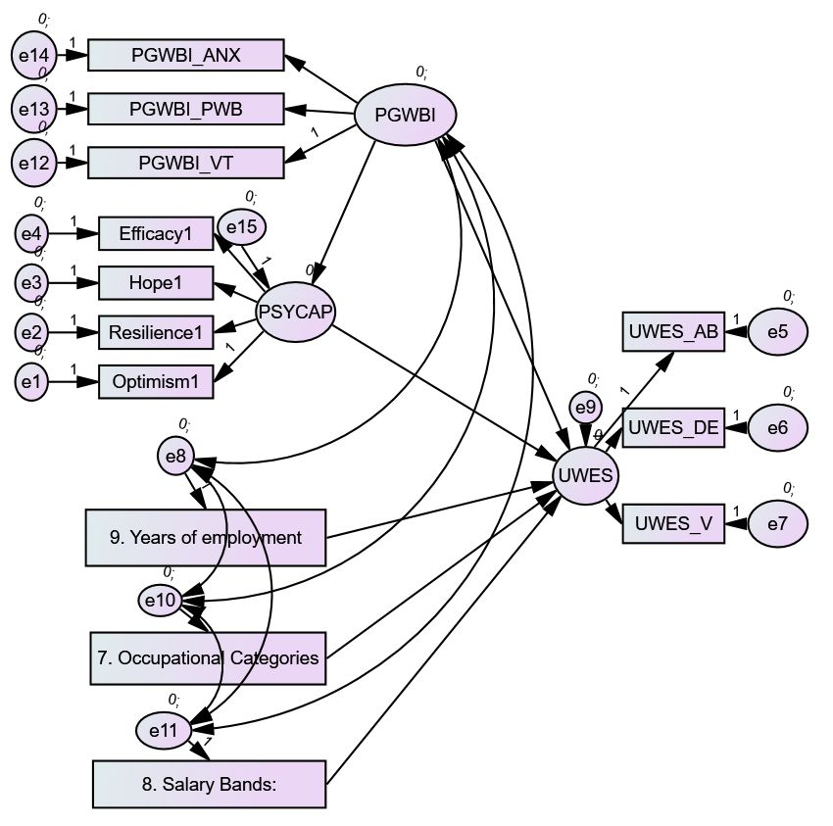
Model diagram 3: mediated effect of Psychological capacity (PSYCAP), Years of employment, job category and salary band on the effect of General well being (PGWBI) on employee Work Engagement (UWES).
Structural Equation Model reflecting best predictor variables explaining employee well-being as measured at three business units of GDOH.

Slide 10
FINDINGS
It was noted that years of employment had a very small positive effect on work engagement meaning that as employee gains experience in the workplace he tends to engage more with his work, This effect work jointly with the employee’s general well being to achieve better work engagement.
In contrast it was observed from the above result that the lower an employee’s occupational category and salary band the less likely the employee would be able to engage effectively with his work.
These effects were very small and were not significant.
We observed non-significant mediation for Psychological General Well-Being on Psychological Capacity and the three structural variables Years of employment, Occupational categories, and Salary bands.
Interpretation: The main predictor of work engagement (UWES) was general well-being (PGWBI) and interacts with Psychological Capacity (PSYCAP).
Psychological Capacity (PSYCAP) is stronger to influence on work engagement than general well-being (PGWBI).
This effect will work jointly with the employee’s general well being to achieve better work engagement.
In contrast it was observed from the above result that the lower an employee’s occupational category and salary band The main predictor of work engagement (UWES) was general well-being (PGWBI) and interacts with Psychological Capacity (PSYCAP).

Slide 11
FINDINGS
Conclusion about the above model
In contrast to what we hypothesized, it appeared that those workplace variables we thought could influence work engagement (Years of employment, salary band and job category) failed to explain the output factor work engagement (UWES).
Instead, work engagement was influenced most significantly by the mediation role of PSYCAP in General well-being’s (PGWBI) influence on UWES.
We thereby conclude that work engagement in this context is mostly determined by a combination of well-being and predominantly psychological capacity.
To further explore the plausibility of this model’s assumption, Model 4 hypothesis was formulated to evaluate the plausbility of the above effect without entering the workplace observed variables of years of employment, job category and salary band.

Slide 12
Model 4: Psychological Capacity (PSYCAP) mediates the influence of Psychological General Well-being (PGWBI) on Work Engagement (UWES).
Firstly we evaluated a general interaction model. The results indicated that Psychological Capacity (PSYCAP) significantly interacted with General well-being (PGWBI) on Work Engagement (UWES). Interpretation: The hypothesis that PSYCAP and General Psychological well-being (PGWBI) jointly influenced Work Engagement (UWES), and was partially supported and mediation could not be established. Therefore, we conclude that at most Psychological General well-being (PGWBI) and PSYCAP jointly influenced Work Engagement (UWES) but the direction was not clear. According to the standardized regression weights table, the results indicated that PSYCAP played a bigger role in Work Engagement (UWES) than General Psychological Well-being (PGWBI).

Slide 13
FINDINGS
It has also been noted that Psychological Capital has been tested as a construct to show that it impacts positively on employee wellbeing,
PsyCap has the capacity to facilitate and enhance high levels of positive psychological well-being. Bakker and Leiter (2010)
Employee Engagement (UWES) is defined as the ability for employees to be present, focused and energised while feeling connected to their Organisational purpose. Paek,S. (2015)
UWES emphasises that an engaged individual employee is enthusiastic, inspired, proud and challenged at work, and is willing to make an effort while maintaining concentration and being deeply engrossed in the task.
The individual is persistent in the face of difficulties or distractions, and sees time at work passing by quickly, finding it difficulty to detach him or herself from work (schaufeli, et al.,2002:74-75).
Strong positive correlations between all the observed dimensions of General Well-being (PGWBI) and Work Engagement (UWES).
Similarly, strong correlations between all dimensions of Psychological Capacity (PWB) and Work Engagement (UWES).
The correlations between all dimensions of General Well-being (PGWBI) and Psychological Capacity (PSYCAP) were insignificant and weak.
This led us to conclude that Psychological Capacity had little influence on the General Well-being of employees, this role being fulfilled by a construct such as Work Engagement.

Slide 14
FINDINGS
Findings from the study confirmed two sets of prediction models.
Firstly, at the organizational structural level the study confirmed that employees’ General Well-being was directly influenced by their Psychological Capacity
Secondly, Employee efficacy at the direct observational level was a powerful indicator of both well being and work engagement,
Psychological capacity is to a lesser extent influenced by these issues and is a fundamental capacity in ensuring the level of adjustment to the workplace.
Conclusion is reached that employees in low salary bands and who are relatively new in the Organziation should be given special attention by the Organisational Wellness Programme
whilst Human Resources (HR) Practices should encourage participation in work decision making, planning and managing of workload as this has an empowering effect on employees.
It was indicate that SEM is an appropriate tool for estimating relationships among theoretical interesting and meaningful constructs that are free of the effects of measurement problems as a result of reliability issues. Nesselroade (1991: 499)

Slide 15
DISCUSSION
The above finding had pertinent implications for wellness programmes.
The result indicates that wellness programmes should focus their efforts towards newer employees that had just joined the organization and were more likely to present with severe psychological adjustment problems during the first period of their employment.
Consideration should be given to how long the employee had worked for the department.
It could be expected that the longer the person had worked the better his overall well-being and psychological capacity would be to withstand the stresses of the workplace.
It was likely that younger employees would have more immediate well-being problems due to their difficulties in the workplace combined with having less psychological resources such as resilience and efficacy to deal with difficult situations.
Services such as reactive counselling were more suitable for young employees who tended to experience anxiety related to their adjustment to the work-environment.
It was possible that in these three units at least, short term employees had more problems with adjustment to the system, than long term employees who knew the system and had already adjusted.

Slide 16
HAVE THE OBJECTIVE BEEN REACHED
Globally Employee Health and Wellness has been recognized as a critical strategic intervention.
The employer is required to implement integrated employee health and wellness programme or health promotion programme hat looks after the needs of its own people.
The implementation of a wellness programme requires commitment of resources (both materials and financial support) for implementing on-site activities.
Previous researchers concluded that the health and wellness of employees could be improved by worksite health initiative.

Slide 17
KEALEBOGA
THANK YOU
SIYABONGA

