Slide 1
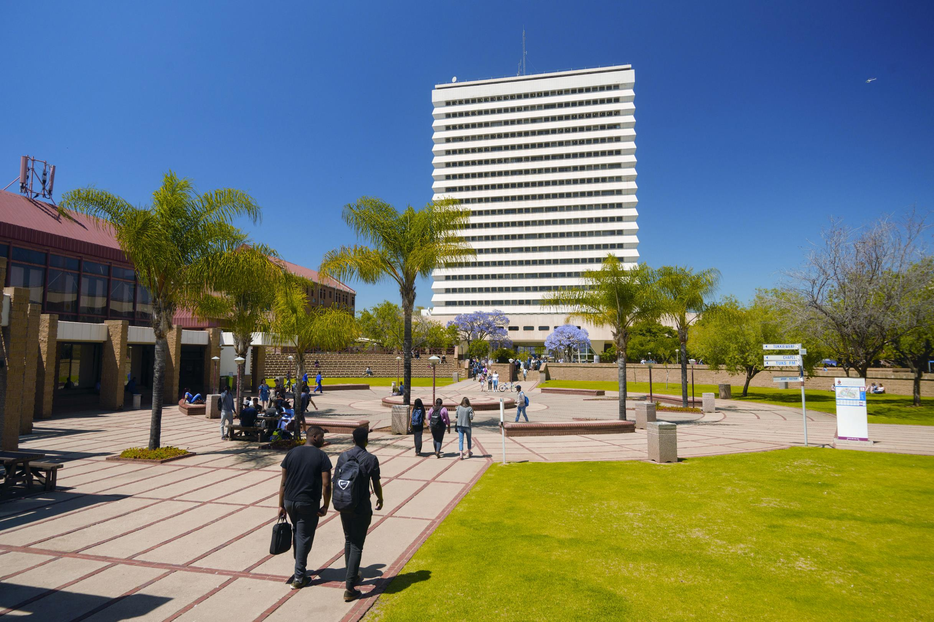

Social support among South African older persons during COVID-19: Enhancing resilience through gerontological social services
Stephan Geyer, Barbra Teater & Jill Chonody

Slide 2
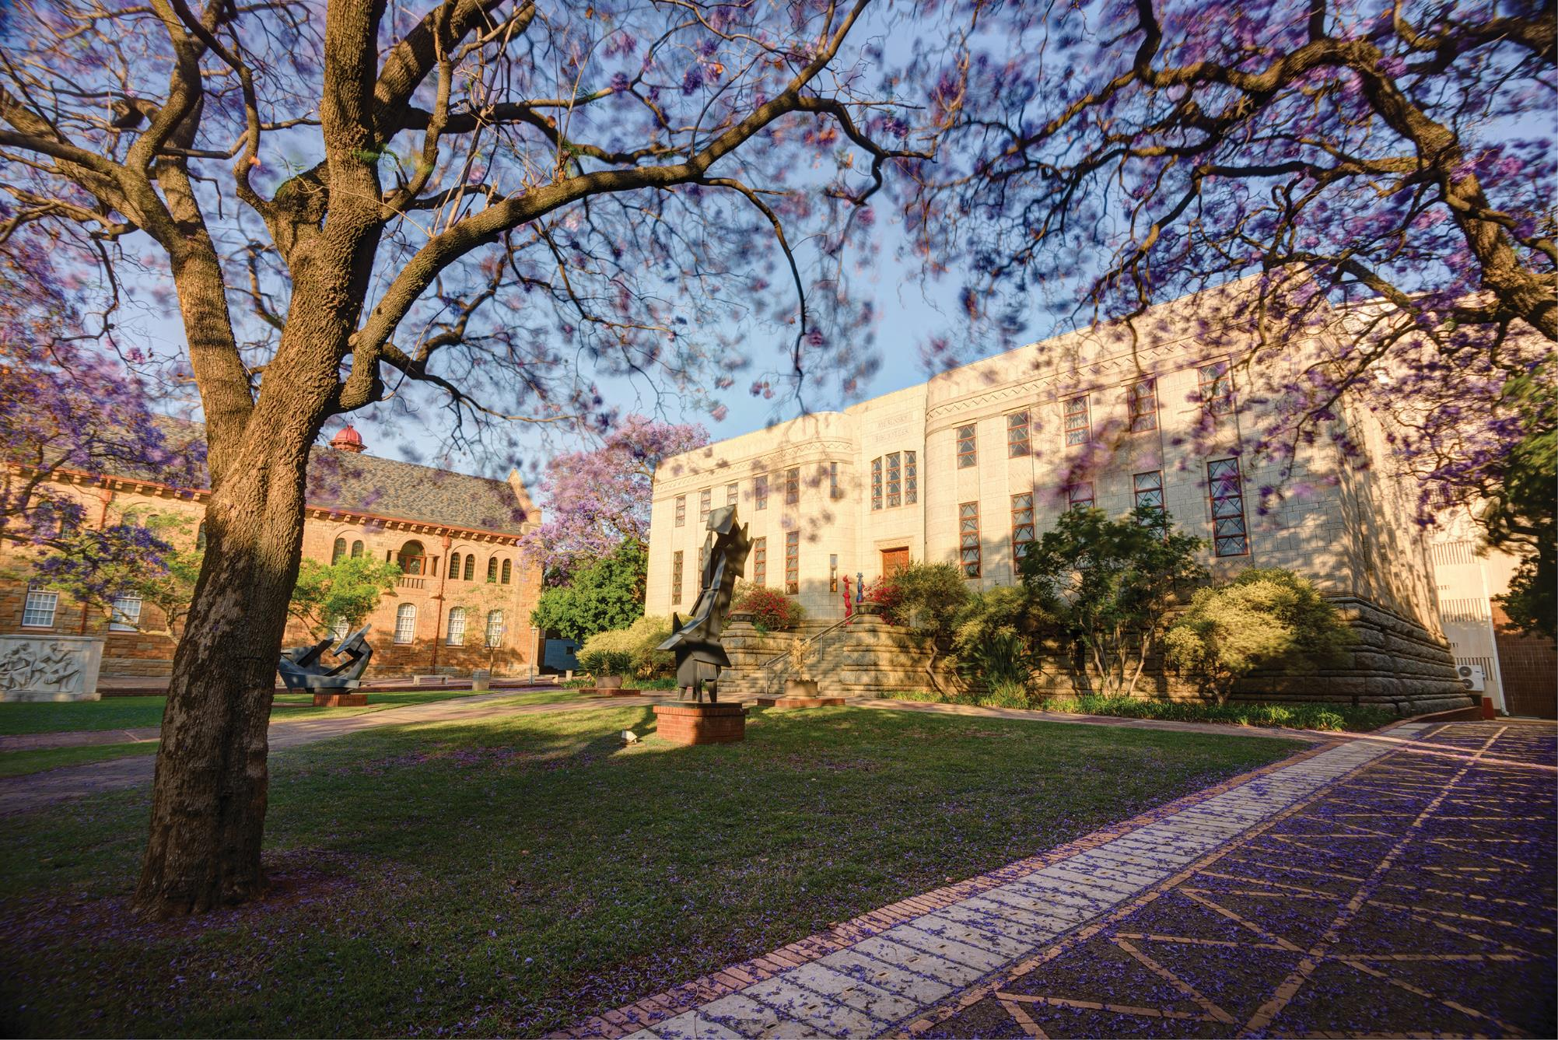

INTRODUCTION

Slide 3
BRIEF INTRODUCTION
Novel coronavirus COVID-19, March 2020 - WHO
South Africa:
  State of emergency, March 2020
    Five-level alert system, among the strictest in the world
    Protective measures, e.g. physical distancing, face-masks, stay-at-home (DoH, 2023)
  4.09 million positive cases
  102 595 deaths (population = 60.6 million)
  Vaccinations started in February 2021 (SANICD, 2022)

Slide 4
Older persons (60+ years) particularly affected
  Direct impact:
    Physical distancing
    Socio-emotional impact: irregular contact with significant others
    Limited social connections (e.g. church, social groups)
    Stress
    Ageism – triage at ICU (Erasmus, 2020)
    Quality and quantity of social support
      Physical and mental health (Gorenko et al., 2021; Vahia et al., 2020)
  Indirect impact:
    Trauma via media reports
    Secondary stressors, e.g. reduced income, care for
    family, and grandchildren
    Not familiar with ICTs
    (Chipps & Jarvis, 2017; Garfin, 2020, Smith et al., 2020)
9.2% of population = 5.58 million older persons
Positive cases: 569 700
Deaths: 85 000

Slide 5
Lacuna
South Africa = collectivist society
  “Flock together” during times of distress (Ebersöhn, 2019)
  Social support → important protective factor (Fuller et al., 2021)
No study focused on social support among SA older persons during COVID-19
  Risk and protective factors related to social support?
  Implications for gerontological social services?

Slide 6

Theoretical framework:
Developmental social welfare:
  White Paper for Social Welfare (1997)
Resilience theory: socio-ecological perspective on resilience
BPSS being in interaction with social and physical environment
PPFPs: Abilities, internal and external promotive and protective factors (e.g. social support, contact with others, physical and mental health)
Gerontological social services → mediating processes enabling older persons towards better-than-expected outcomes

Slide 7
RESEARCH QUESTIONS

Slide 8
What is the self-reported level of social support (emotional/informational; tangible; affectionate; positive social interaction; overall social support) pre- and during COVID-19?
Is there a statistically significant difference in self-reported social support pre- to during COVID-19?
To what extent do different types of social contact, the number of close friends/relatives, physical health, mental health, and socio-demographics contribute to (a) emotional/informational support; (b) tangible support; (c) affectionate support; (d) positive social interaction; and (e) overall social support during COVID-19?

Slide 9
RESEARCH METHODS

Slide 10
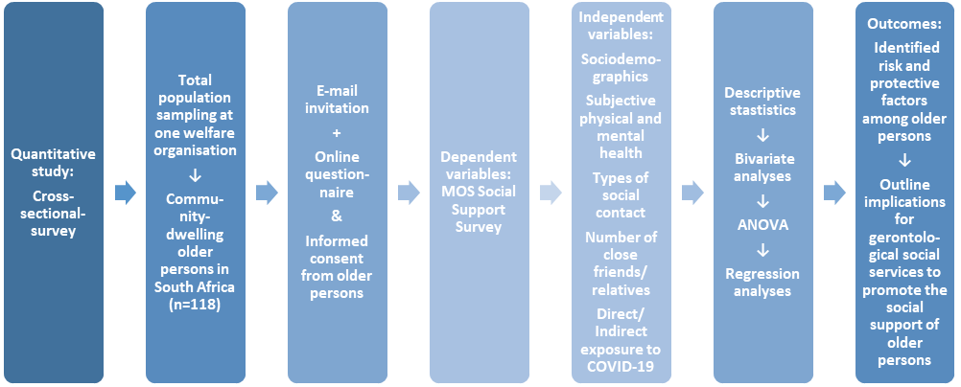

Slide 11
RESEARCH RESULTS &
DISCUSSION

Slide 12
Profile of respondents
Mean age: 72.6 (SD = 7.1) (Range: 60-90 years)
Gender: Male (28%); Female (72%)
Home language: Afrikaans (92.3%); English (6.8%); Setswana (0.9%)
Are of residence: Five of nine provinces - Urban (43.1%); Semi-urban (42.2%); Rural (14.7%)
  Highest qualification:
  B degree/Hons. Degree/Professional degree (27.1%)
  Grade 12/Matric (21.2%)
  National diploma (21.2%)
Relationship status:
Married/Partnered (45.3%)
Widowed (39.3%)
Divorced (6.8%)
Number of children: 2.8 (Range: 1-4)
Religion/spiritual beliefs:
  Christian (97.5%)

Slide 13
Health, exposure to and social contacts during COVID-19 (N = 118)
Variable (n) M (SD) Range % (f)
______________________________________________________________________________
Physical health (117) 4.4 (.92) 1 – 6
Mental health (118) 4.7 (.92) 1 – 6
Direct exposure to COVID-19
Yes 51.7% (61)
No 44.9% (53)
Unsure 3.4% (4)
Indirect exposure to COVID-19
Yes 28.4% (33)
No 62.1% (72)
Unsure 9.5% (11)
Face-to-face contact (111) 5.3 (1.9) 0 – 7
Online/Virtual (116) 5.9 (1.5) 0 – 7
Groups/Organisations (116) 2.5 (1.9) 0 – 7
Close friends/Relatives (114) 7.1 (7.3) 0 – 50
______________________________________________________________________________

Slide 14
Social support pre- and during COVID-19
(N = 118)
_______________________________________________________________________________________
Variable Pre-COVID-19 During COVID-19
M (SD) M (SD) Range t p df
_______________________________________________________________________________________
Emotional/Informational support 72.8 (24.9) 69.4 (26.6) 0 – 100 2.6 .01 116
Tangible support 74.7 (25.7) 71.5 (28.9) 0 – 100 2.1 .04 115
Affectionate support 78.6 (24.1) 73.2 (27.9) 0 – 100 3.6 <.001 115
Positive social interaction 74.9 (25.9) 67.8 (29.3) 0 – 100 3.6 <.001 115
Overall social support 74.2 (23.8) 69.8 (25.6) 0 – 100 3.5 .001 116
_______________________________________________________________________________________

Slide 15
Risk and protective factors contributing to social support
Type of social support Protective factors
___________________________________________________________________________
Emotional/Information support * Living in an urban area
* Better subjective mental health
* More face-to-face contact
* Higher number of close friends/relatives
Tangible support * More face-to-face contact
* Higher number of close friends/relatives
Affectionate support * Being older
* Married/partnered
* More face-to-face contact
Positive social interaction * Being older
* Better subjective physical health
Overall social support * Being older
* More face-to-face contact
* Higher number of close friends/relatives
___________________________________________________________________________

Slide 16
RECOMMENDATIONS:
IMPLICATIONS FOR GERONTOLOGICAL
SOCIAL SERVICES

Slide 17
Implications
Overall social support for older person decreased during COVID-19 with the least amount of support coming from positive social interactions and emotional/informational support. | Older persons should be provided with information and opportunities for social interaction and ways in which to engage in accessing information during times of crisis and isolation that is relevant to people in South Africa, such as the use of telephone or printed material, or psychoeducation through television and radio.
Social support during COVID-19 varied based on the socio-demographics of older persons, with higher age, being married/partnered, higher mental health, more face-to-face contact, more online/virtual contact, and more close friends and relatives associated with more social support. | Older persons are heterogeneous and a comprehensive assessment of socio-demographics could assist in identifying potential risk and protective factors for social support.
More face-to-face contact and more close friends and relatives were significant contributors to emotional/informational support, tangible support, affectionate support, and overall social support. | Group work and opportunities to learn how to engage in virtual/online interactions through the use of donated smartphones could assist in linking older people with their support systems during times of crises. Psychoeducation for older people through television programmes and news messages can assist in providing tips and ways in which to remain active and engaged when faced with social isolation. Psychoeducation of the community could assist in alternative and creative ways in which to engage, such as securing donations and distributing resources, such as books, magazines, board games, and puzzles. Free training for older persons to engage in virtual/online venues can enhance their ability to access online social support.

Slide 18
MORE DETAILS …

Slide 20
CONTACT DETAILS

Slide 21
AUTHORS
Stephan Geyer
Department of Social Work and Criminology, University of Pretoria, RSA
stephan.geyer@up.ac.za
Barbra Teater
College of Staten Island, Graduate Center, City University of New York, USA
barbra.teater@csi.cuny.edu
Jill Chonody
School of Social Work, Boise State University, USA
jillchonody@boisestate.edu

Slide 22
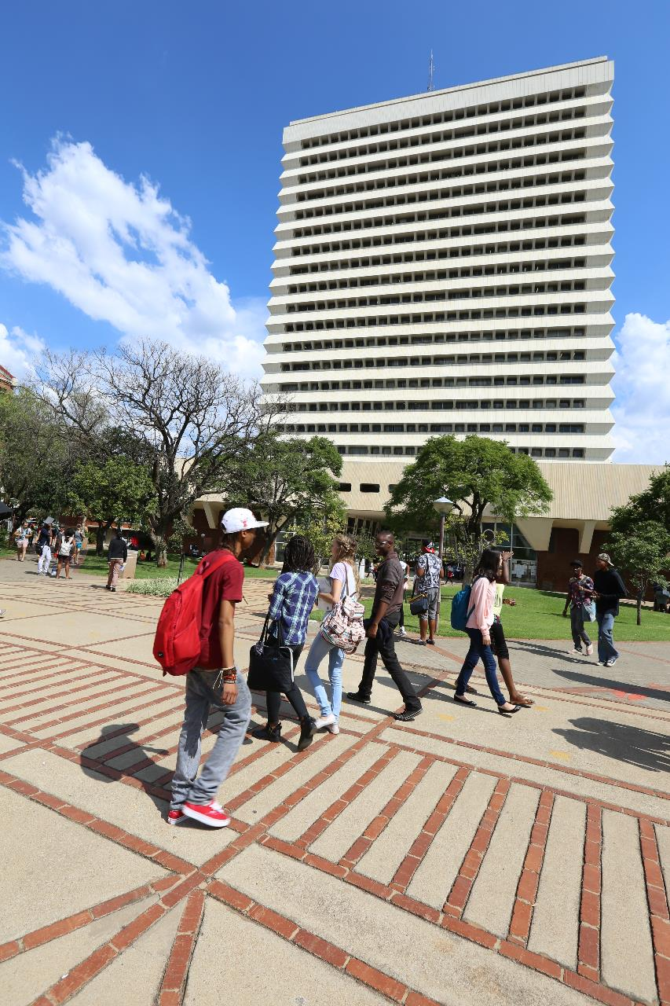

Thank you!

