Slide 1
1. ASASWEI CONFERENCE THEME: ADVANCING SOCIAL WORK PRACTICE THROUGH STRENGTHENED MULTI-SECTORAL RESPONSES TO ADVERSITY, VULNERABILITY AND TRAUMA
Building sustainable, resilient, and self-reliant communities through indigenous modalities, inter-sectoral collaborations, and partnerships
Supporting Families in Mitigating Vulnerabilities

Slide 2
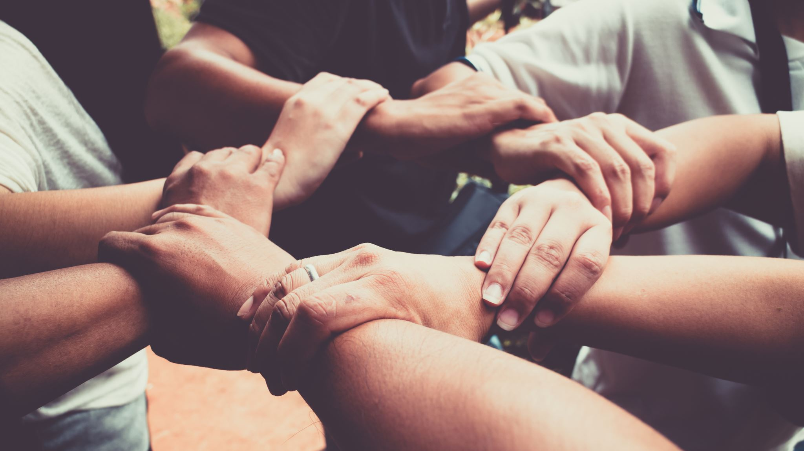
2. CULTURALLY RESPONSIVE MARRIAGE ENRICHMENT INTERVENTIONS:
STRENGTHENING RELATIONAL WELL-BEING.
DR Susanne Jacobs (North-West University Potchefstroom Campus)
MS. Kabaro Neswiswa (PhD Candidate, NWU, Potch)

Slide 3
3. KEYWORDS
Marriage Enrichment Programme (MEP)
Relationship Education
Evidence-based practice
Contextual intervention
Culturally responsive
African couples
Resilient societal structures

Slide 4


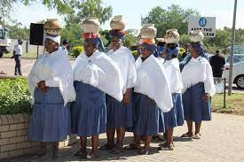

4. BACKGROUND
Communities struggle with various societal influences (syndemics)
Diverse societal challenges & multiple layers of harm cause vulnerability
Relational stress
Breakdown of family structures
Adverse effect on the broader community
Worldwide problem: divorce rising under SA black African couples
Stats increased last ten years.

Slide 5

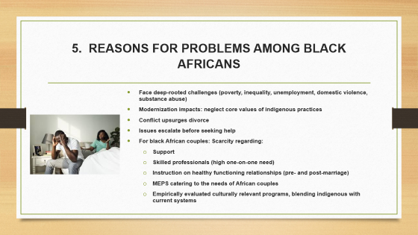
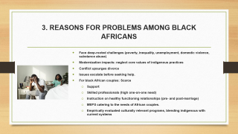
5. REASONS FOR PROBLEMS AMONG BLACK AFRICANS
Face deep-rooted challenges (poverty, inequality, unemployment, domestic violence, substance abuse)
Modernization impacts: neglect core values of indigenous practices
Conflict upsurges divorce
Issues escalate before seeking help
For black African couples: Scarcity regarding:
  Support
  Skilled professionals (high one-on-one need)
  Instruction on healthy functioning relationships (pre- and post-marriage)
  MEPS catering to the needs of African couples
  Empirically evaluated culturally relevant programs, blending indigenous with current systems

Slide 6

6. WHAT IS A POSSIBLE ANSWER TO THE NEED FOR HEALTHY MARRIAGES?
(BASIS FOR FUTURE IDEAL STABLE FAMILIES & SOCIETIES)
The focus of this presentation is to report on a proposed solution:
To endorse a culturally applicable MEP:
a preventative educational intervention
To facilitate the sharing and discussion of evidence-based ME research
An MEP can use the best practice model systems to sustain, support, strengthen, preserve, & promote the marriages of Africans
Interventions as community education/ enrichment for individuals, couples, and families, collectively & cross-culturally
No need to develop new programs

Slide 7
7. STUDY AIM
WHAT?
To develop a culturally relevant MEP for Black Africans (Royal Bafokeng Nation)
The goal is to strengthen marriages (relationships)
incorporating literature & theories
adapting established Western-based programs (PREP 8.0 program) empirical evidence (research findings) &
current international & South African data
modern societal structures, &
traditional contextual, cultural elements (grounded on the strengths of the Royal Bafokeng Nation indigenous community)

Slide 8
8. METHODOLOGY MODEL AND APPROACH: HOW?
D & D Model (Rothman & Thomas, 1994)
Mixed method four-phase research design: pre-and post-test experimental design
Data collection from various sources:
literature,
practitioners,
traditional leaders &
couples

Slide 9

9. METHODOLOGY
PHASE 1:
LITERATURE REVIEW AND PROGRAM CHOICE
Selection of PREP 8.0 program developed in Denver, USA
Empirically tested long-term effectiveness and flexibility
Attended PREP 8.0 training facilitation to mentor other couples
Program Adaptation: Modified PREP 8.0 based on insights from the baseline study to suit the Black African context after baseline information was established

Slide 10
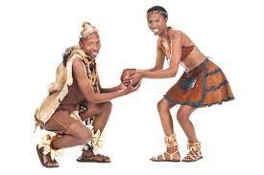
10. METHODOLOGY
PHASE 2:
BASELINE RESEARCH: PERCEPTIONS OF TRADITIONAL MARRIAGES AND MODERN COUPLE NEEDS
Two sample groups
Social services professionals/ practitioners and traditional leaders
One-on-one interviews and focus group discussions

Slide 11
11. METHODOLOGY
PHASE 3:
DEVELOPMENT OF MEP AND PILOT STUDY
Three sample groups: Traditional leaders, social service practitioners, couples
Second round of evaluation: One-on-one interviews, focus group discussions
Pilot study Implementation of the program: weekend five couples
One-on-one interviews with couples: evaluate the effectiveness/viability of the MEP.
Pre-and Post implementation scales (DAS & Couple Satisfaction)

Slide 12
12. WHAT CONSTITUTES AFRICAN TRADITIONAL MARRIAGES?
Communal: Between two people & their families, clan & community.
Family involvement is core: Negotiating bogadi (pride-prize) & supporting post-marriage.
Bogadi Negotiations are a must: not negotiating Bogadi deems marriage invalid.
Couple traditional counselling (go laya) a requirement: All couples must be guided on roles and acceptable behaviours in marriage.
Children are crucial, imperative for procreation, extending a man’s lineage, assures authority in his clan.
RBN-customary land regulations permit only married people's right to land. In a case of divorce, the land is given to the children- not the spouses.
Spirituality: rituals associated with successful marriages (belief in God and ancestors) are practised.

Slide 13

13. PHASE 4:
OUTLINE OF THE 15-SESSION ADAPTED INTERVENTION
SESSION | THEMES/ MODULES | DURATION
SESSION 1 | THE THREE KEYS TO SUCCESS FUN AND FRIENDSHIP | (2 HRS)
SESSION 2 Added sessions, culturally relevant | FACTORS CONTRIBUTING TO POSITIVE MARRIAGE OUTCOMES TRADITIONAL MARRIAGE SYSTEMS THE IMPORTANCE OF CHILDREN AND CHILDREN'S WELL-BEING (FAMILY OF ORIGIN AND IN-LAWS) THE INVOLVEMENT OF FAMILY FROM THE ONSET OF MARRIAGE THE TRADITIONAL GOVERNANCE SYSTEM OF RBN AND THE ROLE OF DIKUTLE IN SUPPORTING MARRIAGES THE IMPORTANCE OF BOGADI NEGOTIATIONS THE IMPORTANCE OF CONVENTIONAL COUPLE COUNSELLING/GUIDANCE (GO LAYA) IN WARRANTING MARITAL SUCCESS EXTERNAL COMMUNITY STAKEHOLDER INVOLVEMENT & EXPERTISE MODERN MARRIAGE SYSTEMS IMPORTANCE OF SPIRITUALITY | (3 HRS)
SESSION 3 | PERSONALITY DANGER SIGNS & TIME OUT | (2 HRS)
SESSION 4 | ANGER & STRESS SPEAKER-LISTENER TECHNIQUE | (2 HRS)
SESSION 5 | EVENTS, ISSUES & HIDDEN ISSUES COMMITMENT | (2 HRS)
SESSION 6 | EXPECTATIONS LOVE STYLES | (2 HRS)
SESSION 7 | PROBLEM-SOLVING ROAD-MAPPING | (2 HRS)

Slide 14
14. SPOUSE DEMOGRAPHIC INFORMATION
(N=10 PARTICIPANTS)
Gender (50/50)
M: 36-43, F29-33
2 Children
Matric, low-middle class
Married in community of property 80%
Customary marriage 20 %
Average years in marriage 40% between 3 and 5, criteria not longer than 7 years

Slide 15

15. OUTCOME: REINFORCES STRENGTHS OF AFRICAN TRADITIONAL MARRIAGE SYSTEMS
COUPLES APPRECIATED THE
PROGRAM:
Rooted in indigenous governance
Passed down through generations
Reinforces healthy spousal and family outcomes
Sustain, support, strengthen, and preserve marriages
Promotes sustainable, resilient, societal structures
Reduced couple's stress/problems and
Reduced divorce rates
AND
POTENTIAL IMPACT

Slide 16
16. POTENTIAL practice IMPACT: MEP STRENGTHS
Pre- and post-test applicability
Potential to educate couples proactively: preventative intervention
Potential to reach many couples at once/ collectively
Reduced workload for social workers
Individual, collective, and cross-cultural benefits
Findings can adapt and expand interventions
Advance and guide practice and policy application: Various stakeholders: traditional leaders, social service practitioners, clinicians, curriculum developers, & community health professionals
Online virtual services have become viable due to the global COVID-19 pandemic
MEP is a preventative education intervention program that provides the necessary skills to eliminate future problems

Slide 17



17. What Next? Way Forward
We look forward to disseminate the programme to the larger RBN community with larger samples and experimental designs to further evaluate effectiveness
Our programme is available/ can be tested with other African communities and possibly make further recommendations cultural contextual adaptation
We are happy to partner with researchers and practitioners who believe in the positive advancement of relationships in black African communities

Slide 18
18. Welcome to contact us!
CONTACT: Ms Kabaro Neswiswa
kgneswiswa@gmail.com
0607629897
Susanne Jacobs
sjacobs2603@gmail.com/ Susanne.Jacobs@nwu.ac.za
0827837373

Slide 19

19. Thank You for Your Attention
Any Questions?

Slide 20
20. References

Slide 21


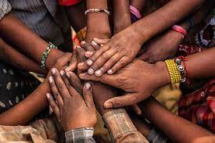
A cultural marriage enrichment program for Black Africans

