Slide 1
Work-life Perspective on the Subjective Wellbeing of Social Workers
Dr Sandra Bredell and Prof Lambert K Engelbrecht
2022

Slide 2
PURPOSE OF THE STUDY
The purpose of this study was to gain an understanding of the subjective wellbeing of social workers within a work-life context, in light of the implementation of the Recruitment and Retention Strategy for Social Workers in 2009 in South Africa, as social work is still known for its high turnover.

Slide 3
RESEARCH QUESTIONS
How do social workers perceive their work-life balance?
How do social workers reflect on their subjective wellbeing?

Slide 4
To examine the nature of social work in the South African context.
To conceptualise a work-life perspective of social work within the South African context.
To describe and analyse the dimensions of social workers’ subjective wellbeing based on a work-life perspective.
To empirically investigate how social workers perceive their work-life balance and their subjective wellbeing.
To draw conclusions and make recommendations to social workers, their managers, and policy formulators regarding the work-life and wellbeing of social workers.
The objectives

Slide 5
THEORETICAL POINT OF DEPARTURE
Positive psychology – Seligman
It is also strengthened by the broaden-and-build theory of positive emotions by Fredrickson (2004), which means that subjective wellbeing broadens our vision and builds more effective use of available resources (Veenhoven, 2008).
The boundary and border theories also serves as a theoretical framework for this research as it was used to study role conflicts in the work-family domains.

Slide 6
This study draws on Diener’s (1984; 2000) theory, which illuminates the “positive affect” and “negative affect” as experienced by the respondents, which in turn are linked to the broaden-and-build theory of positive emotions by Fredrickson (2004) and the flourishing concept by Seligman (2011).
Theoretical departure, in a nutshell …

Slide 7
DEFINITIONS
“Subjective” refers to how people report what they feel. This means listening to what they have to say. “Wellbeing” refers to happiness but in a more medical context.
Subjective wellbeing can generally be defined as “how people evaluate their lives” (Diener & Scollen, 2003:404) which relates to Seligman’s (2011) flourishing concept.

Slide 8
DEFINITIONS
It is evident from the literature that subjective wellbeing is linked to the positive psychology theory (Diener & Scollen, 2003; Peng et al., 2011; Seligman, 2011).
Work-family balance means “satisfaction and good functioning at work and at home, with a minimum of role conflict” (Clark, 2000:751).
The term “work-life” seems to be more comprehensive and is therefore used in this study.

Slide 9
RESEARCH METHODOLOGY
Research approach: Qualitative research
Research design: The exploratory and descriptive research design was applicable to this study
Population and sampling: Purposive sampling. Participants who met the inclusion criteria were chosen from a professional network and participated in their personal capacity. 11 frontline social workers and 12 managers/supervisors were interviewed by myself, with the social workers having at least 18 months' work experience and the supervisors, 2 years.

Slide 10
CONCLUSIONS
It is evident that frontline social workers experience very stressful situations on a day-to-day basis.
Factors that contribute to these stressful circumstances were pointed out to be a lack of emotional support, insufficient supervision and support, a lack of resources, poor salaries, and a paucity of development and decision making within the workplace.
On the home front, financial concerns, a lack of understanding of work circumstances, different roles in the work and family life, and the quality of relationships were mentioned as having an impact on family life.
Aggravating these influential factors was the COVID-19 pandemic that resulted in an extremely uncertain and stressful lockdown period.

Slide 11
CONCLUSIONS
With regard to the deprofessionalisation of the profession, the poor recognition of social work was highlighted and that the participants felt that social workers needed to be more active in advocating for the profession and what it stands for and clearing the misconceptions that still exist around the profession.
The participants felt firmly about the fact that it requires people with a certain type of personality to become social workers and that the qualification should be a screening degree.

Slide 12
CONCLUSIONS
There also seemed to be a lack of organisational commitment regarding available and reliable resources on the one hand and supportive working conditions such as flexible working hours on the other.
If supportive working conditions are in place, it seems to convey to the employees that the organisation cares about them and they then experience a feeling of belonging, which reduces the intention to leave their jobs.

Slide 13
Context of social work in South Africa: With regards to supervision, that a supervisor should not have more than 10 supervisees, that supervision’s main functions should be split equally between the administrative, supportive, and educational components and lastly that young frontline social workers are offered more supervision time and guidance, especially during their first two years of employment.
RECOMMENDATIONS

Slide 14
Regrading salaries, as part of the Recruitment and Retention Strategy for Social Workers, needs to be rolled out specifically to bring the salaries of social workers employed by Welfare Agencies up to par by the South African Council for Social Services Professions in South Africa, and taking a firmer stand to advocate for the profession and standardise a supervisor course to ensure that supervisors are equipped with the necessary skills.
RECOMMENDATIONS

Slide 15
Work-life balance/perspective: Social workers need to take the responsibility for flourishing at work. Social workers will have to enforce the boundaries that they set in place, in order to survive the demanding social worker profession.
Supervisors: attention must be paid to all aspects of social work, as well as the importance of boundaries, work-life balance, and self-care.
Organisations: a proper orientation programme should be followed; a detailed description of the role and job requirements must be provided, and resources should be provided for the job to be done.
RECOMMENDATIONS

Slide 16
Subjective wellbeing: Although the responsibility for self-care lies with the social workers, they need to know that their supervisors, organisations, and the South African Council for Social Service Professions support their efforts.
Time should be allocated during supervision sessions to address the frontline social workers’ skills, boundaries, needs, and personality attributes to combat the high turnover of social workers, as well as to ensure healthy social workers rendering services effectively to their clients.
RECOMMENDATIONS

Slide 17
Management needs to buy in on the concept of self-care programmes, wellness days, and flexible working hours to show their appreciation and support to the workforce.
Wellness programmes and orientation for frontline social workers (in the first two years of employment) should be registered with the South African Council for Service Professions, in the same way as courses are registered for Continuing Professional Development points, for example, 15 points for professional development and 5 points towards self-care and wellbeing.
RECOMMENDATIONS

Slide 18
The government should make the decision to support these endeavours by obligating organisations to play their part, but also to intervene and provide for better salaries and working conditions for social workers.
RECOMMENDATIONS

Slide 19
The figure on the next slide shows
the eight dimensions of wellness encapsulating the work-life balance and subjective wellbeing: Conceptual framework (Bredell, 2022:96)
CONCEPTUAL FRAMEWORK

Slide 20
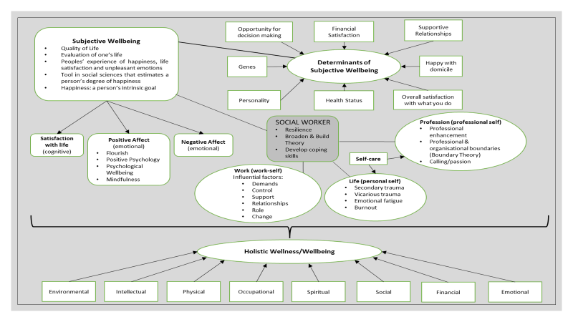

Slide 21
IN CONCLUSION
In summary, most of the social worker participants were thinking of either leaving their jobs or the profession, with the majority being employed in their current job for less than five years. It showed that a high turnover of social workers still exists despite the Recruitment and Retention Strategy for Social Workers being implemented.

Slide 22
IN CONCLUSION
The social worker participants admitted to feeling stressed and overworked, and also highlighted inadequate supervisory support. With regard to work-life balance, the participants echoed that there is a spillover from the work to the family domain and vice versa, which underlines the importance of adhering to boundaries that impact on their holistic wellness and maintaining self-care.

Slide 23
REFERENCES
Bredell, S. 2022. A work-life perspective on the subjective wellbeing of social workers. Doctoral dissertation, Stellenbosch University.
Clark, S.C. 2000. Work/family border theory: a new theory of work/family balance. Human Relations, 53(6):747-770.
Diener, D. & Scollen, C.N. 2003. The evolving concept on subjective wellbeing: multifaceted nature of happiness. Advances in Cell Aging and Gerontology, 15:187-219.
Diener, E. 1984. Subjective well-being. Psychology Bulletin, 95:542-575.
Diener, E. 2000. Subjective well-being: the science of happiness and a proposal for a national index. American Psychologist, 55:34-43.
Fredrickson, B.L. 2004. The broaden-and-build theory of positive emotions. Philosophical Transactions: Biological Sciences, 359(1449):1367-1377. doi:10.1098/rstb.2004.1512.

Slide 24
REFERENCES
Peng, A., Ilies, R. & Dimotakis, N. 2011. Work-family balance, role integration and employee well-being. In: Kaiser, S., Ringlstetter, M.J., Eikhof, D.R. & Pina e Cunha, M. (eds.). Creating balance? International perspectives on the work-life integration of professionals. Berlin: Springer-Verlag: 121-140.
Seligman, M.E.P. 2011. Flourish: a visionary new understanding of happiness and wellbeing. Australia: Random House.
Veenhoven, R. 2008. Sociological theories of subjective well-being. In: Eid, M. & Larsen, R. (eds.). The science of subjective well-being: a tribute to Ed Diener. New York: Guilford Publications: 44-61.

