Slide 1
TOPIC: Employee Health and Wellness Performance Indicators for the Gauteng Department of Health
Presenters: P V Seodi and Prof WJH Roestenburg
The research was for a Master of Social Work dissertation submitted at the North-West University
orcid.org/ 0000-0003-0427-751X

Slide 2
International
Social work Conference
27 – 29 September 2023
ELANGENI HOTEL
ASASWEI
ASSOCIATION OF SOUTH AFRICAN SOCIAL WORK EDUCATION INSTITUTIONS

Slide 3
BACKGROUND
Employee wellness as a significant concern for large state departments such as GDOH. Large amounts of money are spent annually at deploying wellness practitioners in a programme aiming to assist employees with psychosocial problems.
Little is known about the effectiveness of these programmes, and no indicators exist regarding those factors contributing to the overall well being of staff at the department.
GDOH has a total staff component of 78 000, ranging from medical professors to unskilled workers.
The workplace environment is complex, and employees face various environmental, health and wellness challenges that impact their well being at work such as workplace trauma, violence, staff shortages, HIV and AIDS, and increasing occurrence of workplace disputes and conflicts. These adversities lead to increases in vulnerability, trauma, and workplace effects such as poor work performance, and weak workrole enactment.
The question is: What factors can be identified as indicators of workplace based well-being programme effectiveness?
The study aimed to answer this question

Slide 4
AIM of the study
We investigated whether a range of identified workplace factors ”had anything to do” with employee ”well-being” at three Healthcare facilities (Regional state hospitals) of the GDOH.
This study did not involve the total employee population but only three units and was a pilot study.
We used a cross-sectional survey design for data collection that included all employees in the three units. This amounted to 269 employees completing the online or physical questionnaire

Slide 5

STUDY DESIGN
The researcher explored the relationships amongst biographical data, objective indicators of EH&W programme performance and perceived (subjective) social wellbeing of three business units identified in the organisation, Units A, B and C.
The study approach and design was Quantitative and used a Cross Sectional Survey-Design and exploratory
The researcher was not concerned with the generalisation of the results to all the employees, but rather to the business units being selected.
Three sample sets were collected, one for each Unit. N = 269
Business Unit A was selected on the basis that it is a unit that is under-resourced and under-performing as per the performance indicators outlined in the design. Business Unit B was considered on the basis that it is average resourced and lastly Business Unit C, was identified as a well-resourced unit as per the performance criteria
We performed Structural Equation Modelling by means of IBM AMOS 21 statistical software.

Slide 6
Instruments
The study utilised a Google survey instrument that was also printed for paper completion
three constructs of measurement, namely Psychological Capacity, Work Engagement and General Well being as subjective measures.
Psychological capacity was measured utilizingwidely used scales - the PCQ-24 (PsyCap), Work engagement using the Utrecht Work Engagement Scale (UWES) and well-being using the Psychological General Well-being Scale (PGWBI).
Workplace variables such as Years of employment, wellness programme use and several others (These were nominal variables)

Slide 7
Data analytic structure
The questionnaire contained three sections, demographics, pre-designed objective variables and the three scales
Factor analysis to confirm the validity of the three instruments (PGWBI, PSYCAP-24 and UWES)
Reliability of the three instruments
Examination of the differences between the three units to establish if wellness budget had anything to do with well being (Not in this study)
Correlation analysis to determine the relationships between the three dependent variables
Structural equation modelling for identifying the indicator variables using Maximum Likelihood measures
Models were designed based on specific hypotheses regarding factors and their relationships

Slide 8
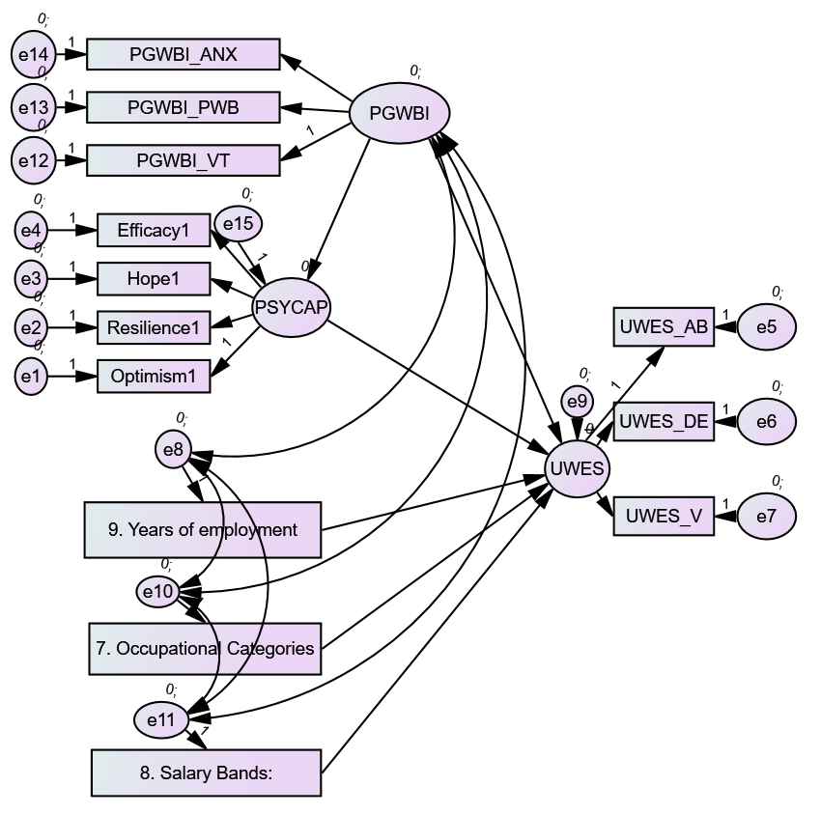
Results
Several model options were explored which found various effects (Combined model illustrated)
Model 1: Psychological Capacity (PSYCAP) and Psychological General Well-being (PGWBI) influences Work Engagement (UWES). CMIN/DF = 2.603, CFI = .943, RMSEA = .073 Model 2: PSYCAP mediates the effect of well-being on work engagement (Not confirmed) Model 3: Years of employment, Occupational category and Salary band failed to contribute significantly to the effect of well-being on work engagement Model 4: Years of employment alone had a small, but significant effect on UWES

Slide 9
Conclusions
We thought our outcome variable was general well-being, but this was not confirmed
Instead, work engagement presented as the outcome variable in our model testing
We thought Years of employment, salary band and job category would influence work engagement, but these failed to explain the output factor work engagement (UWES).
We thereby conclude that work engagement (UWES) in this context is mostly determined by a combination of well-being (PGWBI) and psychological capacity (PSYCAP) (70/30).
Work engagement (UWES) improved with years of employment
Workplace factors such as your salary band, and the type of job you do had little influence on whether you engaged with your work.

Slide 10

Recommendations
One should appreciate the effect of reducing vulnerabilities in the workplace in improving work engagement (work skills improvement). Not realized before.
Newer employees are more vulnerable than more experienced workers. More interventions must be directed at new employees who are more vulnerable and have less psychological capacity to engage with their work.
It could be expected that the longer the person had worked the better his overall well-being and psychological capacity would be to withstand the stresses of the workplace.
A lot can be done to build Psychological capacity through interventions such as workplace decision making that involves the employee, coaching in the workplace and supportive actions that build the person’s individual capacity and strength.
Counseling must not only focus on solving social and relationship problems, but to ensure the person functions better in his job.
It was possible that in these three units at least, short term employees had more problems with adjustment to the system, than long term employees who knew the system and had already adjusted.
Investigate his engagement with work during wellness assessments

Slide 11

Recommendation
The study provided new insights into what critical elements of employees should be addressed by wellness programmes
Traditional interventions have extensively focused on well-being improvement only, but often neglected the person’s role at work, and his personal capacity to perform his duties in the workplace.
In this study, both the psychological capacity and his well-being contribute to better engagement at work, and this should be the new focus of employee wellness programmes, not the other way around.

Slide 12
KEALEBOGA
THANK YOU
SIYABONGA

