Slide 1
THE CHALLENGES AND EXPERIENCES FACED BY THE MA’AT INSTITUTE THERAPISTS WHO PROVIDED PSYCHOSOCIAL SUPPORT DURING COVID-19 AND THE FLOOD DISASTERS.
By: Madlala Wenzile, Nqayi Zamansele, Sibisi Nompilo, Shandu Nokuthula & Nontobeko Buthelezi

Slide 2
OVERVIEW OF PRESENTATION
Introduction
Background
Methodology
Findings and discussions
Conclusion and recommendations

Slide 3
INTRODUCTION
KwaZulu-Natal experienced a global outbreak of the Coronavirus pandemic and the devastation of flood disasters.
During COVID-19, people lost their loved ones, jobs, and normal lives since they had to adhere to COVID-19 protocols (Alonso et al., 2021; Nguse & Wassenaar, 2021).
COVID-19 and the KwaZulu-Natal flood disasters have profoundly affected the provision of psychosocial support to MA’AT Institute therapists (Nguse & Wassenaar, 2021).

Slide 4
INTRODUCTION…
The COVID-19 and the KZN Floods disaster substantially affected the mental health of individuals, families, and communities (Alonso et al., 2021).
The displacement of people, the loss of their loved ones, and being placed in the community halls increased the need for psychosocial support (daily maverick, 2022-05-16)
The MA’AT Institute therapists and other similar organisations provided crisis intervention to mitigate mental illnesses and promote resilience
The MA’AT Institute Psychosocial Internship Project (MIPIP) is at the University of KwaZulu-Natal College of Humanities- School of Applied Human Sciences.
It renders psychosocial services in KwaZulu-Natal through individual, family or community-based interventions and offers teletherapy to communities.

Slide 5
BACKGROUND
Several existing studies demonstrated that those exposed to the risk of infection may develop pervasive fears about their health, worries about infecting others and fear of infecting family members (Alonso, 2021; Naido, 2020; Nguse & Wassenaar, 2021; Posel et al., 2021).
Mental health issues such as anxiety, fear, depression, stress and uncertainty about what will happen in the future compounded mental distress during the various coronavirus waves and the unprecedented environmentally induced floods in South Africa (Nguse & Wassenaar, 2021)

Slide 6
BACKGROUND…
Why is reflection critical?
Critical attributes of therapists
Provision of quality intervention and use of relevant approaches, skills and knowledge
Enhance competency: Learn from experiences and adjust practice
Resolve collaboratively ethical dilemmas and maintain professionalism and ethics
Improve their communication and interpersonal skills.
Enhanced self-care
Openness to new ways of working and knowing
Flexible, adaptable, resourceful and takes initiative Ethical and able to set boundaries
Possess cultural and linguistic competence
Resilient
Critical reflexivity
(Pillay & Kometsi, 2007; Ratele etal., 2021)

Slide 7
PARADIGMATIC STANCE
The overarching philosophy of Ubuntu and the principles of Ma’at guide the reflective analysis of the MA’AT Institute therapist and the current presentation. Acknowledge the following key aspects:
Interdependence of all beings
Communalism and Ubuntu
Spirituality: Oneness of mind, body, soul and spirit
Harmony of all forms of living and non-living beings (embrace animism)
Cultural Relativism: embrace African cultural ideologies and philosophies
Justice (healing and reconciliation rather than punishment)
Diversity and Pluralism
(Mkhize, 2018; Sulamoyo, 2010).

Slide 8
OBJECTIVES
To explore the experiences and challenges of MA’AT Institute therapists during the COVID-19 pandemic and KZN floods.
To evaluate the impact of the pandemic and floods on the MA’AT Institute on the therapists’ service provision.
To recommend further interventions to support therapists during emergencies.

Slide 9
METHODOLOGY
Qualitative research approach
Purposive sampling: 5 Social Work and Psychology therapists
Data collection: Focus group and journal records of therapists
Data analysis: Thematic data analysis
Limitations

Slide 10
FINDINGS AND DISCUSSIONS
Displaying professionalism despite being affected directly or indirectly.
Flooding in Durban KwaZulu-Natal resulted in the loss of loved ones, friends, and community members, triggering grief and mourning among affected therapists.
The additional stress of managing caregiving responsibilities during and after a flood impacted their mental well-being.
Moreover, therapists struggled to confront their distresses during floods and COVID-19 as they had to nurture their loved ones.
Their nurturing did not end within their households, but they experienced the pressure of providing primary counselling and debriefing for the victims.

Slide 11
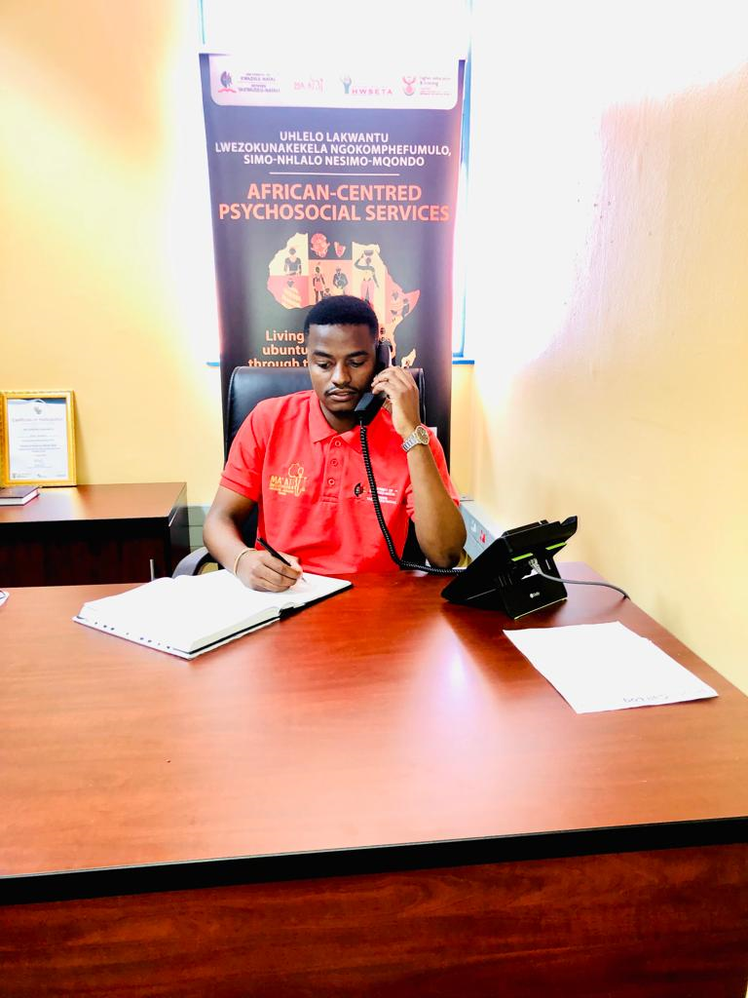
FINDINGS AND DISCUSSIONS…
The MA’AT Institute therapists had challenges in reaching their service users due to network issues since we provide counselling through teletherapy.
MA’AT therapist finds it difficult to communicate with the service users, as the service users preferred face to face counselling instead of teletherapy ,which limited their ability to express their experiences or report the cases.

Slide 12
FINDINGS AND DISCUSSIONS…
The therapists worked from home to provide psychosocial support
Service user’s expectations and challenges
Intervention strategies used during COVID-19/ Flood disasters
Adhere to COVID-19 protocols
Ubuntu as a guiding principle
Internalisation of African cantered paradigm.

Slide 13
FINDINGS AND DISCUSSIONS
The impact of COVID`19 and flood disasters on the therapists:
Mental health and wellbeing
Work/life boundaries
Connectivity issues
Teletherapy, which was a new interventions

Slide 14
FINDINGS AND DISCUSSIONS…
Services were guided by the 4 MA’AT principles, which are Harmony, Justice, Order, and Balance assisted in the provision of coherent and principled interventions
Ubuntu, as a foundation of basic values that manifest in how African people think and behave towards each other and everyone else they encounter, allowed therapists to maintain a critical discourse as they dealt with diverse communities (Sulamoya, 2010)
Afrocentric thought challenged therapists to recognize and attend to people’s suffering in an inclusive and culturally sensitive manner (Zapata, 2021).

Slide 15
RECOMMENDATIONS
Equip the staff to be able to respond to disasters;
Providing debriefing for staff to ensure mental health;
Both risks and resilience of the community and the therapists are fundamental in mental health provision
Being in fluid and dynamic situations such as the COVID-19 pandemic and floods is life-changing for young professionals, and higher education institutions should utilize such events to expose students and document the experiences
Expand the project to have a national psychosocial impact

Slide 16
SIYABONGA
MA’AT Institute
CALL -0800 8000 19 (toll free)
WhatsApp - 060 548 9137
EMAIL -Maat@ukzn.ac.za
Working hours: 08:30 to 16:00 Monday to Friday

