Slide 1
PSYCHOPATHIC TRAITS & DEVIANCE AMOUNG SOUTH AFRICAN YOUTH
DR EMMA CAMPBELL

Slide 2
AIM
INTRODUCTION
Psychopathy scale ratings & offending behaviour
Unified theory of crime
Existing evidence and impact in SA context
Psychometric properties of YPIS
Deviant behaviour among SA youth.
Psychopathy as a unified theory of crime

Slide 3
PSYCHOPATHY AS A UNIFIED THEORY OF CRIME
The concept of psychopathy has been extended into a unified theory of crime by using life-course theory to explain offending behaviour through key dimensions (DeLisi, 2009)
Interpersonal
Narcissism
Affective
Callousness
Superficial charm
Grandiose self-worth
Pathological lying
Manipulation.
Lack of empathy
Failure to accept responsibility
Superficial emotion
Lack of guilt
Behavioural
Poor control over actions
Early childhood problems
Juvenile delinquency
Noncompliance

Slide 4
YOUTH PSYCHOPATHIC TRAITS INVENTORY
Notes:
Measurement

Slide 5
DEVIANT BEHAVIOUR VARIETY SCALE
Notes:
Measurement

Slide 6
SOCIODEMOGRAPIC & SCALE RESULTS
N= 213 |  | Valid Percentage
Gender | Male | 45.7
 | Female | 54.3
Age | 18 | 39.0
 | 19 | 27.8
 | 20 | 33.2
Deviant Behaviours (DBV) | Low (0-4) | 38.5
 | Moderate (5-9) High (10-19) | 32.8 28.6
Youth psychopathic traits (YPIS) | Low (1.00-2.00) | 24.7
 | High (2.01-4.00) | 75.3

Slide 7
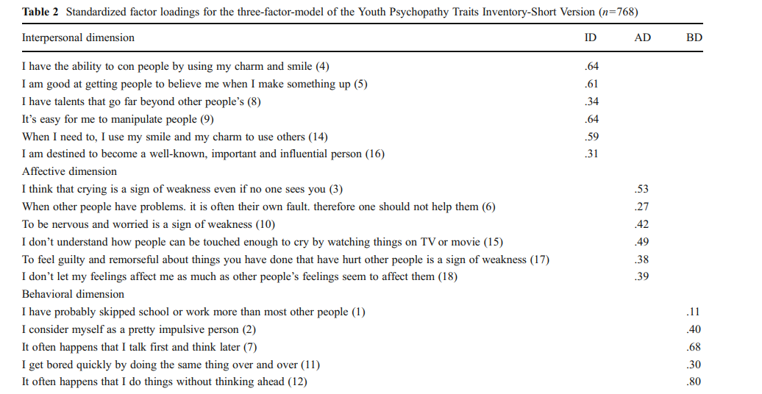
(Colins, Noom, Vanderplasschen, 2012)

Slide 8
PSYCHOMETRIC PROPERTIES OF YPIS
Notes:
Underlying assumptions for factor analysis met &
Results suggested 3 factor solution.
PCA was run with varimax rotation.
These results suggest that the youth psychopathic traits inventory short version might not be the most appropriate tool to measure psychopathic traits, and particularly behavioural traits, among South African youth.

Slide 9
RELATIONSHIP BETWEEN PSYCHOPATHIC TRAITS & DEVIANCE
Chi Square for association (DBV & YPIS)
  Significant relationship (X² (2, N=176) =38.37ª, p<0.001)
  Moderate, positive association (Cramer’s V (0.467, N=176)
  74% of participants who scored above 2.00 on YPI-S also performed more than 5 deviant behaviours
Linear regression
  Statistically significant (R² = 0.237, F(1, 174) = 54.098, p = <0.001)
  Durbin-Watson value =1.800
  Adjusted R square=0.233

Slide 10
CONCLUSIONS & RECOMMENDATIONS
Value in YPIS & emotional subscale
Interventions: emotional regulation for youth
Link between violence, emotional regulation and adverse outcomes
School based & caregiver interventions: improved emotional regulation
YPIS did not function as in the original studies
Application of existing scales & theories in SA context
Cross-cultural experience of scales (Focus groups, Interviews, Experts)
Build locally appropriate scales & theories.

Slide 11
REFERENCES
Bell, C. C., & McBride, D. F. (2010). Affect regulation and prevention of risky behaviors. JAMA, 304(5), 565-566. Brown, L. K., Houck, C., Lescano, C., Donenberg, G., Tolou-Shams, M., & Mello, J. (2012). Affect regulation and HIV risk among youth in therapeutic schools. AIDS and Behavior, 16, 2272-2278. Colins, O. F., & Andershed, H. (2016). The Youth Psychopathic Traits Inventory-Short Version in a general population sample of emerging adults. Psychological assessment, 28(5), 449. Colins, O. F., Noom, M., & Vanderplasschen, W. (2012). Youth Psychopathic Traits Inventory-Short Version: A further test of the internal consistency and criterion validity. Journal of Psychopathology and Behavioral Assessment, 34, 476-486. DeLisi, M., 2009. Psychopathy is the unified theory of crime.. Youth Violence and Juvenile Justice, pp. 256-273 Dieltiens, V., & Meny-Gibert, S. (2012). In class? Poverty, social exclusion and school access in South Africa. Journal of Education, 55(1), 127-144. Foxcroft, C. D. (2004). Planning a psychological test in the multicultural South African context. SA Journal of Industrial Psychology, 30(4), 8-15. Hessler, D. M., & Katz, L. F. (2010). Brief report: Associations between emotional competence and adolescent risky behavior. Journal of adolescence, 33(1), 241-246. Kim, J., & Cicchetti, D. (2010). Longitudinal pathways linking child maltreatment, emotion regulation, peer relations, and psychopathology. Journal of child psychology and psychiatry, 51(6), 706-716. Moffitt, T. E. (2013). Childhood exposure to violence and lifelong health: Clinical intervention science and stress-biology research join forces. Development and psychopathology, 25(4pt2), 1619-1634. Sharkey, P. T., Tirado-Strayer, N., Papachristos, A. V., & Raver, C. C. (2012). The effect of local violence on children’s attention and impulse control. American journal of public health, 102(12), 2287-2293. Sui, X., Massar, K., Kessels, L. T., Reddy, P. S., Ruiter, R. A., & Sanders-Phillips, K. (2020). Exposure to violence across multiple contexts and health risk behaviours in South African adolescents: the moderating role of emotion dysregulation. Psychology & Health, 35(2), 144-162. Wills, T. A., Simons, J. S., Sussman, S., & Knight, R. (2016). Emotional self-control and dysregulation: A dual-process analysis of pathways to externalizing/internalizing symptomatology and positive well-being in younger adolescents. Drug and alcohol dependence, 163, S37-S45. Wills, T. A., Walker, C., Mendoza, D., & Ainette, M. G. (2006). Behavioral and emotional self-control: relations to substance use in samples of middle and high school students. Psychology of Addictive Behaviors, 20(3), 265.

