Slide 1
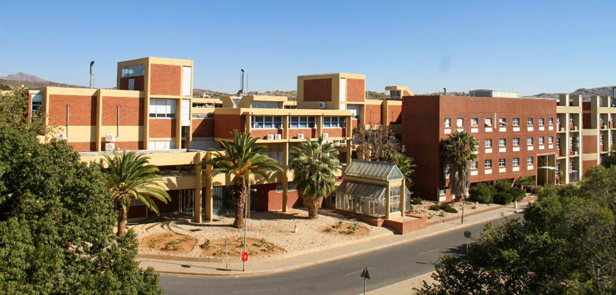
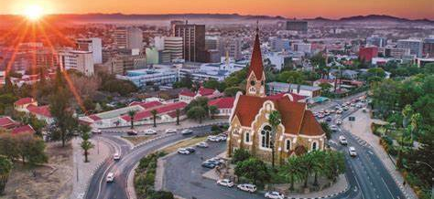
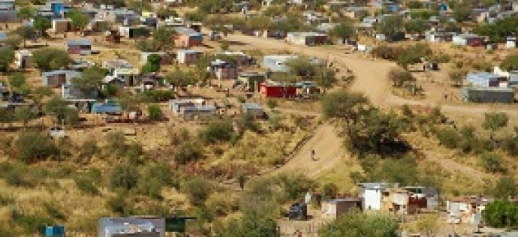
STRENGTHENING RESILIENCE OF COMMUNITY-BASED STRUCTURES: A MULTI-SECTORIAL APPROACH TO ADDRESSING ADVERSE EVENTS. .
Presenter: Ms. Dainess Ziba Amukwelele
University of Namibia

Slide 2
Presentation outline
Introduction.
Defining relevant concepts.
Status of adverse events and vulnerability in Namibia.
Strategies for Strengthening Resilience of community-based structures
Implications for social work practice.
Conclusion.

Slide 3
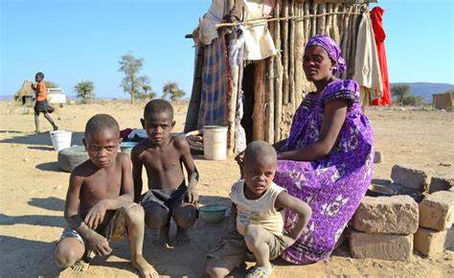
INTRODUCTION
Namibia like other African countries has been experiencing an increase in and frequency of environmental hazards.
While the biophysical aspect of vulnerability has been extensively studied.
Little research is done on strengthening the resilience of community-based structures as an approach to enhancing resilience.
Adverse events have the potential to inflict significant harm on communities, leading to loss of lives, livelihoods, and social cohesion.
As stated by Saeed & Gargano (2022), natural disasters are large-scale adverse events which result from Natural processes of the earth, often associated with death, trauma, and destruction of property.
These disasters threaten, harm or cause death to a large group of people, destruction of services and social networks and a communal loss of resources.

Slide 4
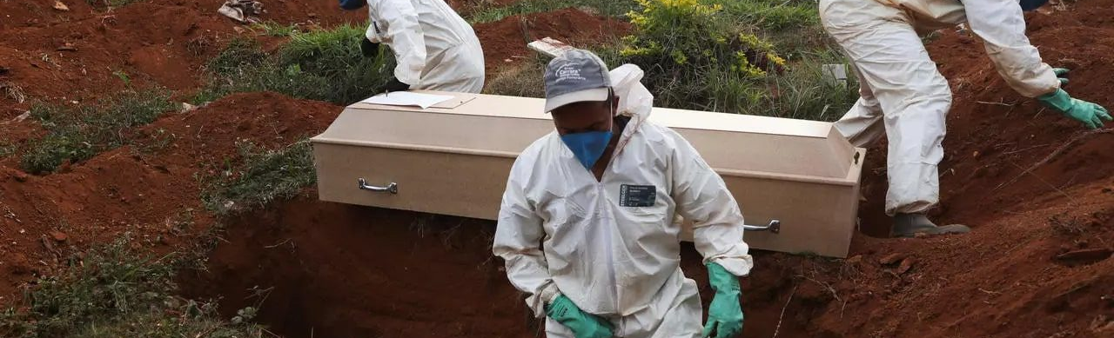
These events come with effects on the economic, environmental, infrastructure and psychosocial well-being of individuals, groups, and communities and disrupt their livelihoods, stability overall well-being.
The Covid-19 pandemic is another example, which started as a health emergency with now huge socio-economic long-term effects that interplay with the unfolding climate and environmental crisis.

Slide 5
RESILIENCE
Resilience has been defined in diverse ways.
Magis (2010), states that Resilience is the ability of a social system to respond and recover from disasters and includes those inherent conditions that allow the system to absorb impact and cope with an event, as well as post-event.
It is the existence, development, and engagement of community resources by community members to thrive in an environment characterised by change, uncertainty, unpredictability, and surprise.
It is seen an adaptive process that facilitates the social system’s ability to re-organize, change, and learn in response to a threat.

Slide 6
VULNERABILITY
Vulnerability is a function of the exposure (who or what is at risk) and sensitivity of systems (the degree to which people and places can be harmed) (Adger, 2006; Cutter, 1996).
It is the pre-event, inherent characteristics or qualities of social systems that create the potential for harm.
Despite vulnerabilities, Folke et al., (2003) assert that communities need to accept the inevitability of change and adapt to live with uncertainty and surprise.
This notion on system disruption and response depicts communities as dynamic human systems that remain viable through constant adaptive responses to change and the development of the ability to thrive in environments characterised by change.

Slide 7
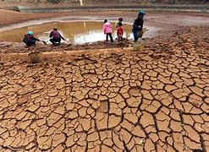
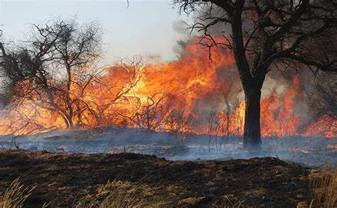
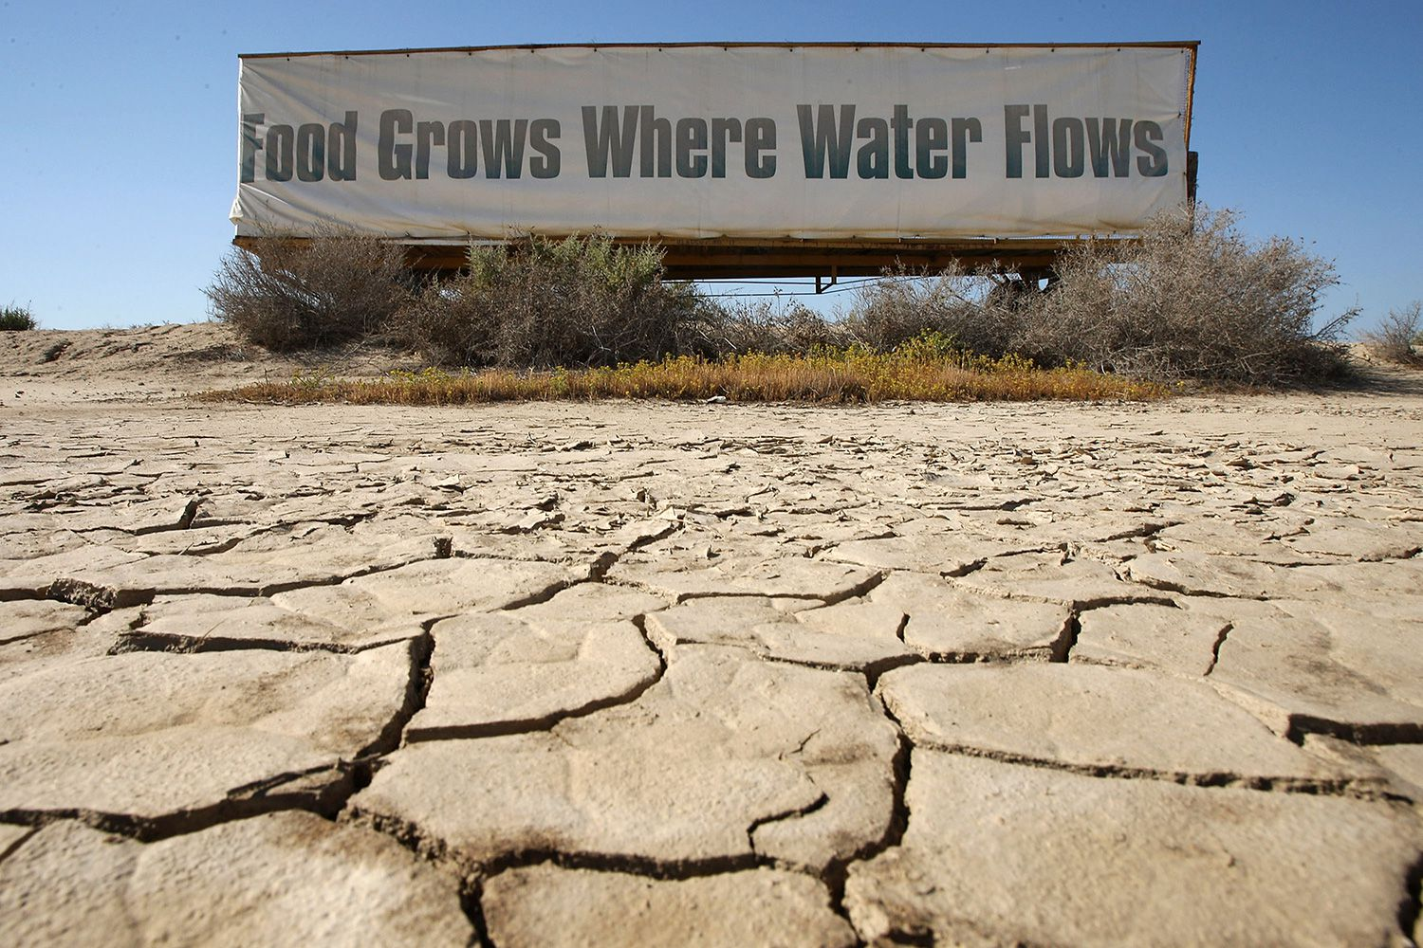
THE STATUS OF ADVERSE EVENTS AND VULNERABILITY IN NAMIBIA.
Natural Disasters in Namibia
Floods
Statistics
approximately 70,000 people are affected Annually.
Effects
Floods disrupt water supplies, and trigger outbreaks of waterborne diseases e.g. cholera and malaria.
Example: Damaged sewage systems in cities in 2008.
Draughts
Wildfires
In the year 2013-2016 floods in Namibia affected around 450,000 people and caused massive food insecurity.
In 2018/2019, the worst draught events caused the deaths of around 80,000 livestock and largely compromised household food security after the previous draughts which happened around 40 years before 2019
Hot and Cold Weather
Covid-19
Hepatitis- E

Slide 8
Strategies for Strengthening Resilience of community-based structures
Community-based flexible multi-sectoral structures

Slide 9
A MULTI-SECTORAL APPROACH
Community resilience is best developed through collective effort. Collective action requires participation and leadership from the entire community.
Extraordinary work of an individual or group of individuals is insufficient, compared to collaborative approaches.
Collective action is more effective when people from diverse and autonomous groups work together.
One of the first principles as stated by Miller (2012) in developing community Resilience is partnership.
Partnership for resilience building is to work in partnership with local people and to do so cooperatively.

Slide 10
Multi-sectoral systems ensure efficient resource allocation, improved communication, and a comprehensive response (FEMA, 2020: WHO, 2017).
By establishing clear communication channels, sharing resources, and coordinating efforts, a multi-sectoral system can enhance the overall response, minimising duplication of efforts and optimising the use of available resources (CDC, 2018; UNDP, 2015).
Agenda 2023 calls for multi-disciplinary and multisectoral approaches and participation of local communities in sustainable development (UNDP, 2015)
Notes:
For example, during a natural disaster, healthcare providers, emergency responders, and community organisations must work together to provide medical assistance, shelter, and essential supplies.

Slide 11
Develop collaborative engagement with stakeholders in the communities and should involve various stakeholders such as,
Government agencies, non-profit organisations, private businesses, community leaders and individual citizens, faith-based and community-based organisations.
Engaging stakeholders ensures that diverse perspectives and expertise are considered, leading to a more effective and inclusive system (Keim et al., 2019; WHO, 2017).
Community-based structures can further ensure data integration.
Data can be collected through various sources (Stakeholders).

Slide 12
Resource mobilisation and allocation can be used to strengthen community-based structures by establishing mechanisms for efficient resource sharing and coordination.
Involves creating resource centres, leaving public-private partnerships, and implementing mechanisms for financial assistance and donations (UNDP, 2015; WHO, 2017).
It is best developed at the local level within a framework established by state or national government.
To be successful, preparedness must involve the public (Smith, (2013).

Slide 13
COMMUNITY ASSETS FOR COPYING, RECOVERY, AND RISK REDUCTION
One key strategy for managing adverse conditions is the development of social capital within a community.
Social Capital refers to the networks, relationships, and trust that exist among individuals and groups.
Strong networks contribute to a community’s ability to cope with crises and recover more quickly.
These networks provide social support, facilitate information sharing, and enable efficient resource allocation during adverse conditions.

Slide 14
.
Culture according to Miller (20120 is not static. Generally, a variety of cultural traditions exist before a disaster. Once disaster sticks, it disrupts cultural traditions.
From an Ubuntu perspective, African Assert theory is worth appreciating to understand what entails assets in Africa.
According to the African Social Work Network, Africans value assets and use them to quantify and qualify wealth.
Family assets: land, cattle, houses, food, clothes, blankets, inherited/monarchical leadership and power, knowledge, water sources.
Community assets: pastures, paths, roads, schools, local markets, water sources.
Societal assets: rivers, markets.
Environmental assets: forests, shared land,
Spiritual assets: worship places, ancestors, symbols of worship and
Notes:
(African Theories of Social Work and Development - Africa Social Work Network (ASWNet)

Slide 15
CAPACITY BUILDING FOR RESILIENCE
When disasters happen, communities lack the capacity and expertise to respond to emergencies when they occur.
Enhancing community capacity has been found to be instrumental in fostering adaptability and resilience.
Communities do not control all the conditions that affect them.
For example, the status of land ownership or the industries influencing the local economy
Community resilience is therefore not about controlling all the conditions that affect communities but rather, about individuals & community’s ability to respond to change.
Based on the Agenda 2021, Policies and practices for disaster risk management should be based on an understanding of disaster risk in all its dimensions of vulnerability, capacity, exposure of persons and assets, hazard characteristics and the environment.
Such knowledge can be leveraged for the purpose of pre-disaster risk assessment, for prevention and mitigation and for the development and implementation of appropriate preparedness and effective response to disasters (UN, 1992).

Slide 16
PROACTIVE MEASURES REDUCING VULNERABILITY INCREASING RESILIENCE
How can we know that community-based structures are resilient?
Encouraging communities to develop disaster management plans, conduct drills, and establishing local response teams
Successful response to crises, Opportunities and change collaboratively,
Multi-sectorial participation and collaboration over time,
Investments in resilient robust communication networks.
Successful implementation of shared plans,
Development of a new direction and future for itself, and
Ability to adapt to changes within and outside the community
Development and implementation of community-centred plans, and community resources over time.
Community resilience is not about controlling all the conditions that affect it but thriving in those conditions.
Strengthening early warning signs is one proactive measure to minimise vulnerability
Empowering women and marginalised groups within communities ensures inclusivity in preparedness efforts (Moyo et al., 2018).

Slide 17
CHILDCARE AND PROTECTION FORUMS IN NAMIBIA
Create a framework for protecting and promoting well-being for all children
recognizes that issues of children are cross-cutting
collaboration between ministries, NGO’s, FBO’s
Multi-sectoral coordination
An example of a multisectoral approach to building community resilience.
Notes:
Racoc-Regional HIV and AID Coordination coordinating

Slide 18
RATIONALE OF CHILDCARE AND PROTECTION FORUMS
Create framework for protecting and promoting well-being for all children
recognizes that issues of children are cross–cutting
collaboration between ministries, NGO’s, FBO’s
Multi-sectoral coordination
OVC POLICY
Child Care and Protection Forums

Slide 19
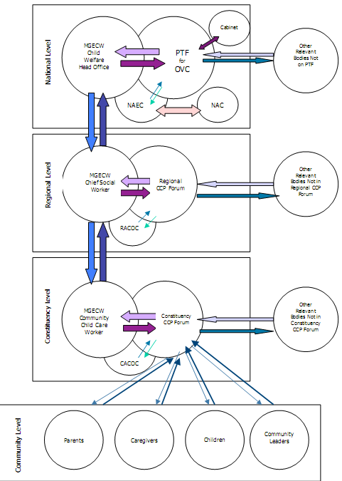
Linkages of coordinating bodies
Notes:
NAEC, RACOC, AND CACOC WHERE initially established to address HIV and AIDs related issues. However, all issues affecting communities are now addressed through these platforms.

Slide 20
IMPLICATIONS FOR SOCIAL WORK PRACTICE
Filing the social work education gaps in curriculum could increase social service involvement in Disaster preparedness and management.
A shift from relieve service provision to risk reduction, preparedness and management.
Disaster risk research and interventions further the mission of social work.
The definition of environment in social work directs the profession to improve human welfare by mitigating global disasters, including worldwide ecological collapse.
Advocacy for policy adaptation and alignment in social services and disaster risk management.

Slide 21
CONCLUSION
Capacity building and resource mobilization efforts play critical roles in enhancing community resilience.
Building social capital, strengthening local economies, and promoting community engagement are key approaches to harnessing community assets for resilience.
Minimizing vulnerability through preparedness and risk reduction actions.
Investing in infrastructure, strengthening governance and policy frameworks are proactive measures that can significantly reduce vulnerabilities.
By implementing these measures, Africa can enhance its resilience and minimize the adverse impacts of natural disasters, climate change, and other vulnerabilities through the community based-structures.

Slide 22
Bibiliography
Datta, D., & Sadhu, A. (2019). Community-Based Resource Mobilization for Disaster Management: A Case Study of the Sunderbans, India. International Journal of Disaster Risk Reduction, 41, 101292. https://doi.org/10.1016/j.ijdrr.2019.101292
Folke, C., J. Colding, and F. Berkes. 2003. Synthesis: Building resilience and adaptive capacity in social-ecological systems. in Navigating social-ecological systems: Building resilience for complexity and Change, eds. F. Berkes, J. Colding, and C. Folke, 352–387. Cambridge, UK: Cambridge University Press.
Folke, C. 2006. Resilience: The emergence of a perspective for social–ecological systems analyses. Global Environ. Change16:253–267.
Hooli, L. J. 2015. Resilience of the poorest: Coping strategies and indigenous knowledge of living with the floods in Northern Namibia. Reg. Environ. Chang., 16, 695–707. [CrossRef].
Jones, L., & Tanner, T. (2020). Climate Change Education for Community Resilience in High-Risk Areas. Climate and Development, 12(6), 517-530. https://doi.org/10.1080/17565529.2019.1656685
Magis, K. 2010. Community Resilience: An Indicator of Social Sustainability. Routledge Taylor & Francis Group. USA.

Slide 23
Morris, J.C., M.W. McNamara, and A. Belcher. 2019. Building resilience through collaboration between grassroots citizen groups and governments: Two case studies. Public Works Management & Policy 24: 50–62.
Miller. J. 2012. Psychosocial capacity building in response to disasters. Colombia Press University. New York.
Miller, J. 2018. Psychosocial Capacity Building in Response to Cascading Disasters: A Culturally Informed Approach. Colombia University Press. West Sussex.
Smith K. 2013. Environmental hazards. Assessing risk and reducing disaster. Sixth edition. Routledge. Canada
Smith, K., McCarty, C., & Nelson, L. (2018). Building Disaster Resilient Communities: Perspectives and Implications from a United States Government-Sponsored Program. International Journal of Disaster Risk Science, 9(1), 94-109. https://doi.org/10.1007/s13753-018-0160-6
Namibia Statistics Agency. Poverty Dynamics in Namibia: A Comparative Study Using 1993/1994, 2003/04 and the 2009/10 NHIES Surveys; Namibia Statistics Agency: Windhoek, Namibia, 2012
United Nations Environment Programme. 2017. Strengthening Community Capacity for Disaster Risk Reduction in Africa (unep.org).
United Nations (UN). 1992. United nations conference on environment and development Rio-De Janeiro, Brazil. Agenda 21.

