Slide 1
A Multi-Sectoral Approach in the provision of services to homeless people in Durban, South Africa by Vanessa Singh
GROWING KWAZULU-NATAL TOGETHER

Slide 2
INTRODUCTION
To contain the spread of Coved 19 during the national state of emergency in 2020, a level 5 hard lockdown was implemented countrywide in terms of the Disaster Management Act 57 0f 2002 in South Africa. In line with the Presidential promulgation, the Department of Social Development in KZN, together with other stakeholders viz SAPS, Department of Health and Non Profit organisations were tasked with the responsibility of ensuring the removal of homeless from the streets of Durban to safe facilities such as shelters provided by the eTthekwini municipality. The aim of this study was to examine the strategies that were utilized by social workers, when working with homeless people, at the inception of the Covid 19 pandemic, in Durban.

Slide 3
LEGISLAIVE MANDATES
Republic of South Africa Constitution 1996 (Section26) Housing White Paper on Reconstruction and Development Programme (RDP) OF 1994 Prevention of Illegal Eviction (PIE) Act (1998) Rental Housing Act (Act No 50 of 1999) The Social Housing Act (2008) The National Development Plan (NDP) 2030 (Guidelines on response to Homeless People,2020)

Slide 4
LITERATURE REVIEW
The word homeless means without a home. Homelessness is about ‘people living on the streets who fall outside a viable network of assistance and who are not able to provide themselves with a shelter at any given time and place.’ (DSD, 2020) The South African Homeless population has been estimated at 200 000. (2015) According to Ikhaya Lami: understanding homelessness in Durban study by Human Science Research Council (2016): 87% of people living on the streets are African, 5% White, 4% Indians, 4% Coloureds, 45% aged 25-34 years and 26% aged 19 to 24 years.

Slide 5
LITERATURE REVIEW
68% originated from KZN and 45%are from within KZN municipality, 42% are seeking employment, 19% family disagreement, 10% no where to go, 8% family death, 6% substance abuse. TRIGGERS OF HOMELESS- some people are victims of interpersonal violence and abuse, personal and familial substance abuse, mental health issues, extreme poverty, family disintegration, housing shortages, unemployment, rapid urbanization. According to the Bereamail in the June 2022, “Durban is a city recently hit by the devastating impacts of the covid-19 pandemic, July unrest 2021 and the recent April and May floods. In the midst of economic strain, job losses and destruction, the city’s homeless population has risen to 16 000.”

Slide 6
INTERVENTIONS
53 social workers (30 DSD &23 NPO) worked with 1700 homeless people for the period 23 March 2020 to 1 October 2020 (6months) in Ehekwini Metro. Profiling of homeless people –DSD social workers. Assessments of homeless people-DSD Social Workers and Department of Health. Deployment of Social Workers to Shelter-DSD and NPO Social Workers Psychosocial support rendered to homeless people - DSD and NPO Social Workers. Family reunification -DSD social workers and Municipality. Recreational programmes to support homeless people in different shelters-DSD Programme 5, NPOS and FBO. Removal of homeless people from the streets-SAP (provision of the shelters were undertaken by the Municipality)

Slide 7
GROWING KWAZULU-NATAL TOGETHER
No | Name of Shelter | Physical address | Capacity | Gender | Structure
1 | Strollers | Mansel Road | 67 | Females | Fixed Building
2 | YMCA | Diakonia | 322 | Males & Females | Fixed Building
3 | Dennis Hurley | Dennis Hurley Road | 47 | Males | Fixed Building
4. | Moses Mahbida | Stadium | 195 | Males | Under Cover Parking
5 | Peoples Park (Block AK) | MY Ave | 157 | Males | Marquee
6 | Jewish Hall | keMasinga Rd | 127 | Males | Marquee
7 | Old Drive In Site | Corner of Stalwart Simelane and MY Ave | 225 | Males | Marquee
8 | Albert Park | Albert Park | 103 | Males & Females | Marquee
9 | Bellhaven | Umgeni | 65 | Males | Fixed Building Harm Reduction
10 | Lahee Park (Pinetown) | Anderson Rd | 139 | Males & Females | Marquee
11. | Isipingo | Sports Ground | 52 | Males | Marquee
12 | Phoenix | Rydevale Sports Ground | 36 | Males | Marquee

Slide 8
OUTCOMES
1700 homeless people were profiled , assessed and allocated to 12 shelters, scaled down to 6 shelters. 575 homeless people received psycho-social services. 455 homeless people were re-united with their families in KZN, there 5 from other provinces viz Limpopo, EC, FS, JHB, WC. Transportation was undertaken by DSD social workers. 7 Mothers with babies were removed and placed in funded shelters Ethekwini Metro. 2 older placed in Child and Youth Care Centres for children in need of care and protection. Substance Abuse: 31 homeless people were admitted to Newlands Park Rehab Centre for substance abuse, and group work were conducted at 4 shelters on substance abuse. 200 people were accessing methodone programme at Bellhaven which functioned as a harm reduction centre,

Slide 9
OUTCOMES
There was a focus on economics on employment or income generation amongst Homeless People. 2 DSD Funded Youth organisations called Sakhisiswe and Johny Makhatini, provided skills development programmes at Old Drive In and Peoples Park homeless Shelters viz Basic Computer skills, Music, Plumbing, Upholstery.Graduation Ceremony held on 2 June 2020, 71 residents 40 Homeless people required assistance with Department of Home Affairs. High prevalence (40%) of health and mental health issues, amongst homeless people that required the intervention of Department.

Slide 10
RECOMMENDATIONS
Strengthen the multi-sectoral approach in providing services to and the homeless People. Identify the critical stakeholders that provide services to homeless people, and the Department that would lead the co-ordination. Municipality Department of Social Development South African Police Services Department of Health Sports and Recreation Department of Arts and Culture Department of Public Works Department of Co-operative Governance and Traditional Affairs Department of Basic Education and Higher Education Department of Human Settlements , NPOs, Business, Community Department of Employment and Labour, Faith Based Organizations

Slide 11
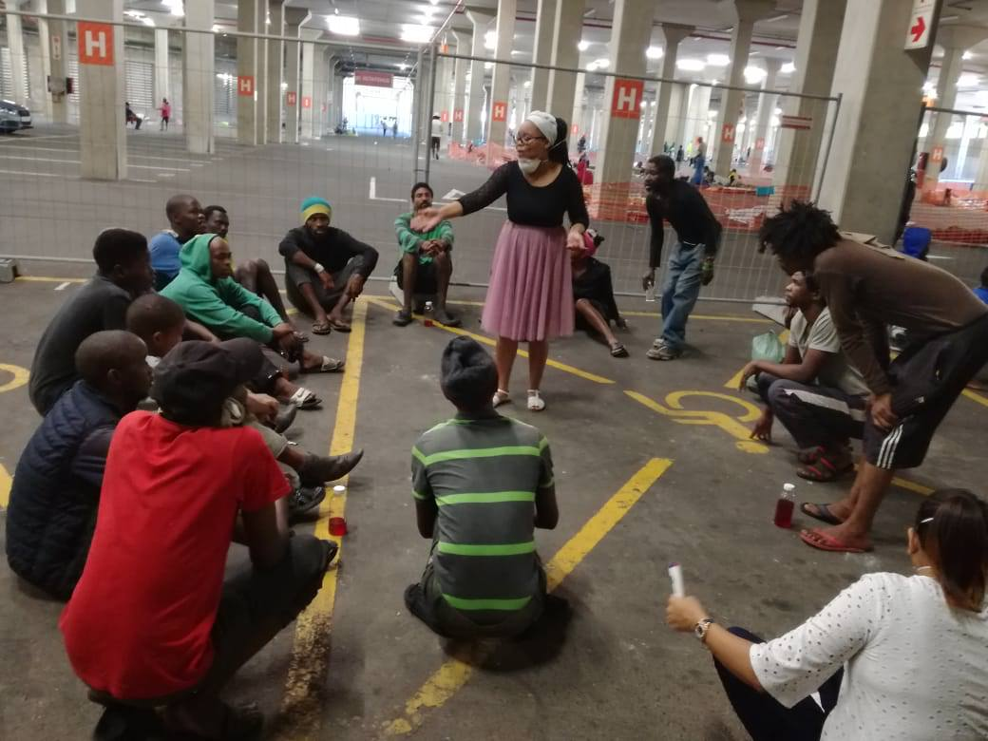
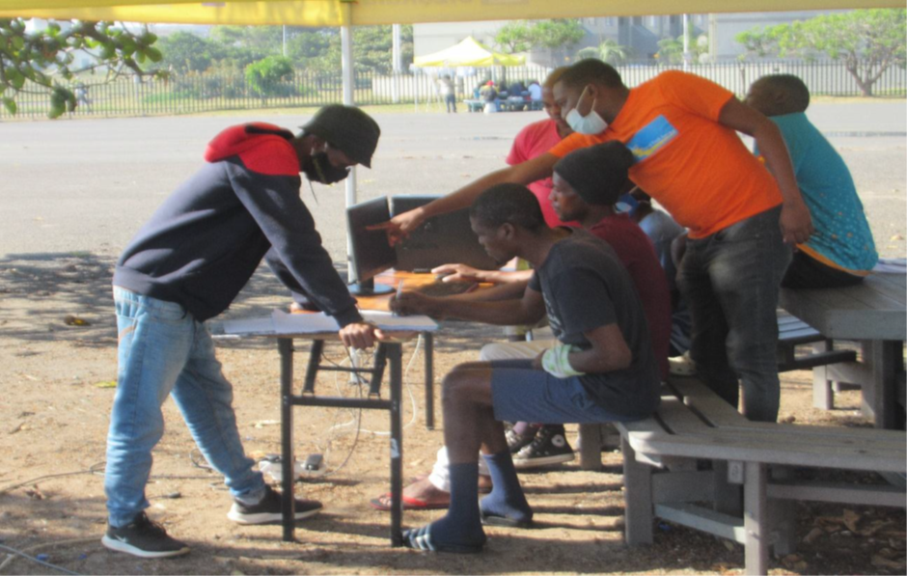
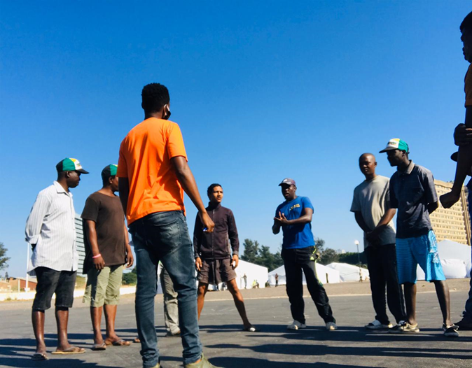
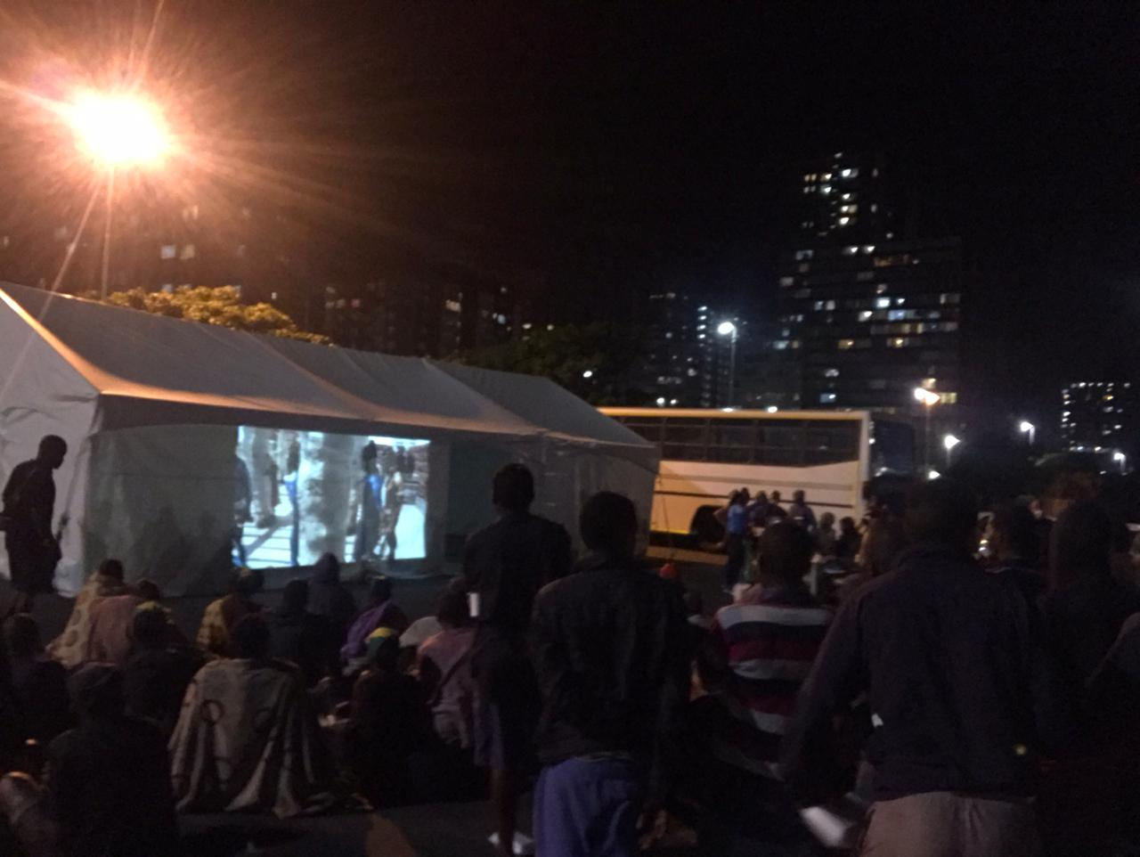
CONCLUSIONS
The multifaceted needs of people living on the streets need to be prioritized, and a more integrated approach to be used.

Slide 12
BIBLIOGRAPHY
“16 000 homeless people recorded in Durban.“http://bereamail.co.za/297477/16000-homeless-recorded-in-Durban/ Department of Social Development.2020.Concept Paper for People living at Shelters for the Homeless 3. Department of Social Development.2020.Guidelines on response to Homeless People. 4. “ Homelessness in South Africa(http://wp.wpi.edu/capetown/projects/p2015/service- dining-rooms/background/homelessness-in-south-africa/). 5. Human Sciences Research Council. 2016. Ikhaya Lami: Understanding Homelessness in Durban.

