Slide 1
Social Work Role in Differentiated Service Delivery for People with HIV/AIDS and Multidrug Resistant Tuberculosis
Professor Jennifer Zelnick, MSW, ScD
Karl Reis, M.D. (Class of 2024)

Slide 2
Acknowledgements
Funding for this work was provided by the United States National Institute of Health (R01AI124413).
Thanks to our coauthors Allison Wolf, Dr. Rubeshan Perumal, Dr. Boitumelo Seepamore Dr. K. Rivet Amico Dr. Amrita Daftary and Dr. Max O’Donnell, and the staff and patients involved in the PRAXIS study

Slide 3
BACKGROUND
For people living with HIV/AIDS, Differentiated Service Delivery (DSD) has focused on enhancing resilience, self-efficacy, and engagement.
For people co-infected with HIV/AIDS and multidrug-resistant tuberculosis (MDR-TB), there are severe challenges associated with treatment, including stigma, social, and structural barriers.
We used empirical adherence data and qualitative research to identify barriers to medication adherence to inform MDR-TB HIV DSD models.
Social Workers can play a key role in delivering this model of patient-centered care.

Slide 4
METHODS
Adults with MDR-TB and HIV initiating bedaquiline (BDQ) and receiving antiretroviral therapy (ART) in KwaZulu-Natal, South Africa were prospectively enrolled and followed through the end of MDR-TB treatment.
Separate electronic dose monitoring devices (EDM) (Wisepill RT2000) measured BDQ and ART adherence through six months, calculated as observed versus expected doses aggregated at a weekly level.
We defined “severely adherence challenged” as <85% cumulative EDM-measured doses of ART and BDQ.
Focus groups were conducted by trained staff and transcripts were analyzed thematically to describe early, middle, and late-stage treatment challenges.
We used this analysis to hypothesize what increased care might be needed at different stages of treatment

Slide 5
RESULTS
From November 2016 through March 2020, 283 participants with MDR-TB/HIV were enrolled and followed through TB treatment completion (median 17.8 months [IQR 16.5–20.2]) and had 8 (4 – 8 IQR) study visits (Table 1).
198 participants were enrolled in the observational PRAXIS cohort, and 85 were enrolled in the mHealth arm of the PRAXIS trial.
12 focus groups were conducted.
Most participants (82.7%, 234/283) maintained high adherence, a subpopulation (17.3%, 49/283) had a steep decline in mean BDQ adherence from 94.9% to 39.9% and mean ART adherence from 83.9% to 26.6% over six months.

Slide 6
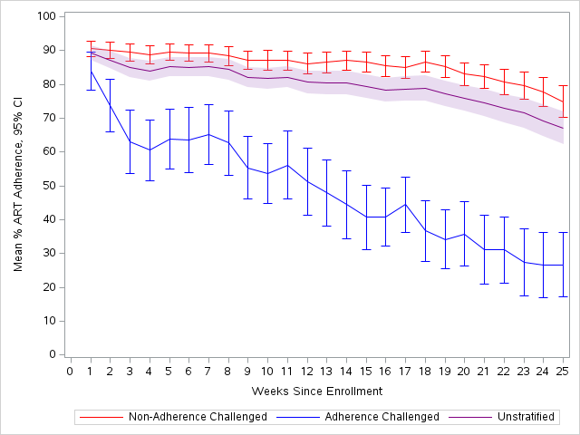
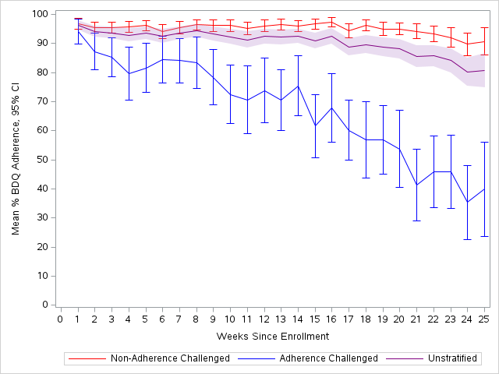
A
B
Panel A: Weekly mean antiretroviral (ART) adherence with 95% confidence intervals calculated weekly based on observed versus expected EDM openings through six months stratified by adherence challenged (<85% cumulative adherence). (N=283)
Panel B: Weekly mean bedaquiline (BDQ) adherence with 95% confidence intervals calculated weekly based on observed versus expected EDM openings through six month stratified by severe adherence challenged (<85% cumulative adherence). (N=283)

Slide 7
Focus Group Results
Qualitative analysis identified discrete treatment stages associated with specific barriers which, when aligned with quantitative data, suggests that declining medication adherence may relate to psychosocial, behavioral, and structural barriers.

Slide 8
Challenges at different treatment stages
Panel C: Qualitative stages of MDR-TB HIV treatment with thematically derived cross-cutting and stage-specific treatment challenges derived from longitudinal focus groups (14 focus group discussions; 55 total participants).

Slide 9
Roles for the public health social worker at different stages of treatment
Stage 1: Treatment initiation Getting adjusted to treatment -supporting ART adherence through BDQ treatment initiation, delivering MDR-TB treatment counseling, and facilitating connection to social services. Education that includes family and community may alleviate stigma and electronic-dose monitoring that incorporates text-message reminders may support adherence.
Stage 2: Early continuation phase Reintegration into the community. Peer support should be cultivated to help people cope with experiences of stigma. Weekend activities (including alcohol and substance use) may arise, and patients may need support/harm reduction options. Case management to help with healthcare fragmentation and access.
Stage 3: Treatment continuity Recognizing disruptions, sticking to the plan financial security and relationship (re-) building. Strategies for streamlining community-based delivery of TB medication individual counseling, referrals to mental health and harm reduction services as needed, and financial and structural supports

Slide 10
Framework for DSD:
Longitudinal evidence-based assessment of adherence and treatment progression, which may include EDM and/or risk-factor assessment,
Titration of care to individual needs, especially at critical junctions in the treatment course such as hospital discharge,
Multi-modal adherence support, which may include SMS adherence reminders and adherence support groups,
Interventions linked to discrete treatment stages that account for psychosocial, behavioral, and structural challenges.
Public Health Social Workers can develop relationships so they can help develop patient-centered care plans to support medication adherence and care engagement and help people get through the long process of MDR-TB treatment

Slide 11
CONCLUSIONS
Based on these data, MDR-TB HIV DSD frameworks should
intensify support for severely adherence-challenged subpopulations while adherent patients may require less intensive support,
address decreased adherence over time and
Provide support for psychosocial, behavioral, and structural challenges linked to discrete treatment stages.
DSD models that offer evaluation and intervention at key stages, tailored to needs of individuals, have the potential to improve adherence and outcomes in the treatment of people with MDR-TB and HIV.
Public Health Social Workers have a key role to play.

Slide 12
References:
International AIDS Society. Differentiated Service Delivery for HIV Treatment: Summary of Published Evidence [Internet]. 2020 Nov. Available from: www.differentiatedservicedelivery.org
Tran CH, Moore BK, Pathmanathan I, Lungu P, Shah NS, Oboho I, et al. Tuberculosis treatment within differentiated service delivery models in global HIV/TB programming. J Int AIDS Soc [Internet]. 2021 Oct [cited 2023 Jan 29];24(S6). Available from: https://onlinelibrary.wiley.com/doi/10.1002/jia2.25809
Daftary A, Padayatchi N, O’Donnell M. Preferential adherence to antiretroviral therapy over tuberculosis treatment: A qualitative study of drug-resistant TB/HIV co-infected patients in South Africa. Glob Public Health. 2014 Oct 21;9(9):1107–16.
Bionghi N, Daftary A, Maharaj B, Msibi Z, Amico KR, Friedland G, et al. Pilot evaluation of a second-generation electronic pill box for adherence to Bedaquiline and antiretroviral therapy in drug-resistant TB/HIV co-infected patients in KwaZulu-Natal, South Africa. BMC Infect Dis. 2018 Dec;18(1):171.
Zelnick JR, Daftary A, Hwang C, Labar AS, Boodhram R, Maharaj B, et al. Electronic Dose Monitoring Identifies a High-Risk Subpopulation in the Treatment of Drug-resistant Tuberculosis and Human Immunodeficiency Virus. Clin Infect Dis. 2021 Oct 5;73(7):e1901–10.
Daftary A, Mondal S, Zelnick J, Friedland G, Seepamore B, Boodhram R, et al. Dynamic needs and challenges of people with drug-resistant tuberculosis and HIV in South Africa: a qualitative study. Lancet Glob Health. 2021 Apr;9(4):e479–88.

Slide 13
Thank You!

