Slide 1

MITIGATING CHILD MALTREATMENT THROUGH ASSESSMENT IN CHILD PROTECTION SERVICES: A SOUTH AFRICAN PERSPECTIVE

Slide 2
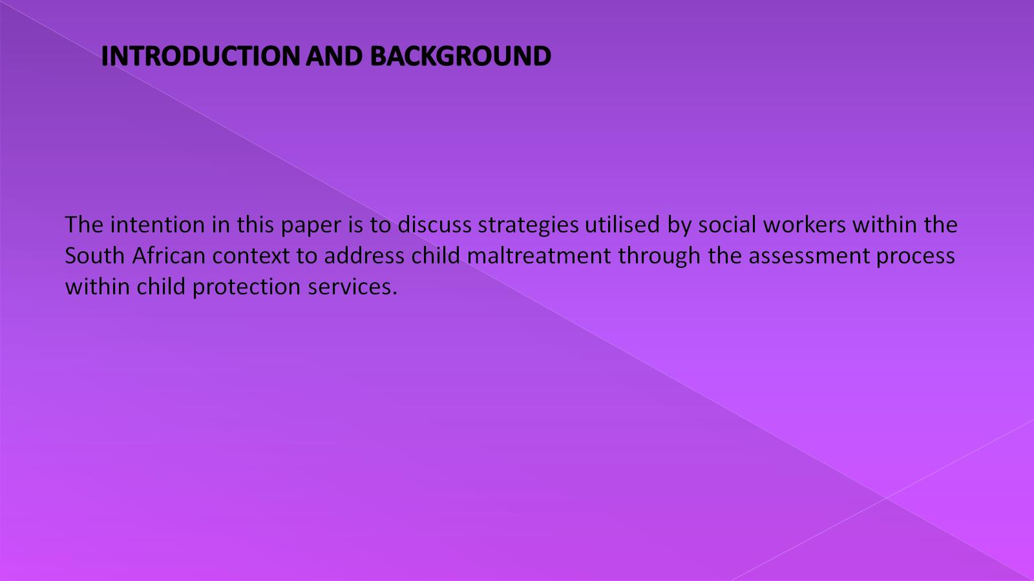
INTRODUCTION AND BACKGROUND

Slide 3
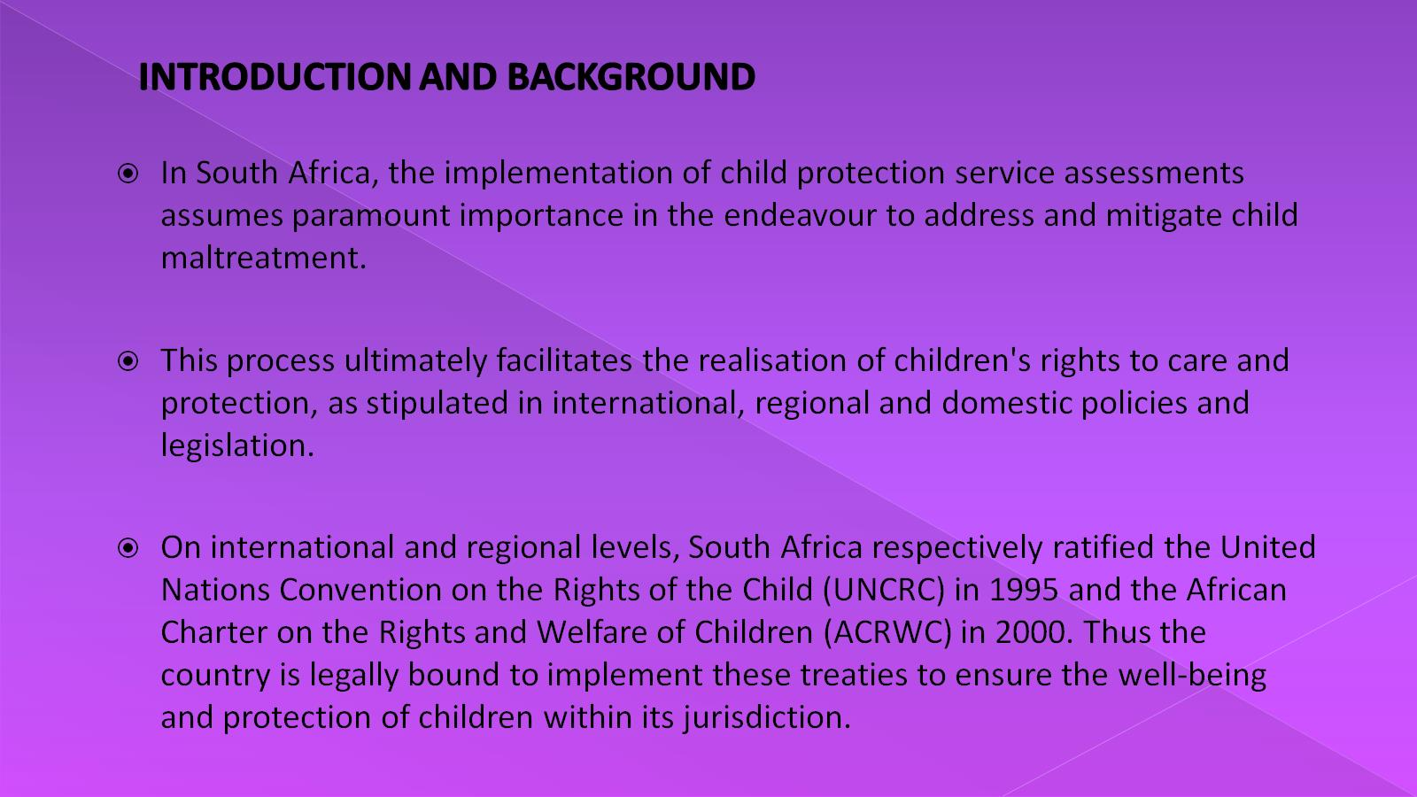
INTRODUCTION AND BACKGROUND

Slide 4
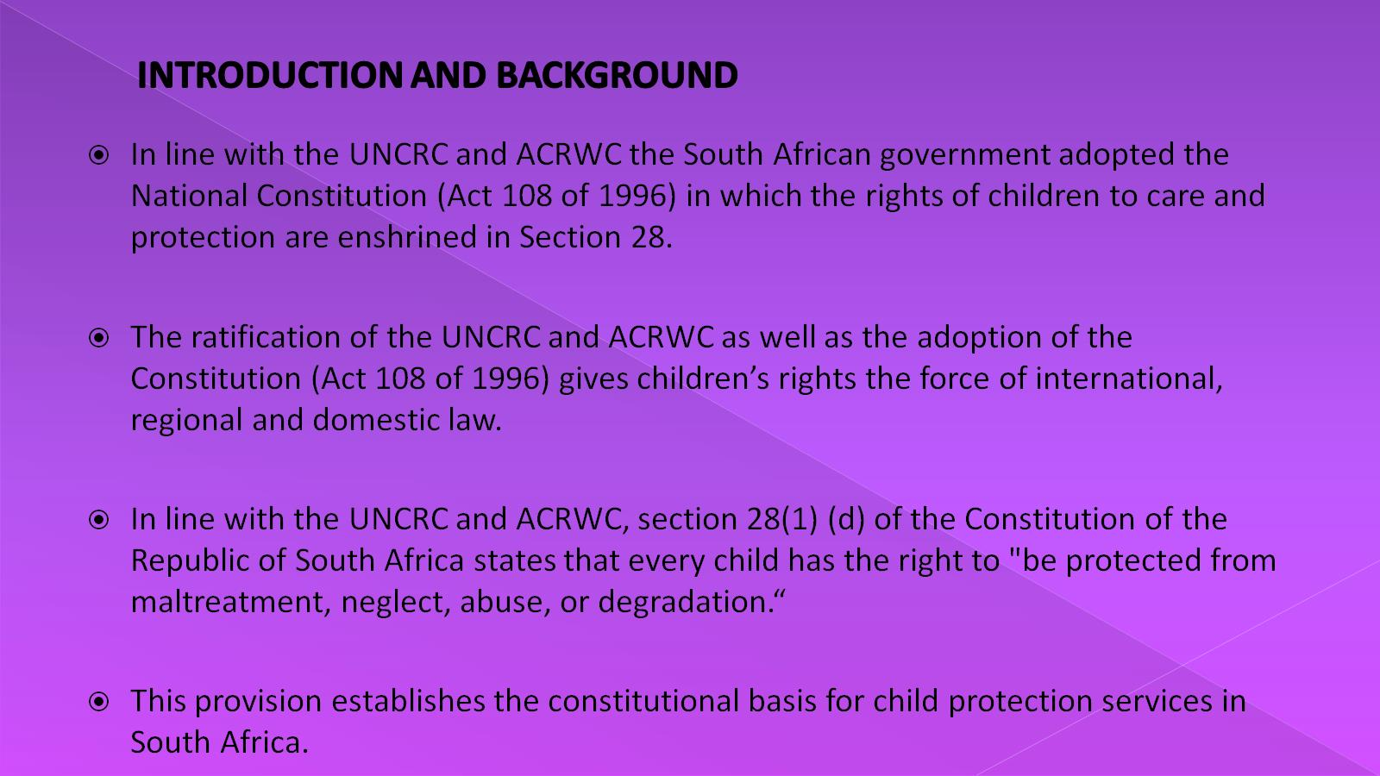
INTRODUCTION AND BACKGROUND

Slide 5
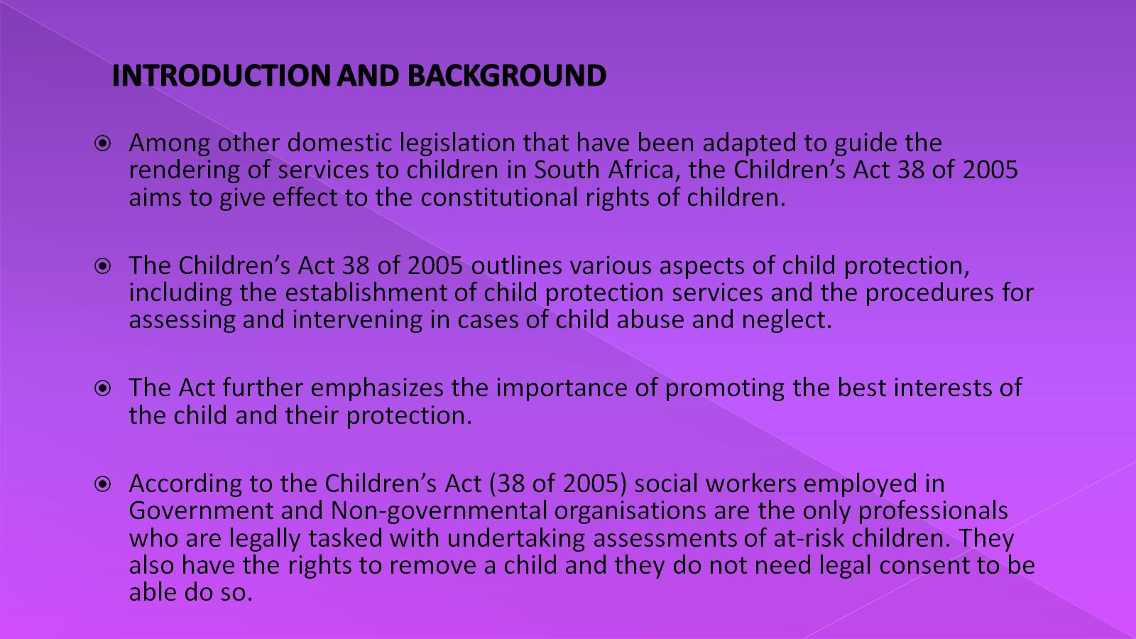
INTRODUCTION AND BACKGROUND

Slide 6
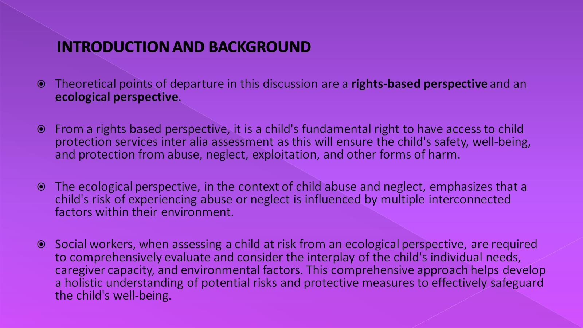
INTRODUCTION AND BACKGROUND

Slide 7
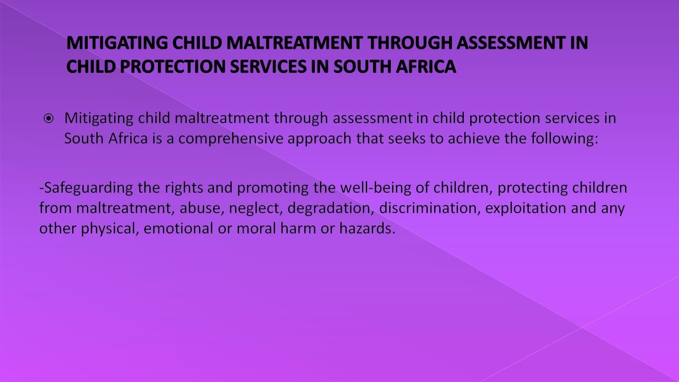
MITIGATING CHILD MALTREATMENT THROUGH ASSESSMENT IN CHILD PROTECTION SERVICES IN SOUTH AFRICA

Slide 8
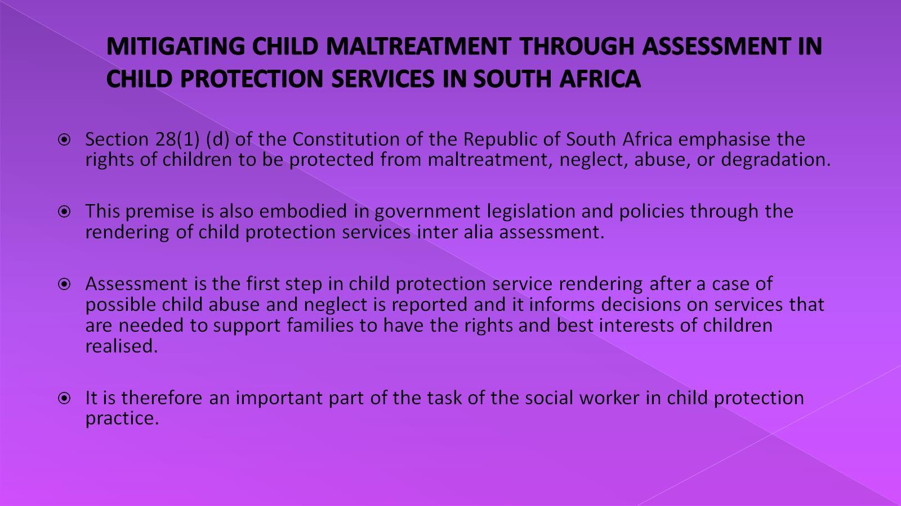
MITIGATING CHILD MALTREATMENT THROUGH ASSESSMENT IN CHILD PROTECTION SERVICES IN SOUTH AFRICA

Slide 9
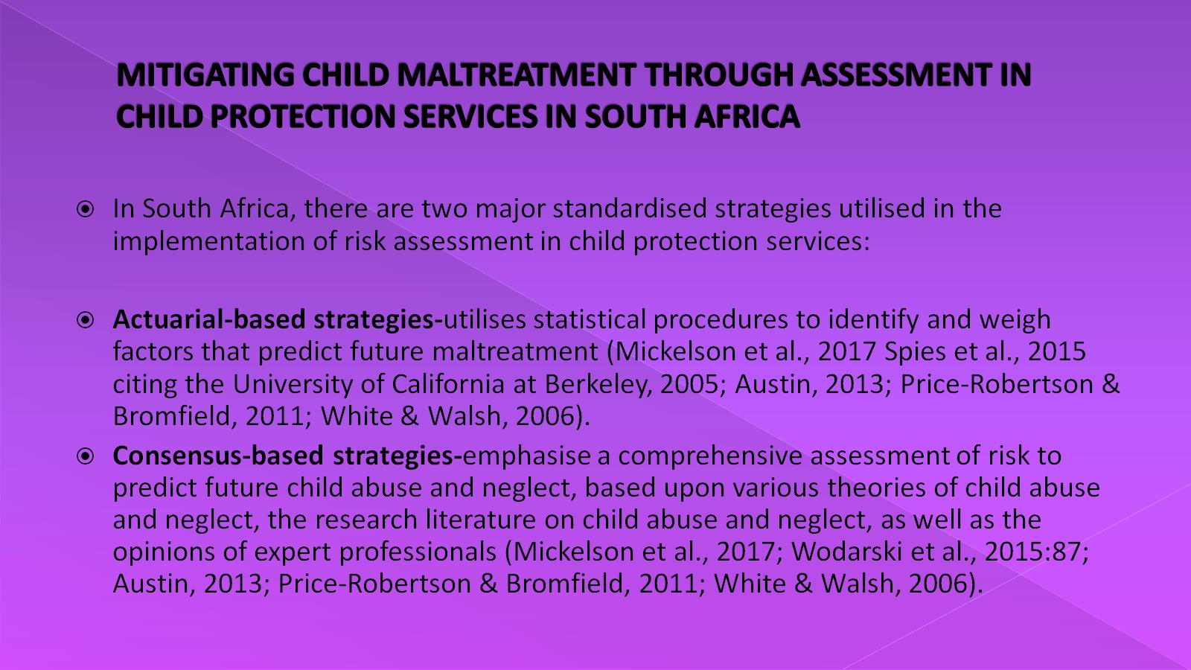
MITIGATING CHILD MALTREATMENT THROUGH ASSESSMENT IN CHILD PROTECTION SERVICES IN SOUTH AFRICA

Slide 10
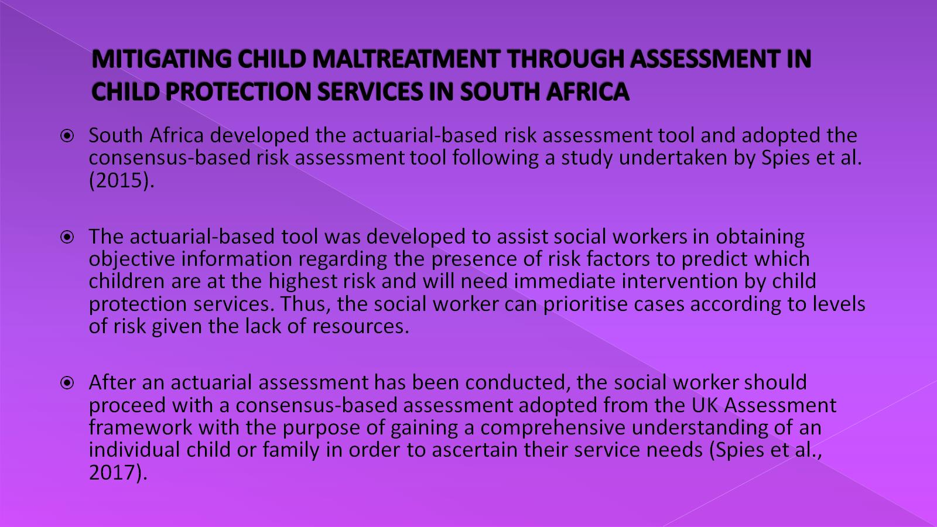
MITIGATING CHILD MALTREATMENT THROUGH ASSESSMENT IN CHILD PROTECTION SERVICES IN SOUTH AFRICA

Slide 11
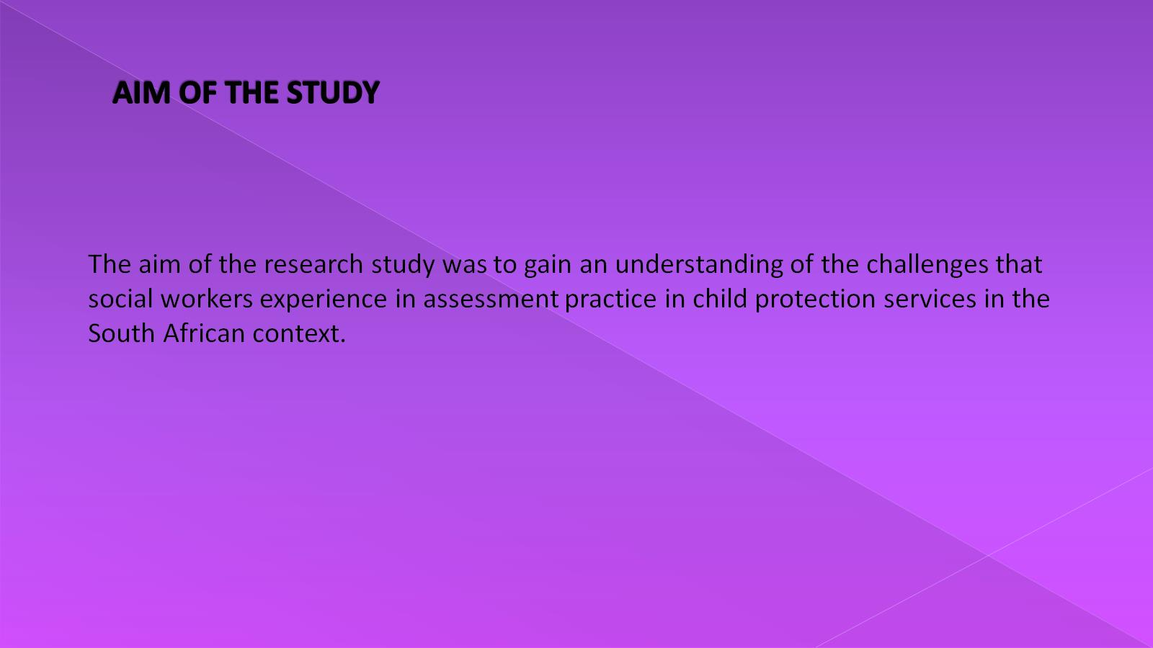
AIM OF THE STUDY

Slide 12
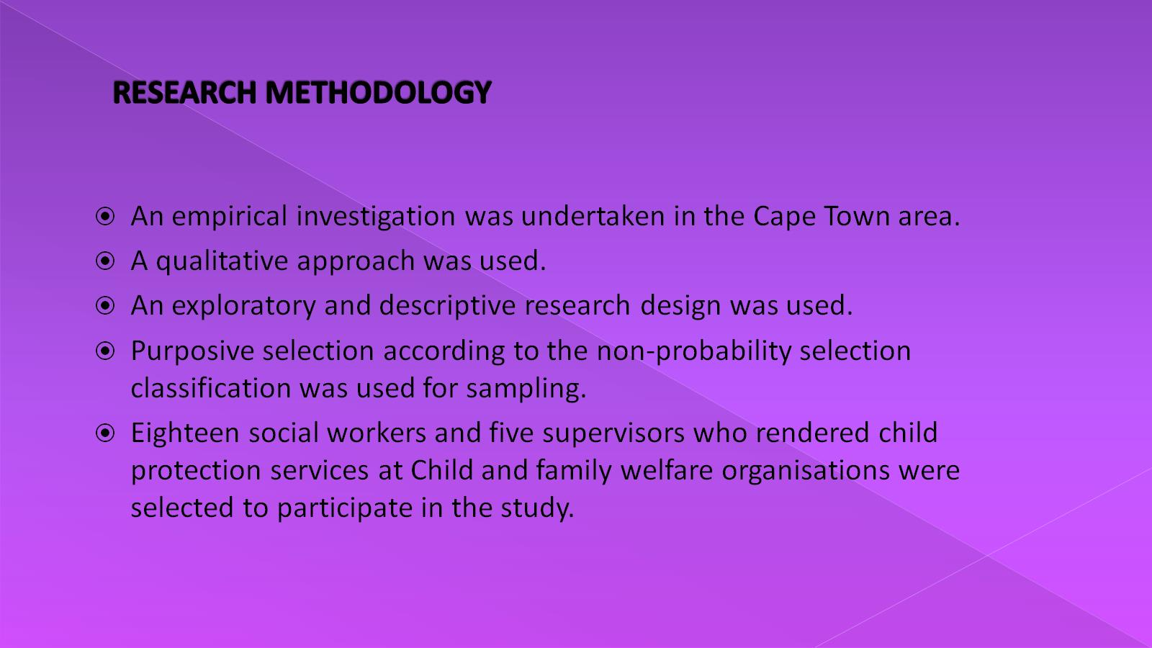
RESEARCH METHODOLOGY

Slide 13
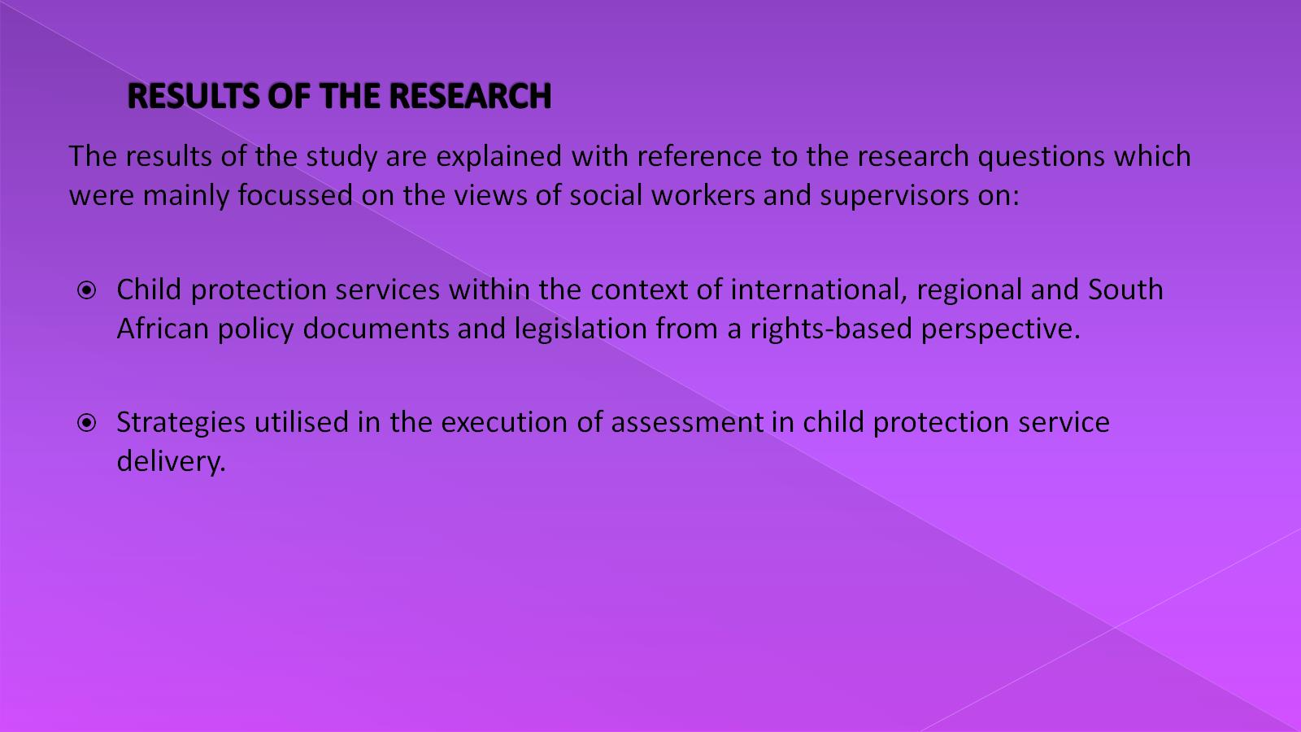
RESULTS OF THE RESEARCH

Slide 14
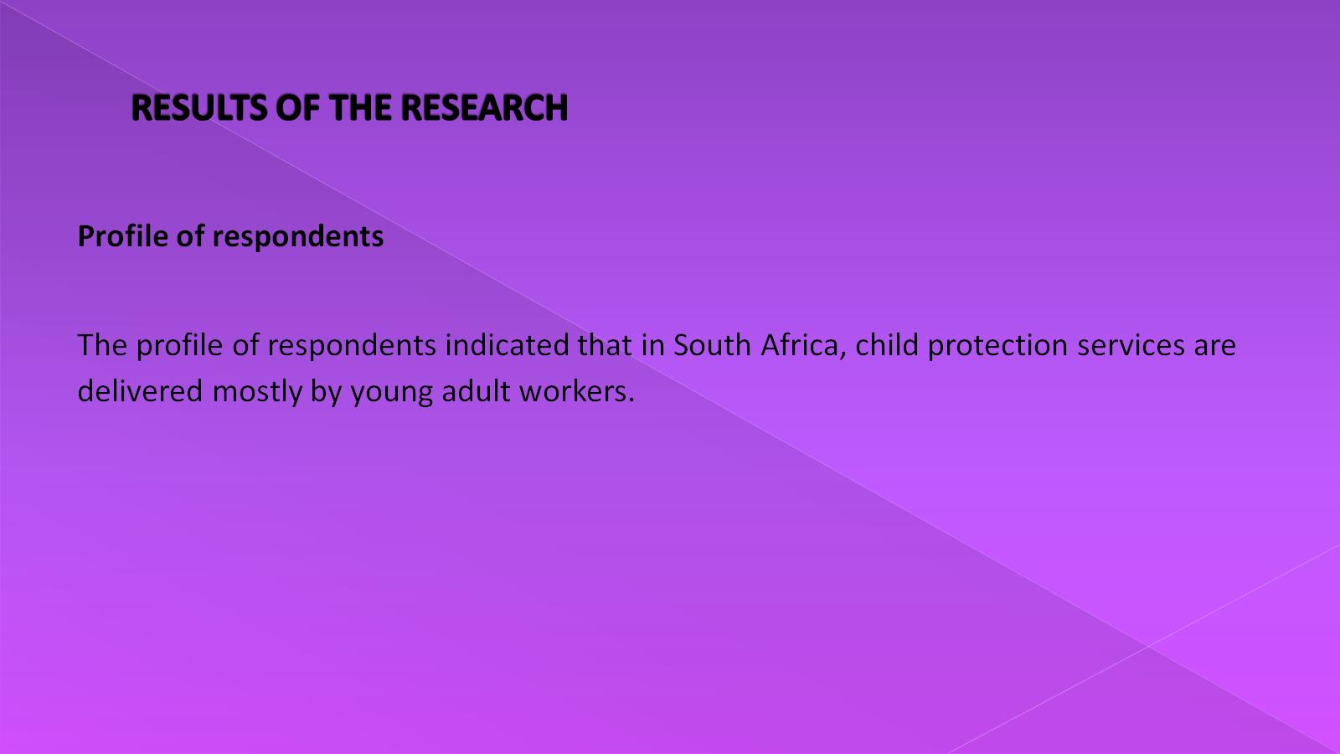
RESULTS OF THE RESEARCH

Slide 15
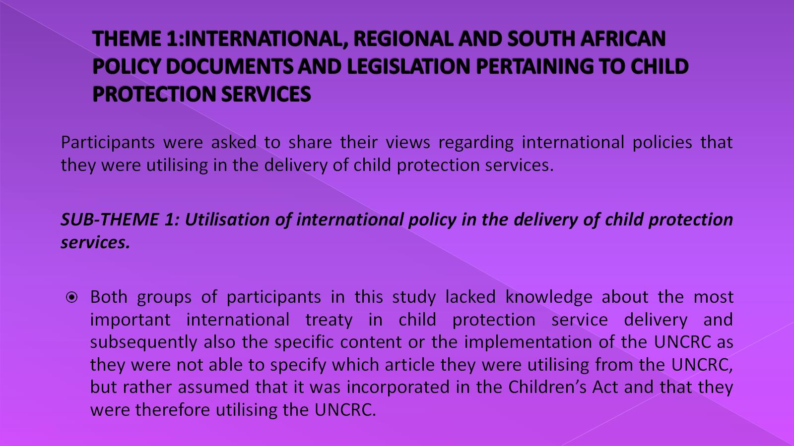
THEME 1:INTERNATIONAL, REGIONAL AND SOUTH AFRICAN POLICY DOCUMENTS AND LEGISLATION PERTAINING TO CHILD PROTECTION SERVICES

Slide 16
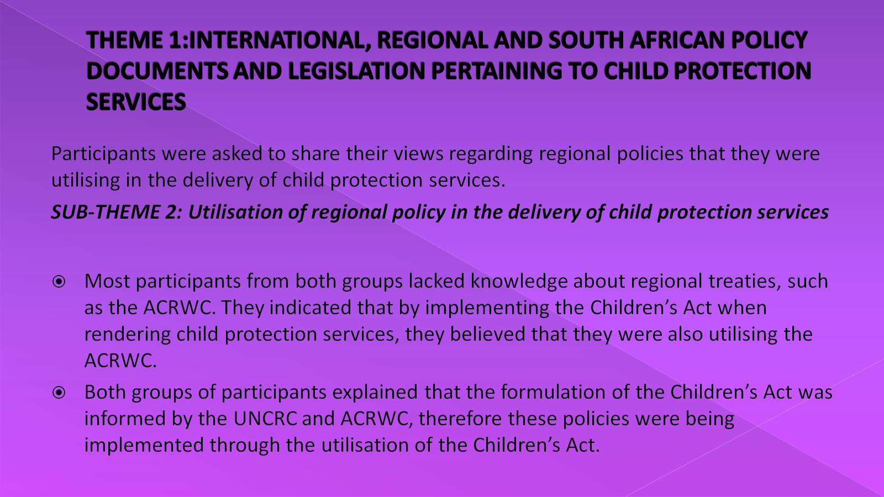
THEME 1:INTERNATIONAL, REGIONAL AND SOUTH AFRICAN POLICY DOCUMENTS AND LEGISLATION PERTAINING TO CHILD PROTECTION SERVICES

Slide 17
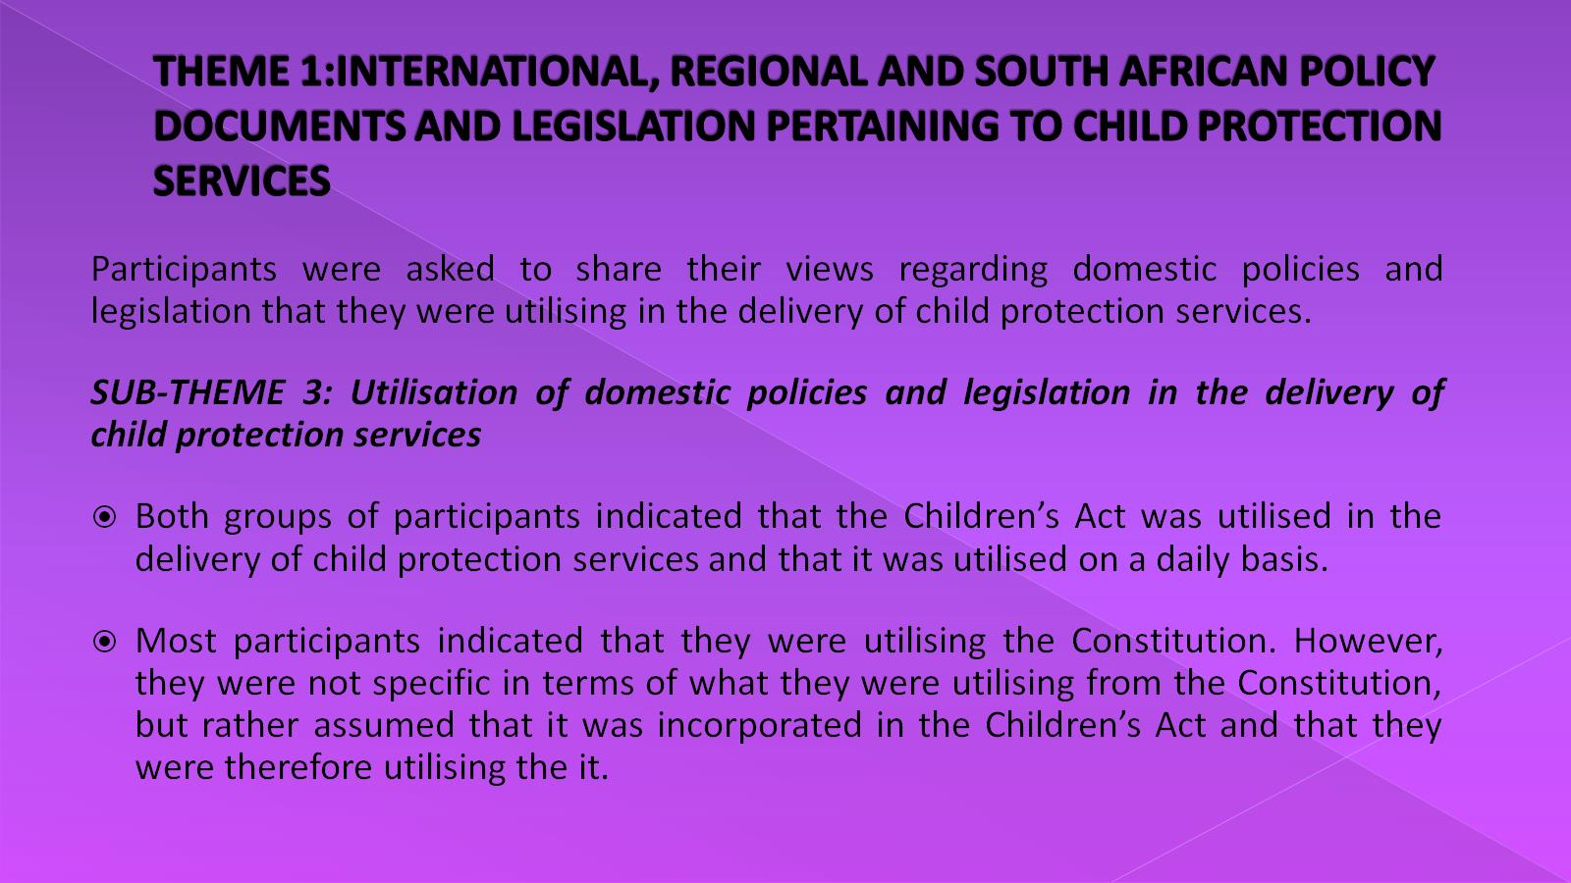
THEME 1:INTERNATIONAL, REGIONAL AND SOUTH AFRICAN POLICY DOCUMENTS AND LEGISLATION PERTAINING TO CHILD PROTECTION SERVICES

Slide 18
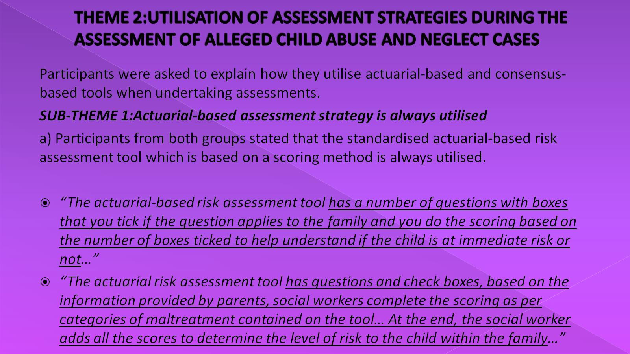
THEME 2:UTILISATION OF ASSESSMENT STRATEGIES DURING THE ASSESSMENT OF ALLEGED CHILD ABUSE AND NEGLECT CASES

Slide 19
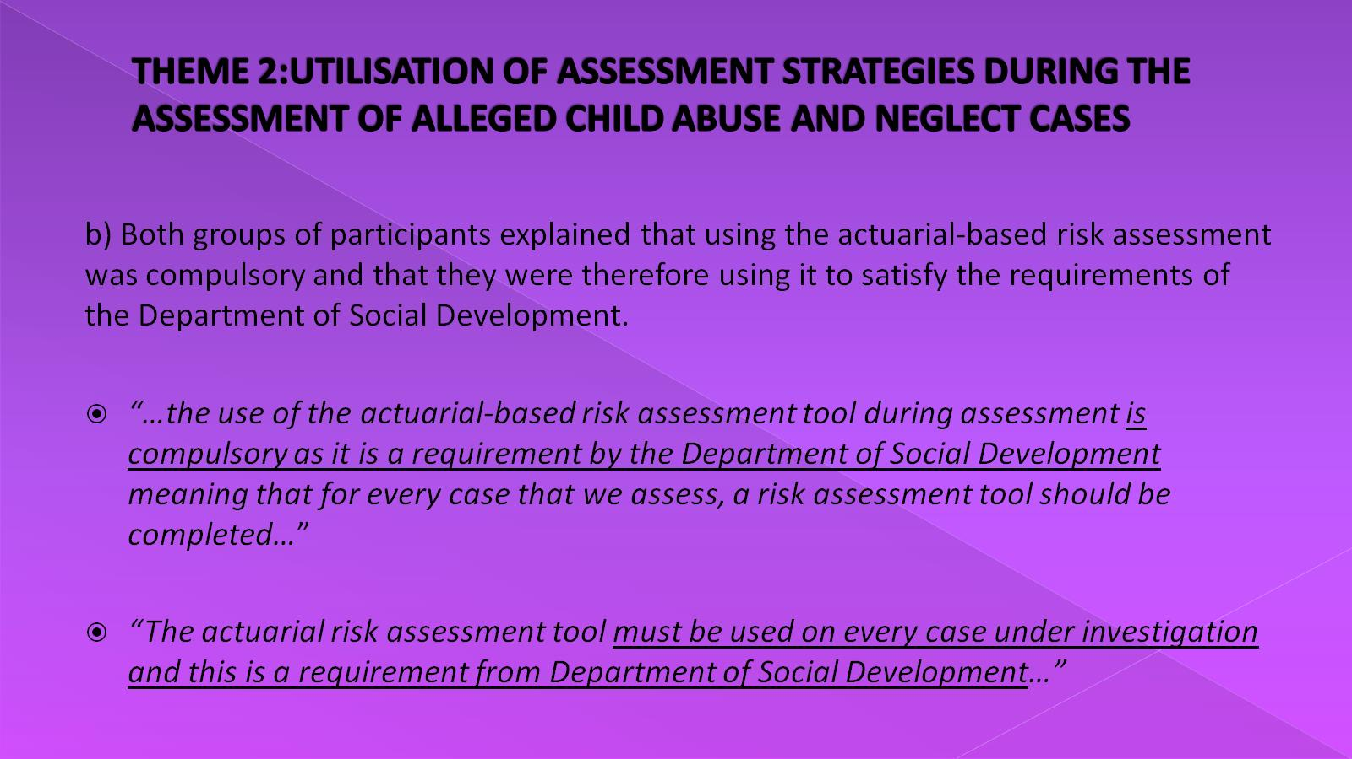
THEME 2:UTILISATION OF ASSESSMENT STRATEGIES DURING THE ASSESSMENT OF ALLEGED CHILD ABUSE AND NEGLECT CASES

Slide 20
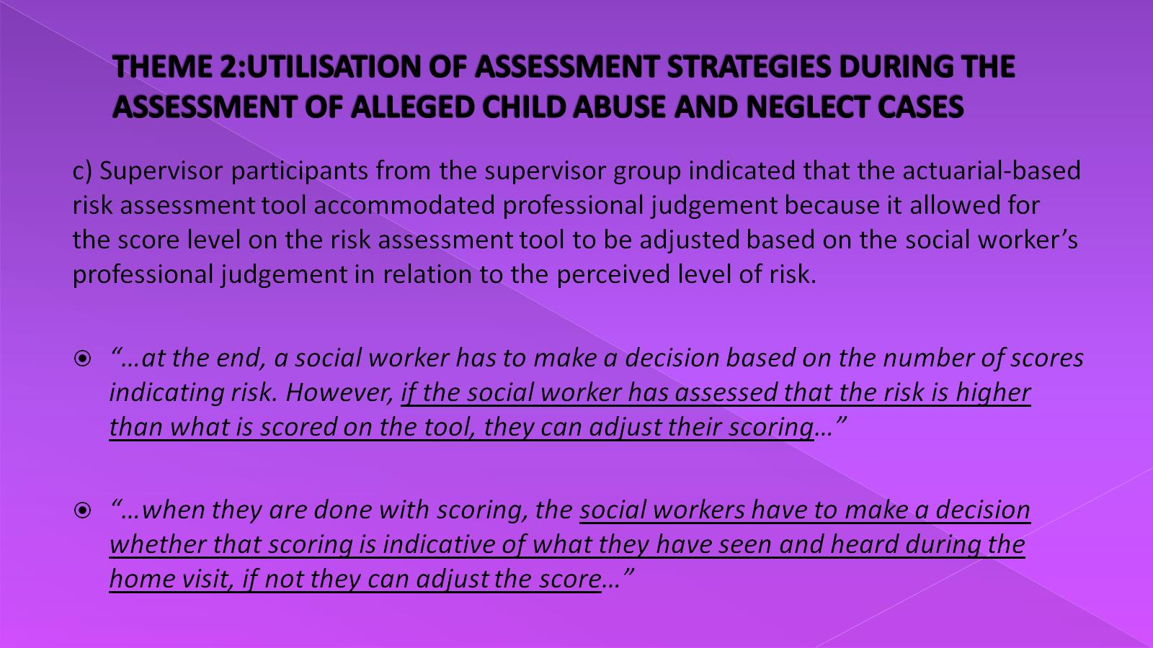
THEME 2:UTILISATION OF ASSESSMENT STRATEGIES DURING THE ASSESSMENT OF ALLEGED CHILD ABUSE AND NEGLECT CASES

Slide 21
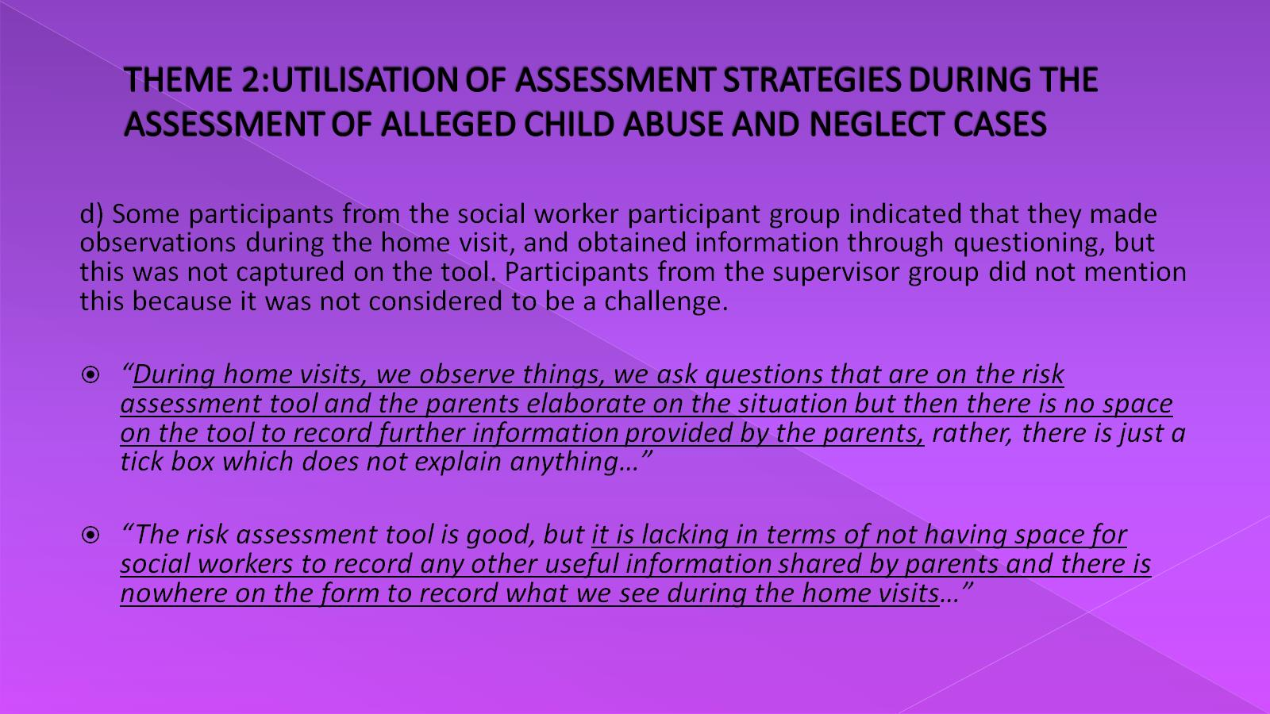
THEME 2:UTILISATION OF ASSESSMENT STRATEGIES DURING THE ASSESSMENT OF ALLEGED CHILD ABUSE AND NEGLECT CASES

Slide 22
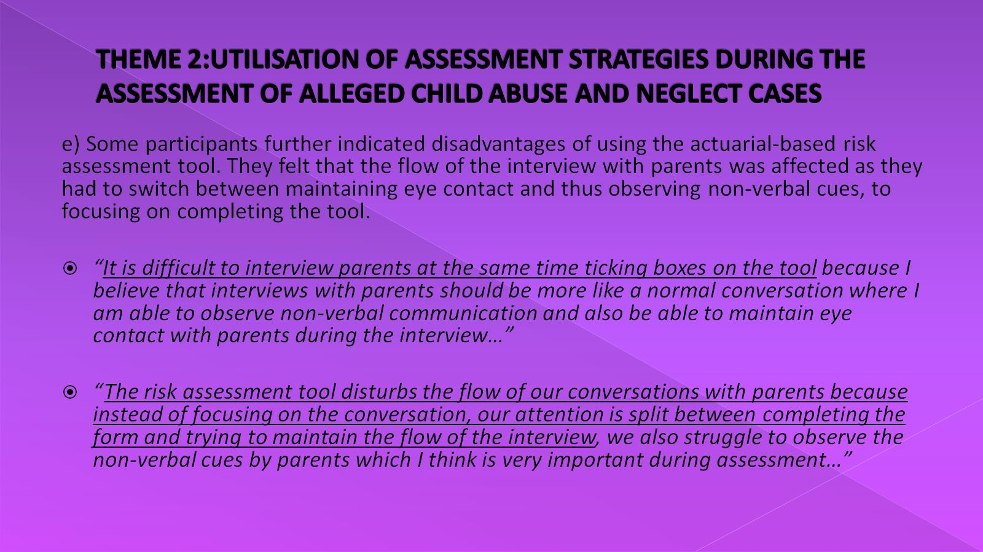
THEME 2:UTILISATION OF ASSESSMENT STRATEGIES DURING THE ASSESSMENT OF ALLEGED CHILD ABUSE AND NEGLECT CASES

Slide 23
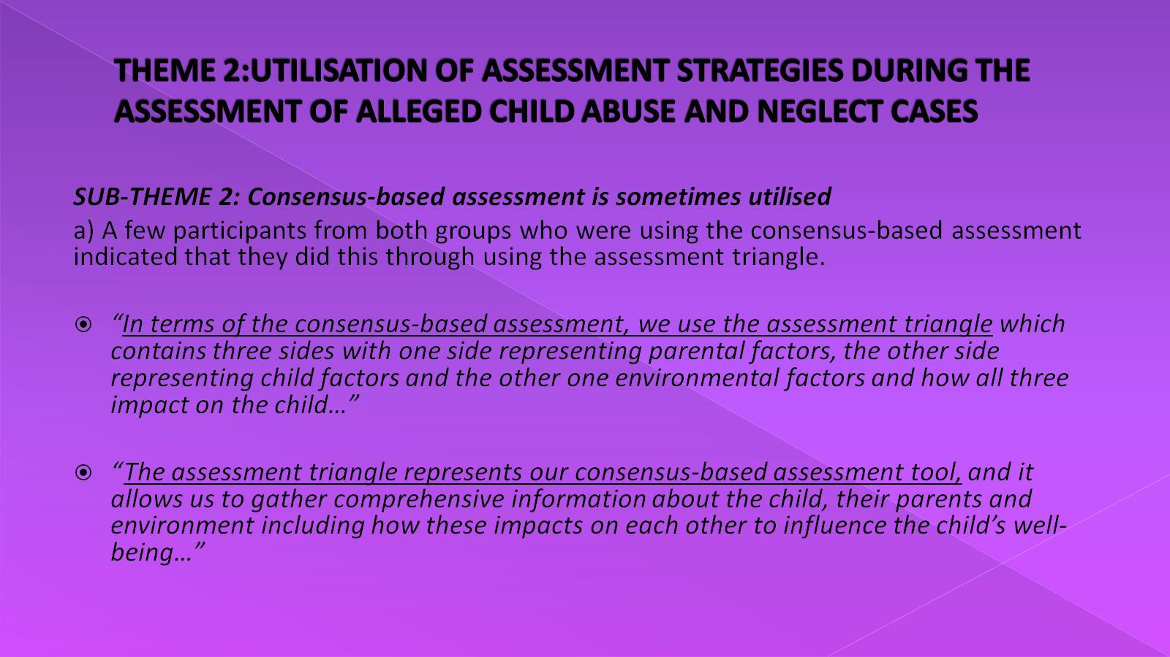
THEME 2:UTILISATION OF ASSESSMENT STRATEGIES DURING THE ASSESSMENT OF ALLEGED CHILD ABUSE AND NEGLECT CASES

Slide 24
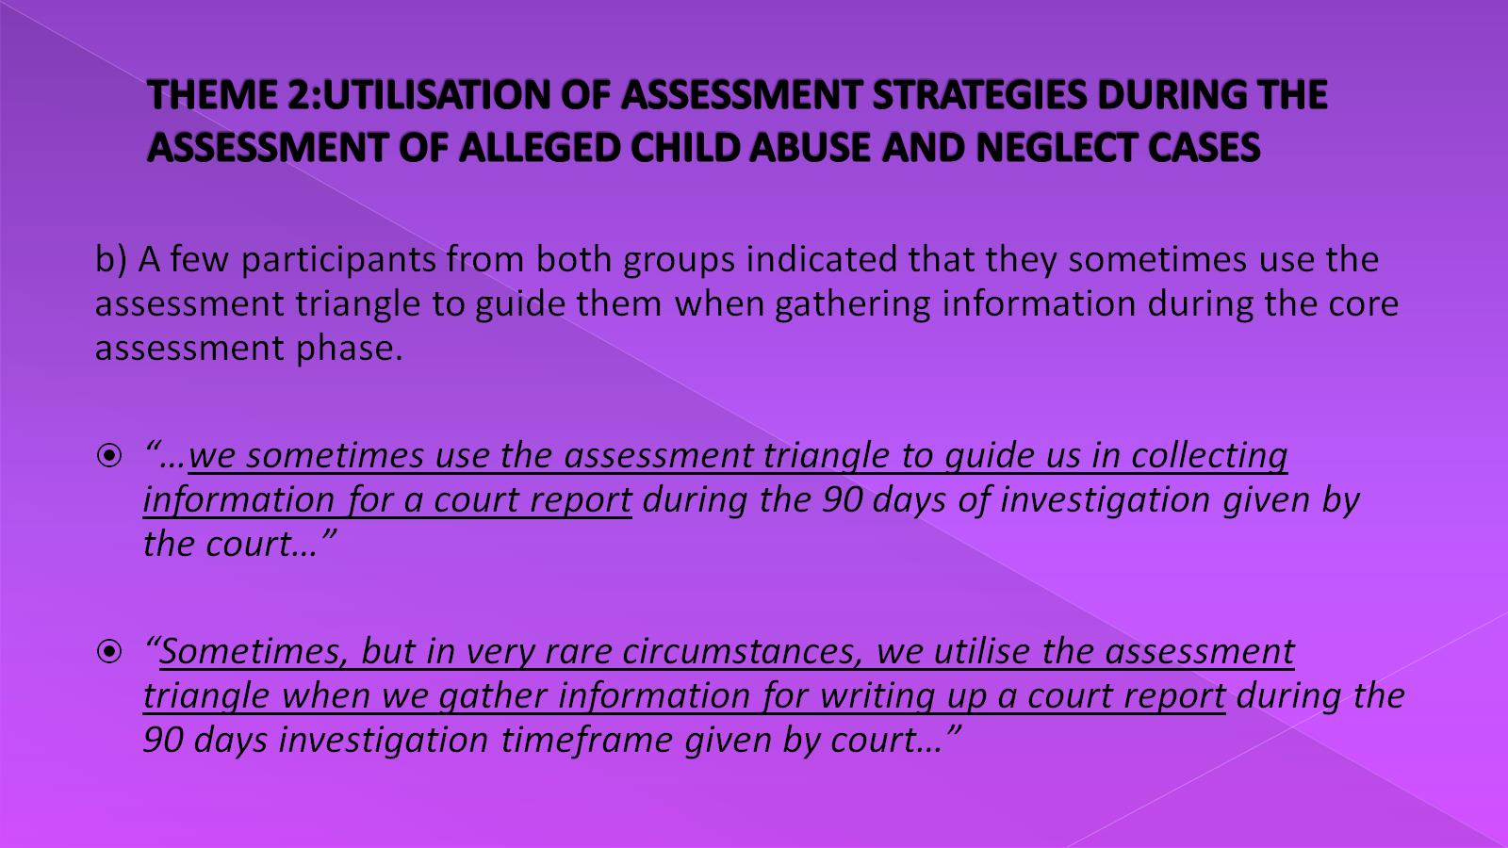
THEME 2:UTILISATION OF ASSESSMENT STRATEGIES DURING THE ASSESSMENT OF ALLEGED CHILD ABUSE AND NEGLECT CASES

Slide 25
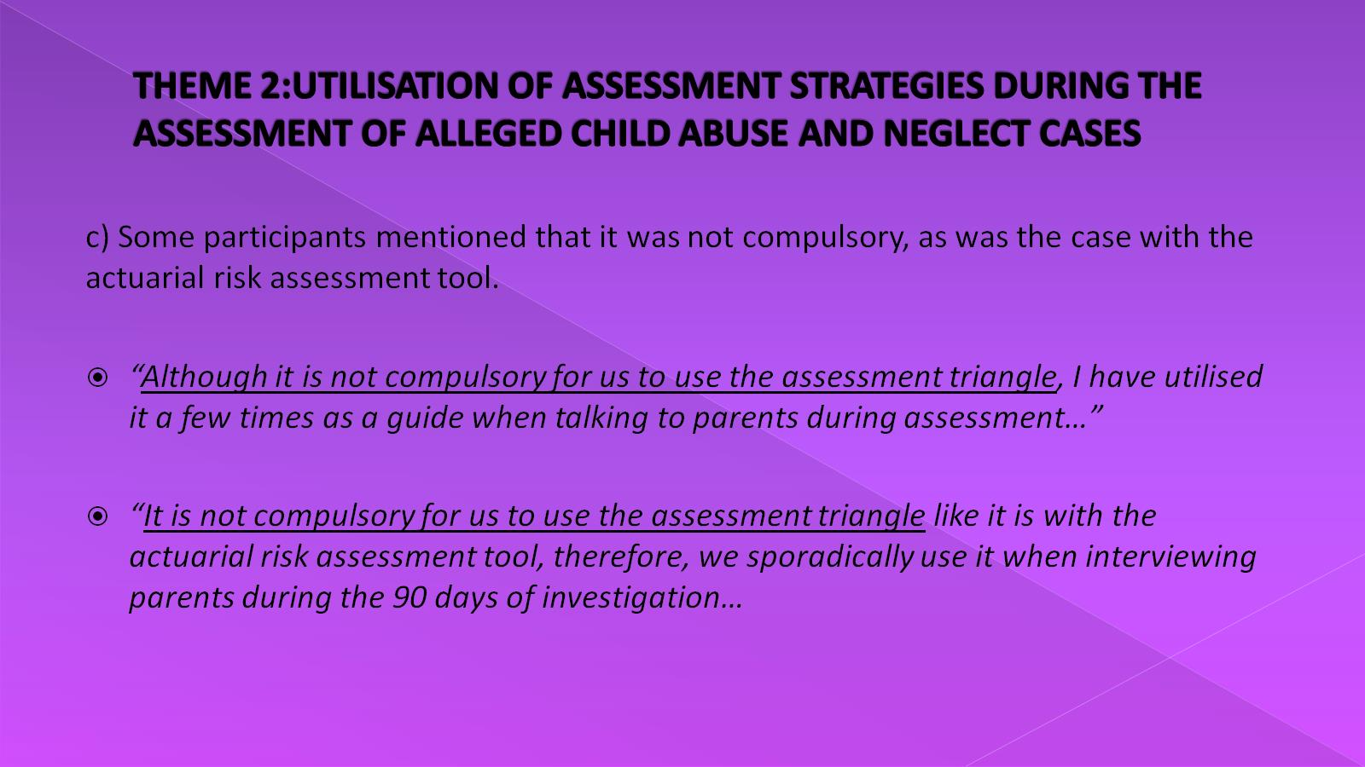
THEME 2:UTILISATION OF ASSESSMENT STRATEGIES DURING THE ASSESSMENT OF ALLEGED CHILD ABUSE AND NEGLECT CASES

Slide 26
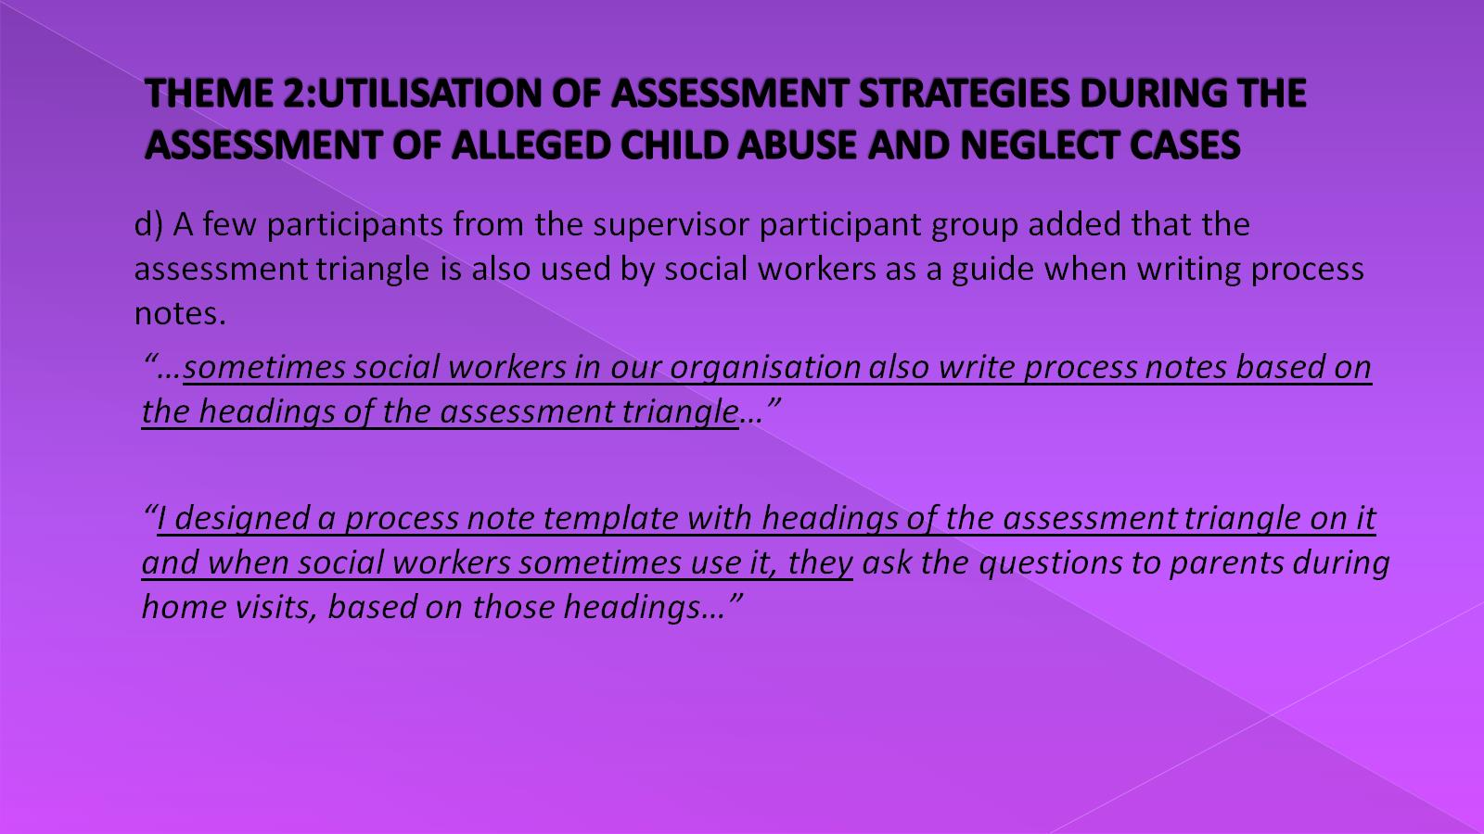
THEME 2:UTILISATION OF ASSESSMENT STRATEGIES DURING THE ASSESSMENT OF ALLEGED CHILD ABUSE AND NEGLECT CASES

Slide 27
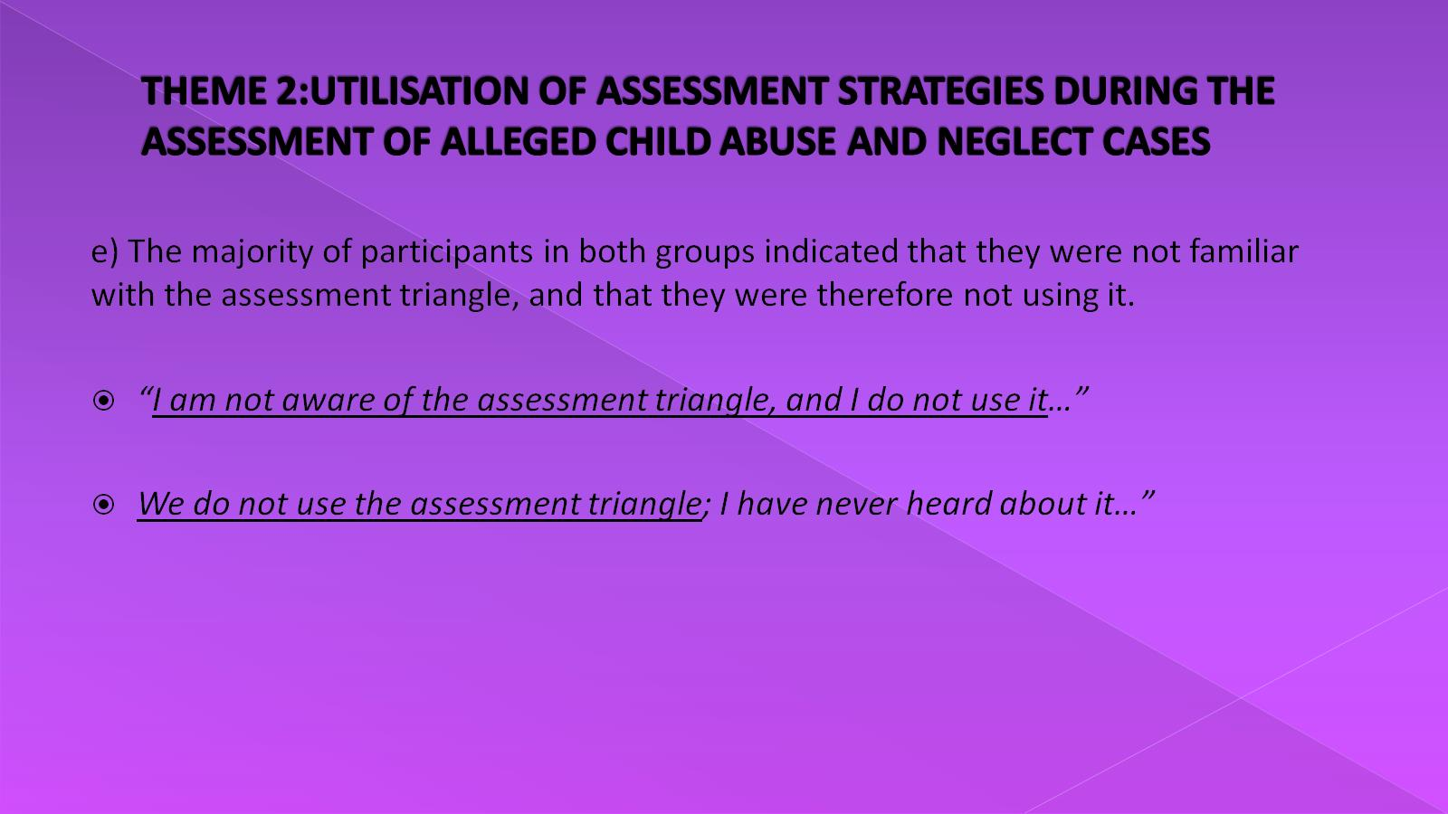
THEME 2:UTILISATION OF ASSESSMENT STRATEGIES DURING THE ASSESSMENT OF ALLEGED CHILD ABUSE AND NEGLECT CASES

Slide 28
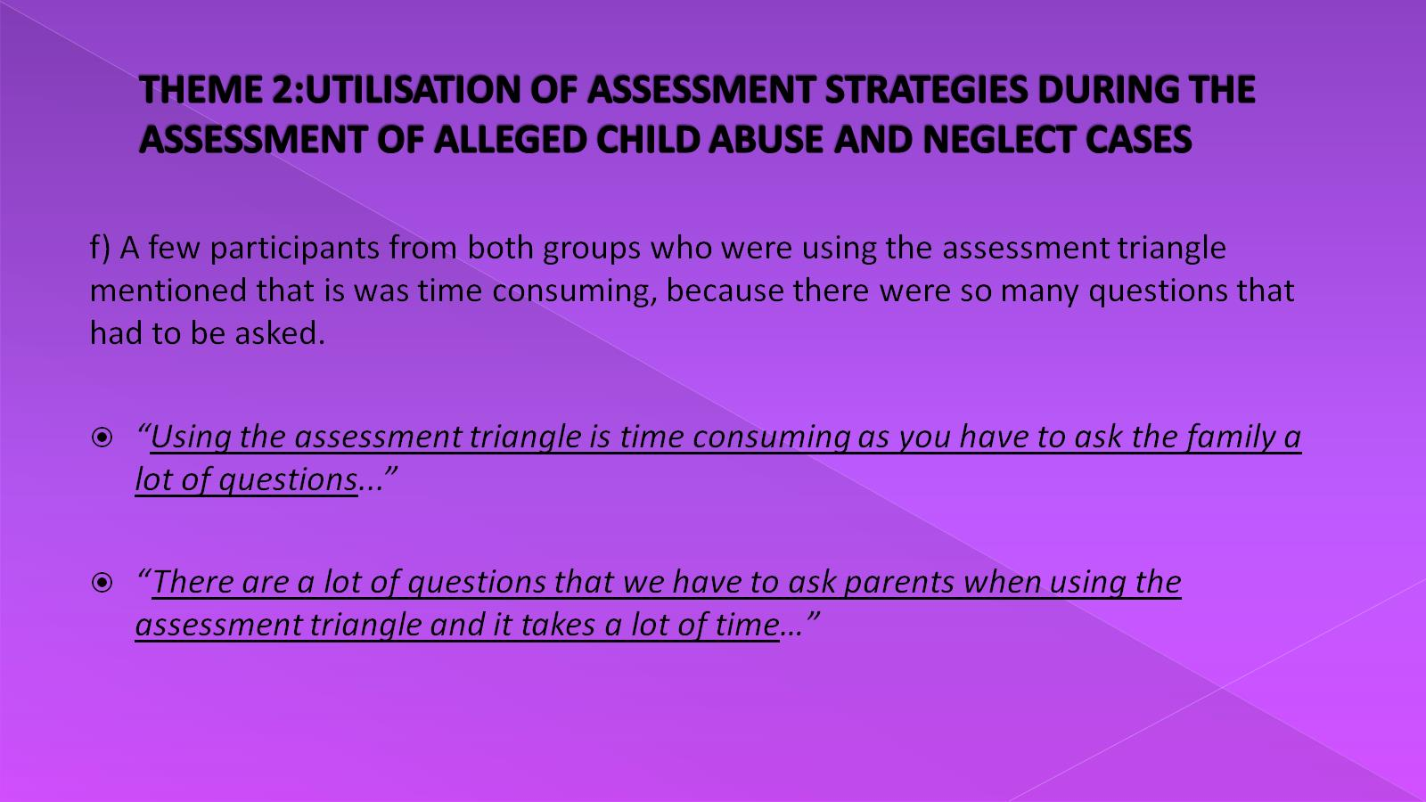
THEME 2:UTILISATION OF ASSESSMENT STRATEGIES DURING THE ASSESSMENT OF ALLEGED CHILD ABUSE AND NEGLECT CASES

Slide 29
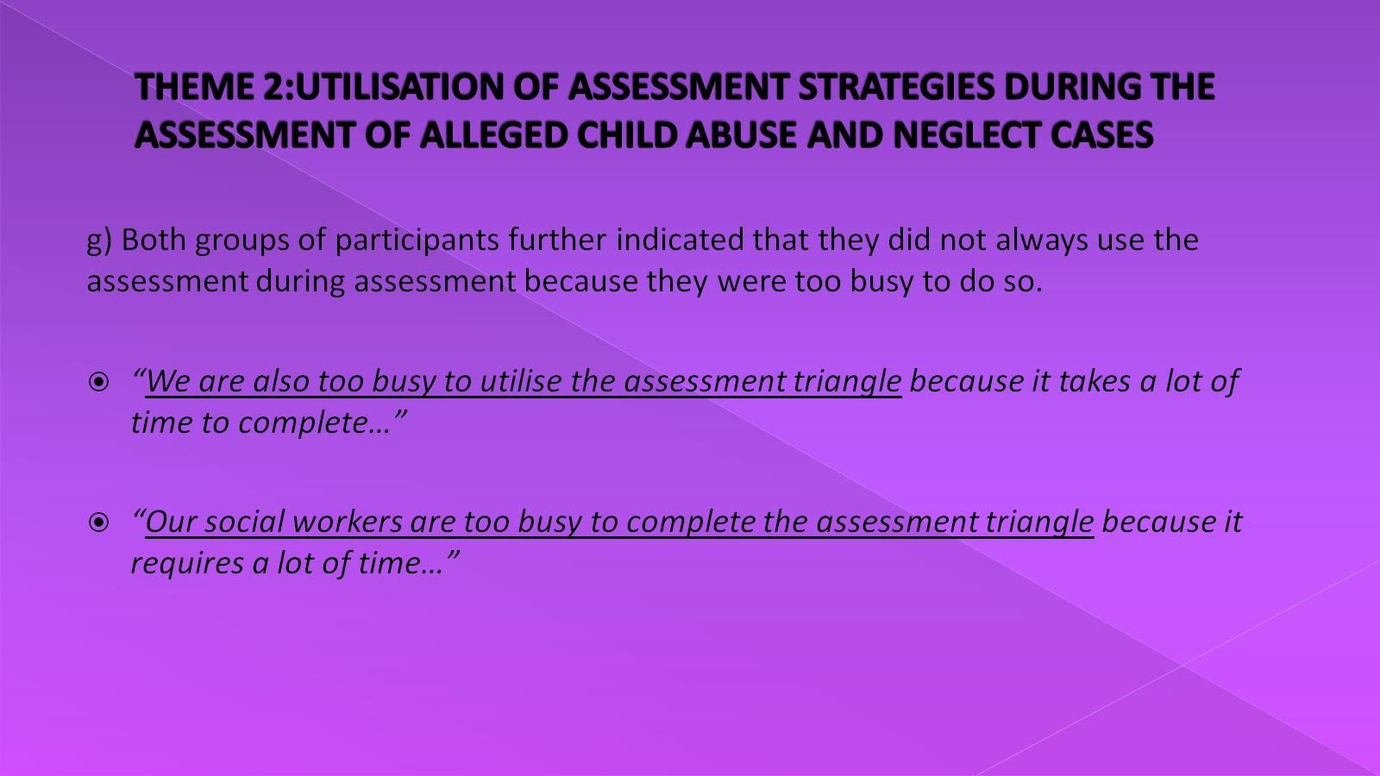
THEME 2:UTILISATION OF ASSESSMENT STRATEGIES DURING THE ASSESSMENT OF ALLEGED CHILD ABUSE AND NEGLECT CASES

Slide 30
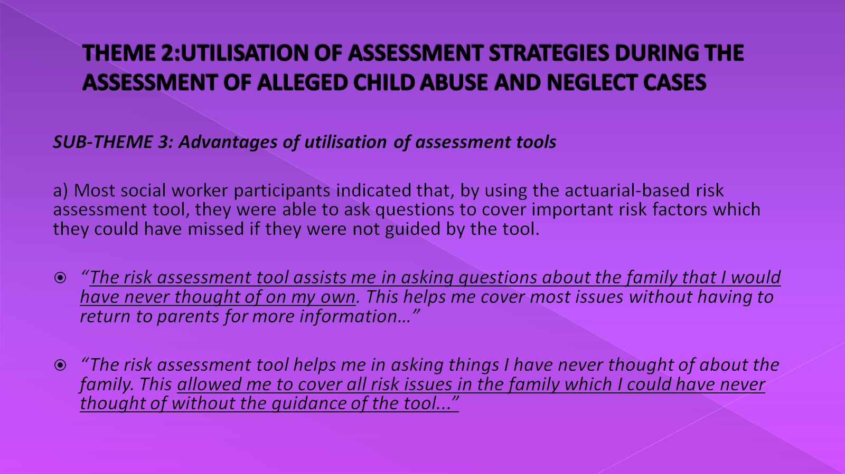
THEME 2:UTILISATION OF ASSESSMENT STRATEGIES DURING THE ASSESSMENT OF ALLEGED CHILD ABUSE AND NEGLECT CASES

Slide 31
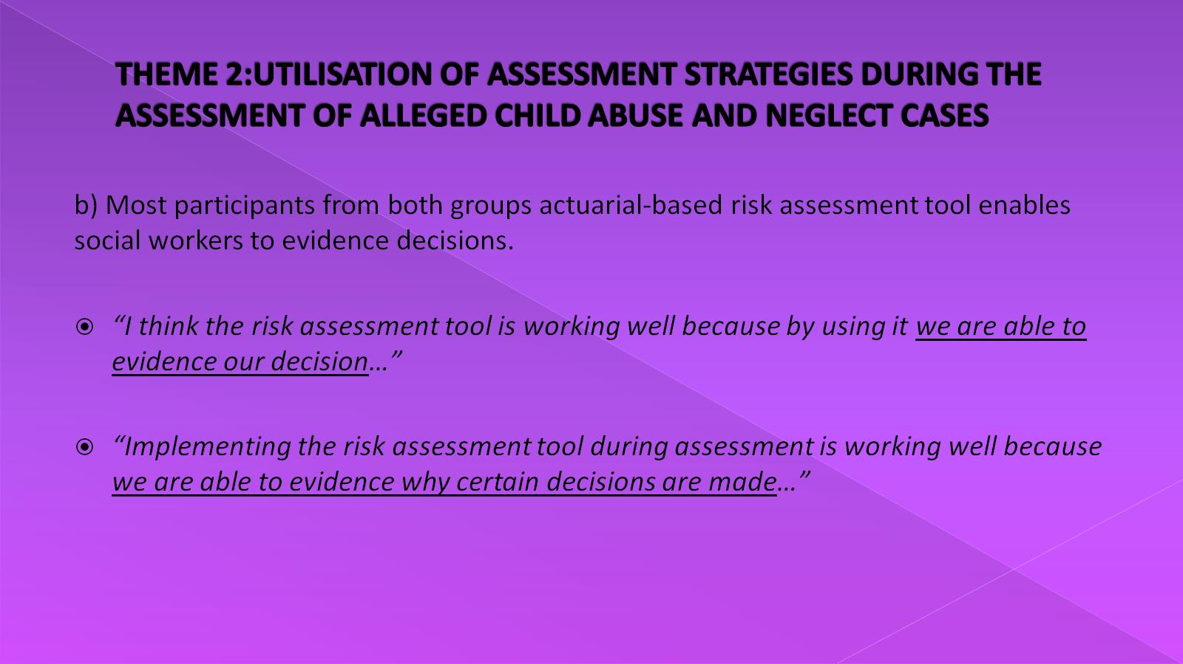
THEME 2:UTILISATION OF ASSESSMENT STRATEGIES DURING THE ASSESSMENT OF ALLEGED CHILD ABUSE AND NEGLECT CASES

Slide 32
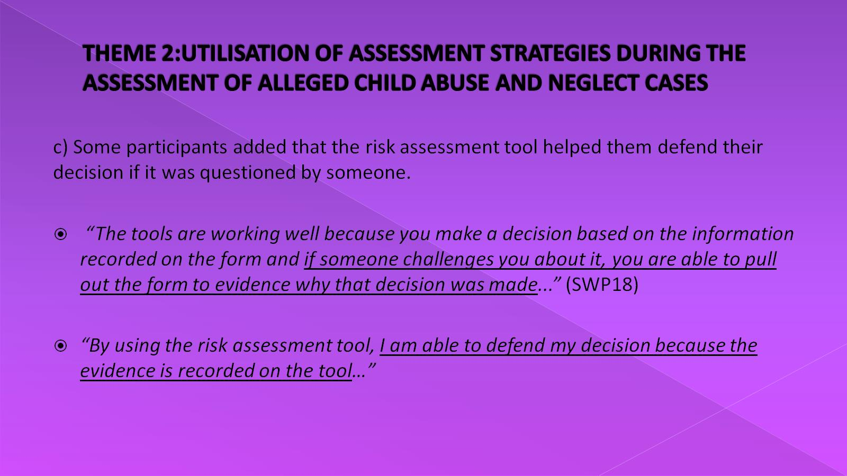
THEME 2:UTILISATION OF ASSESSMENT STRATEGIES DURING THE ASSESSMENT OF ALLEGED CHILD ABUSE AND NEGLECT CASES

Slide 33
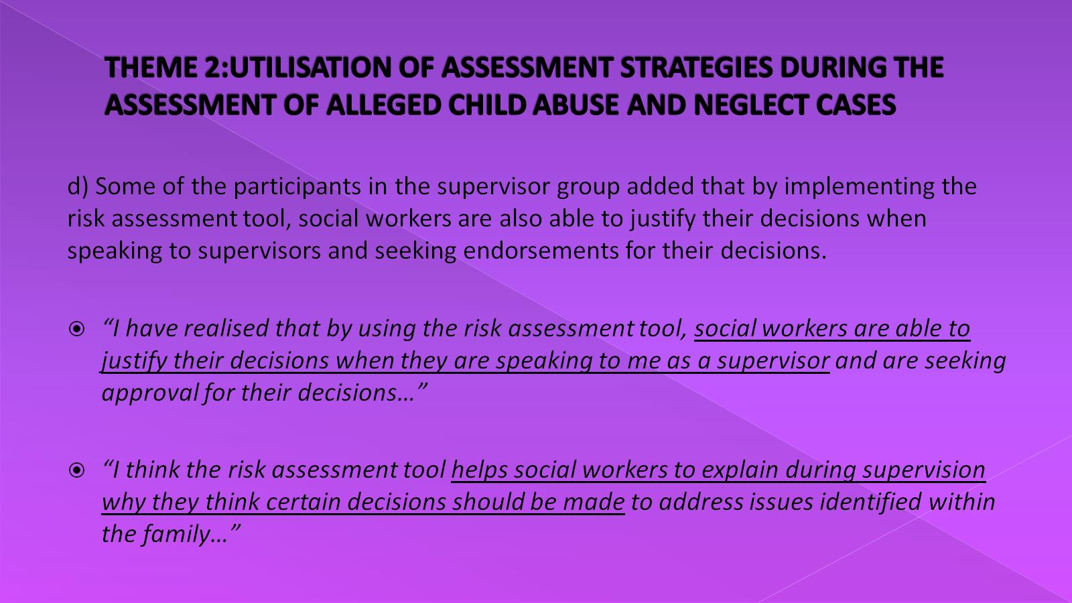
THEME 2:UTILISATION OF ASSESSMENT STRATEGIES DURING THE ASSESSMENT OF ALLEGED CHILD ABUSE AND NEGLECT CASES

Slide 34
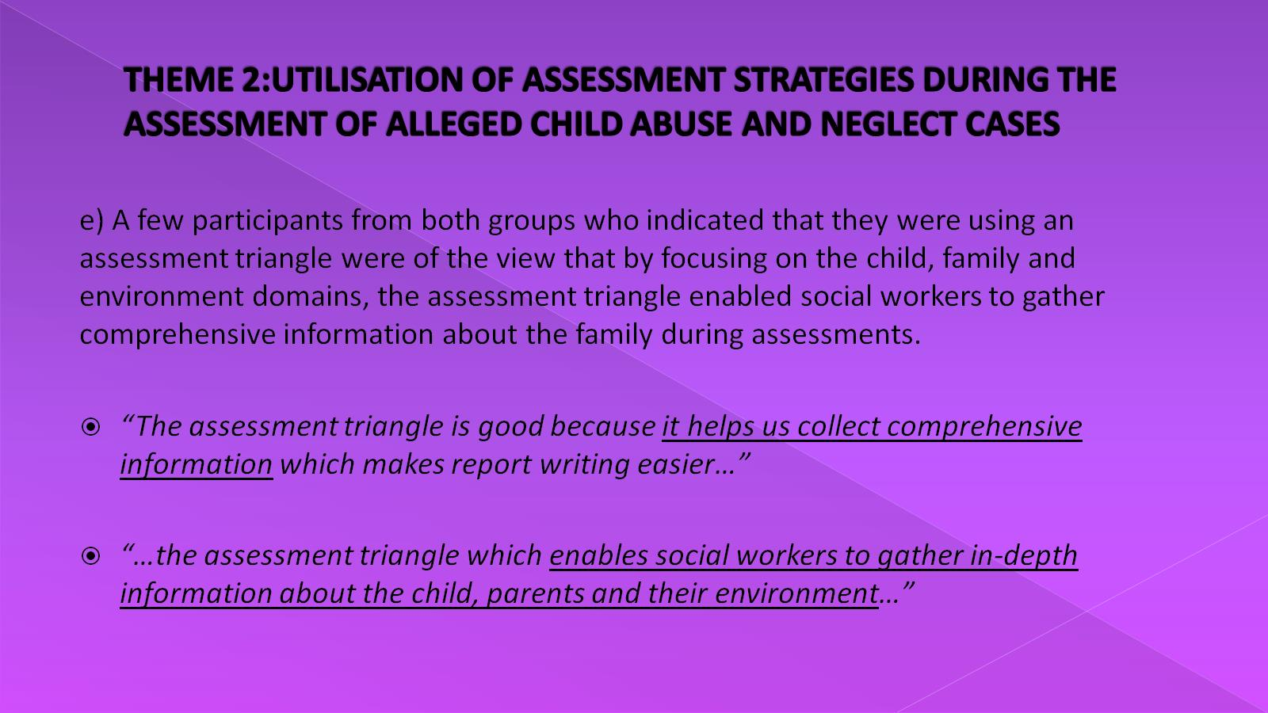
THEME 2:UTILISATION OF ASSESSMENT STRATEGIES DURING THE ASSESSMENT OF ALLEGED CHILD ABUSE AND NEGLECT CASES

Slide 35
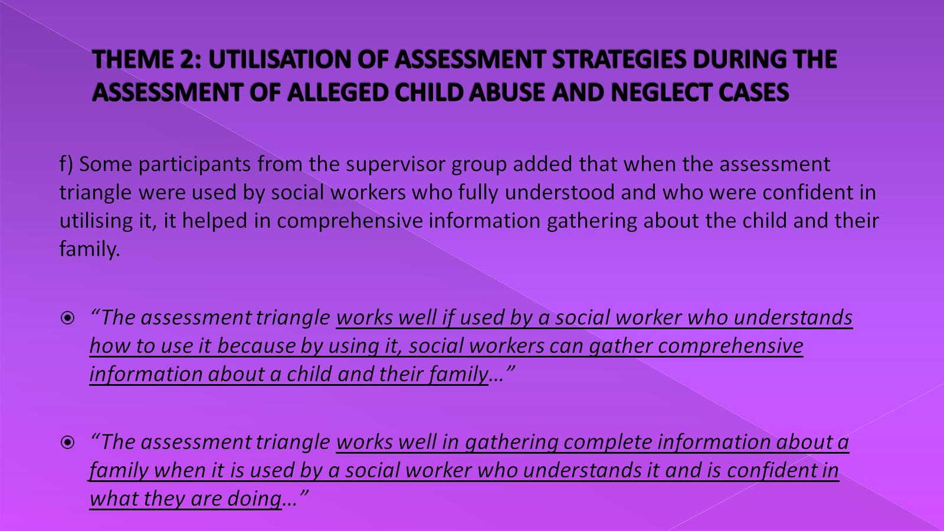
THEME 2: UTILISATION OF ASSESSMENT STRATEGIES DURING THE ASSESSMENT OF ALLEGED CHILD ABUSE AND NEGLECT CASES

Slide 36
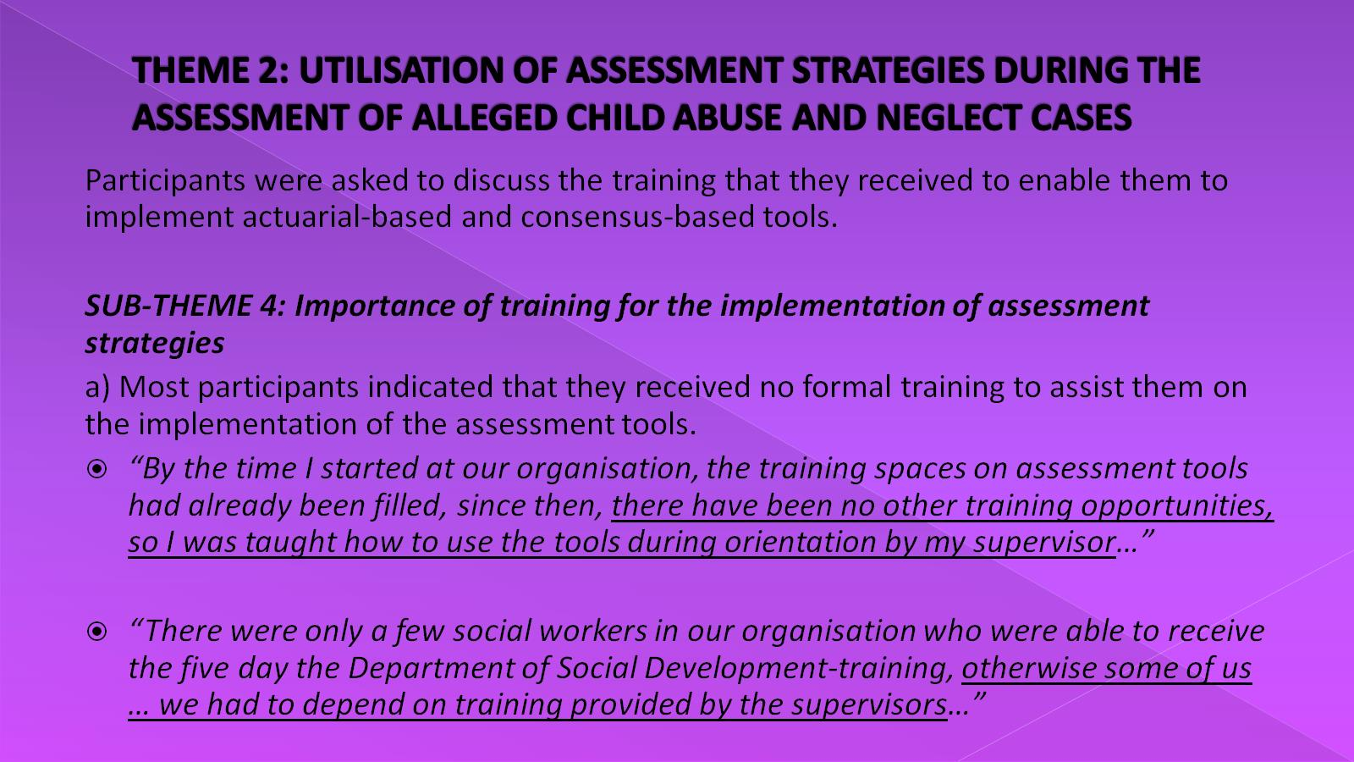
THEME 2: UTILISATION OF ASSESSMENT STRATEGIES DURING THE ASSESSMENT OF ALLEGED CHILD ABUSE AND NEGLECT CASES

Slide 37
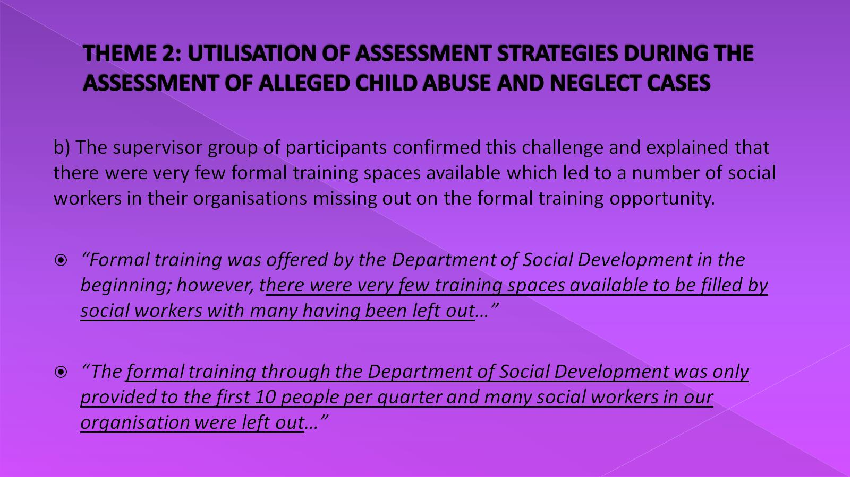
THEME 2: UTILISATION OF ASSESSMENT STRATEGIES DURING THE ASSESSMENT OF ALLEGED CHILD ABUSE AND NEGLECT CASES

Slide 38
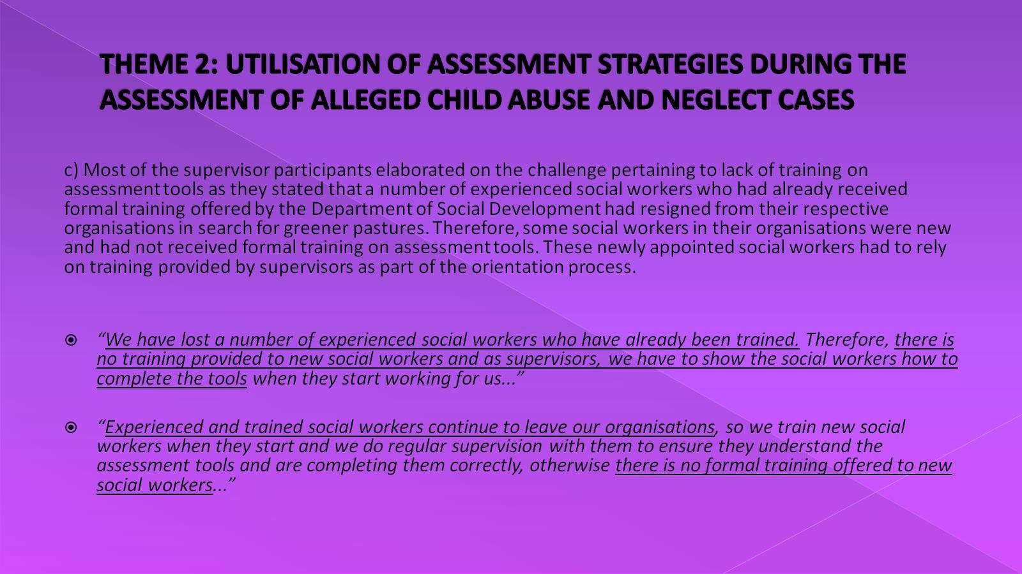
THEME 2: UTILISATION OF ASSESSMENT STRATEGIES DURING THE ASSESSMENT OF ALLEGED CHILD ABUSE AND NEGLECT CASES

Slide 39
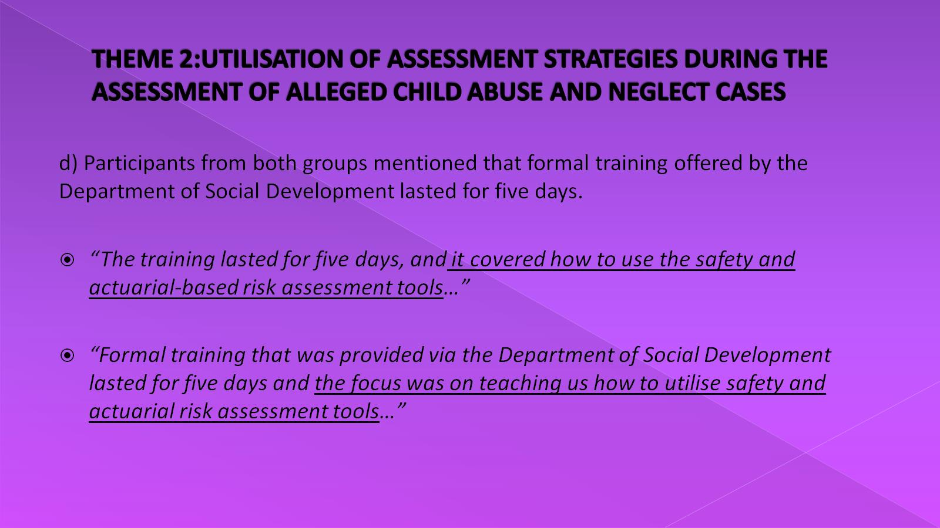
THEME 2:UTILISATION OF ASSESSMENT STRATEGIES DURING THE ASSESSMENT OF ALLEGED CHILD ABUSE AND NEGLECT CASES

Slide 40
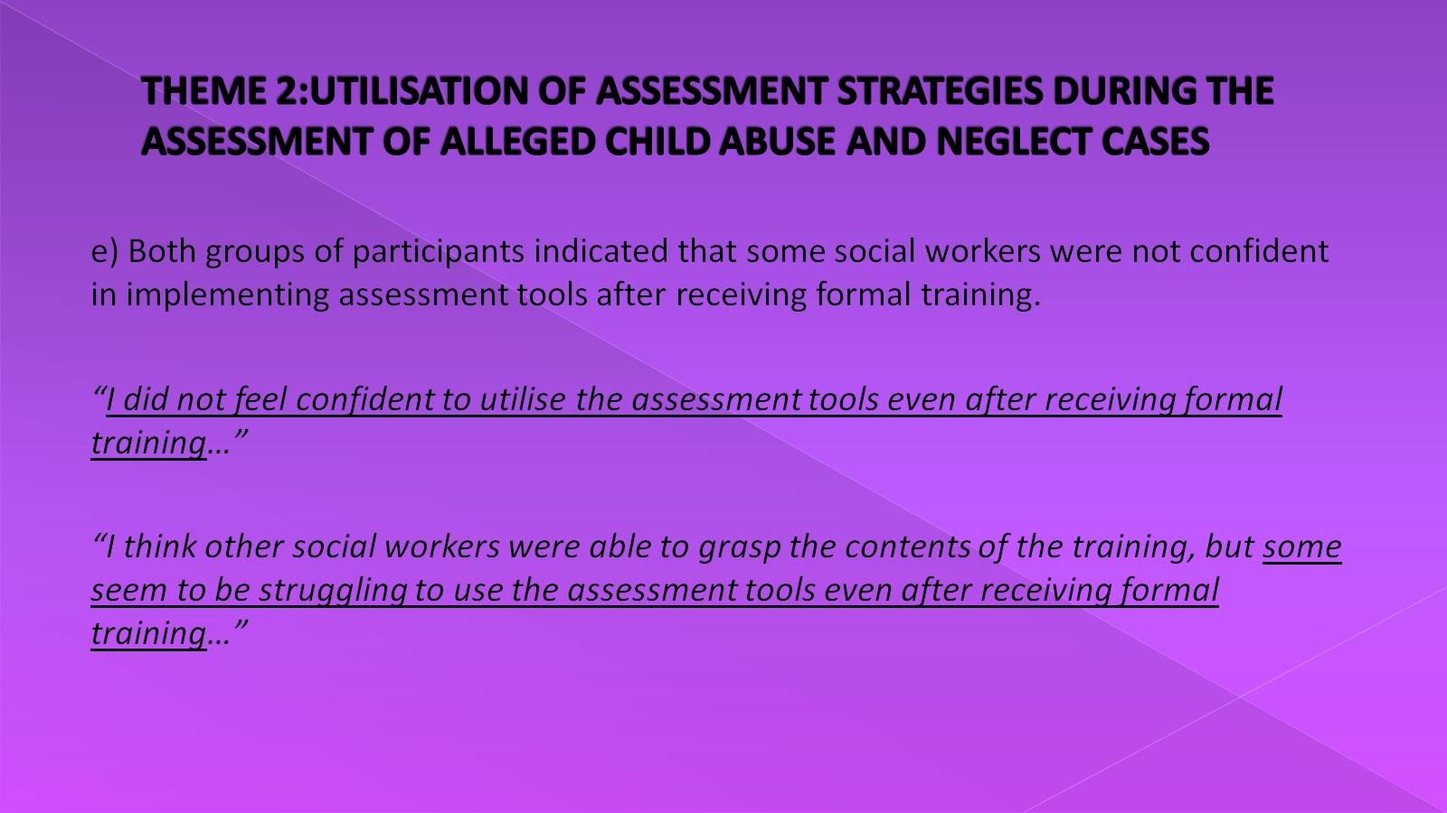
THEME 2:UTILISATION OF ASSESSMENT STRATEGIES DURING THE ASSESSMENT OF ALLEGED CHILD ABUSE AND NEGLECT CASES

Slide 41
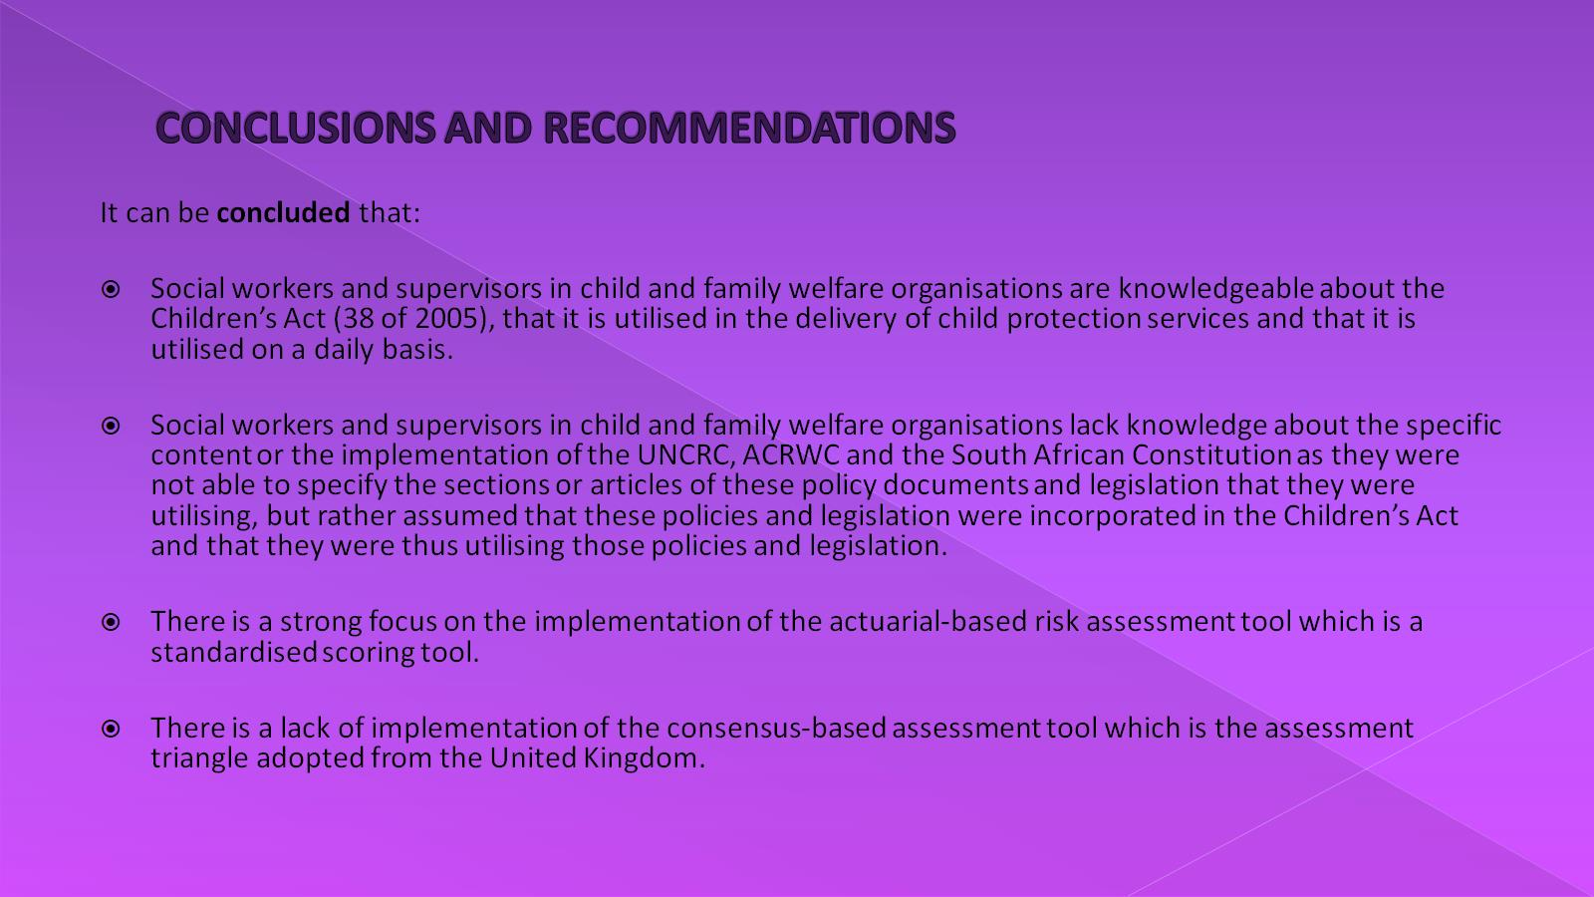
CONCLUSIONS AND RECOMMENDATIONS

Slide 42
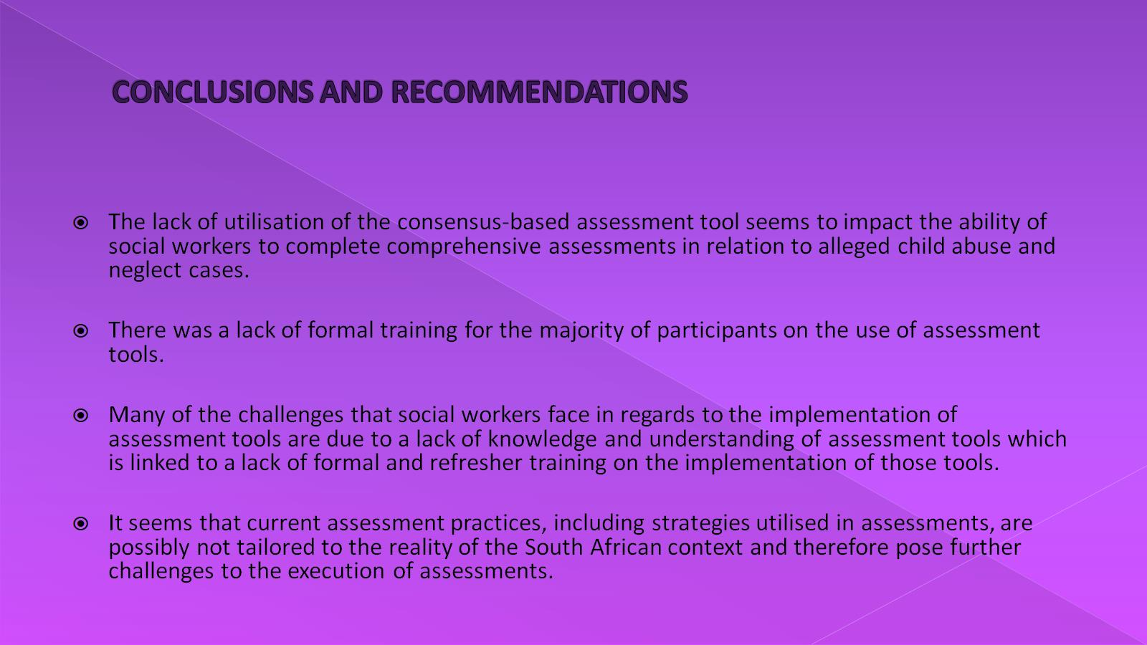
CONCLUSIONS AND RECOMMENDATIONS

Slide 43
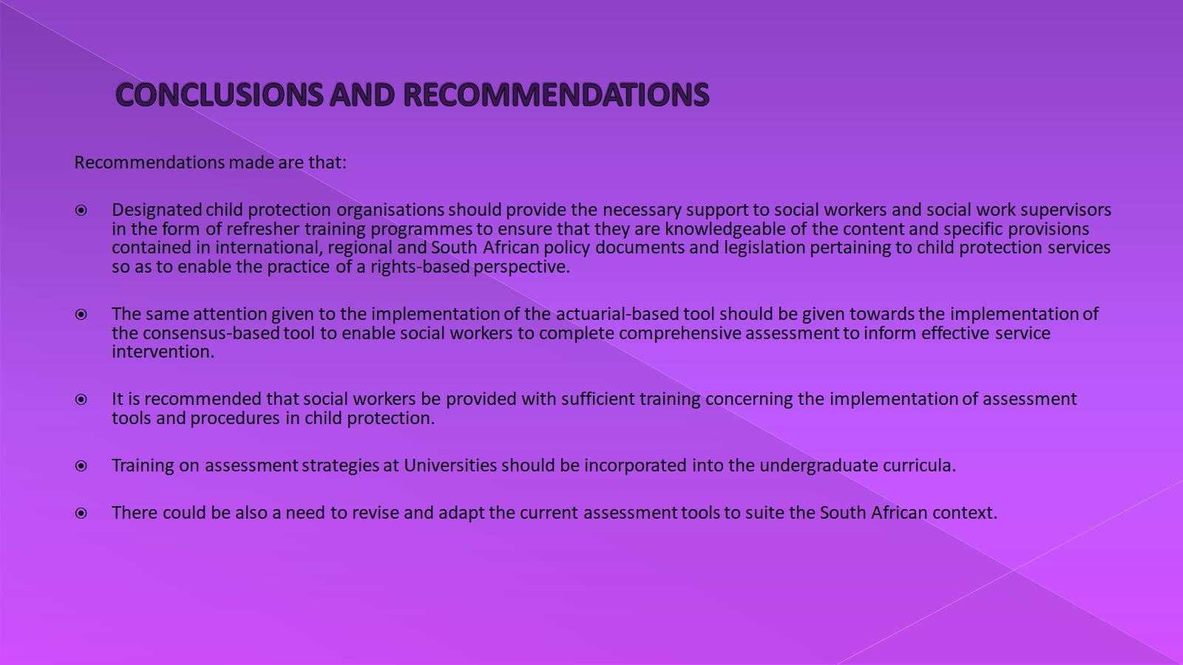
CONCLUSIONS AND RECOMMENDATIONS

Slide 44
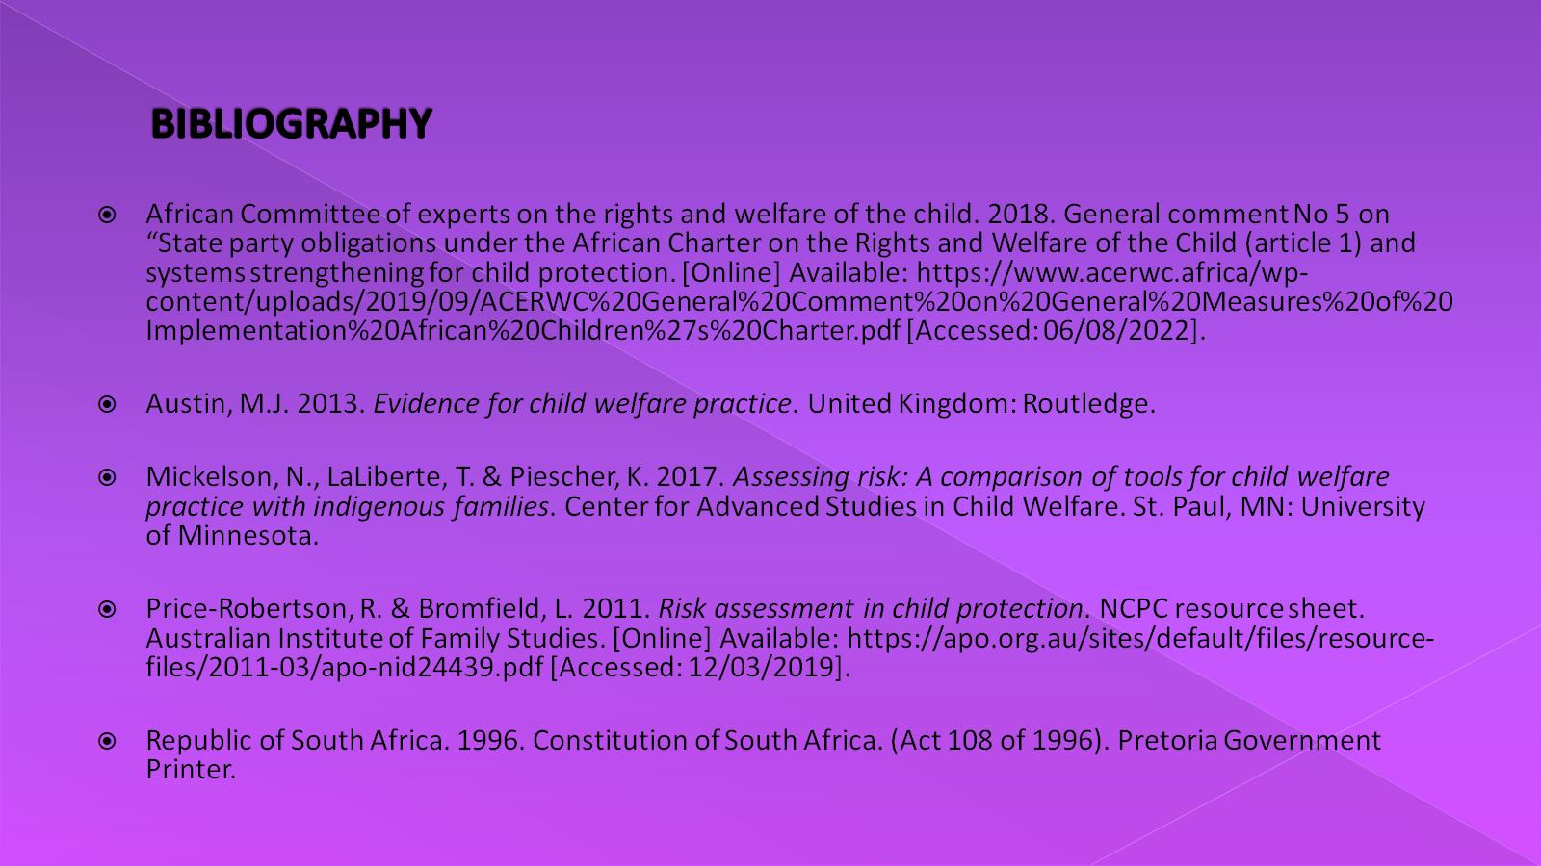
BIBLIOGRAPHY

Slide 45
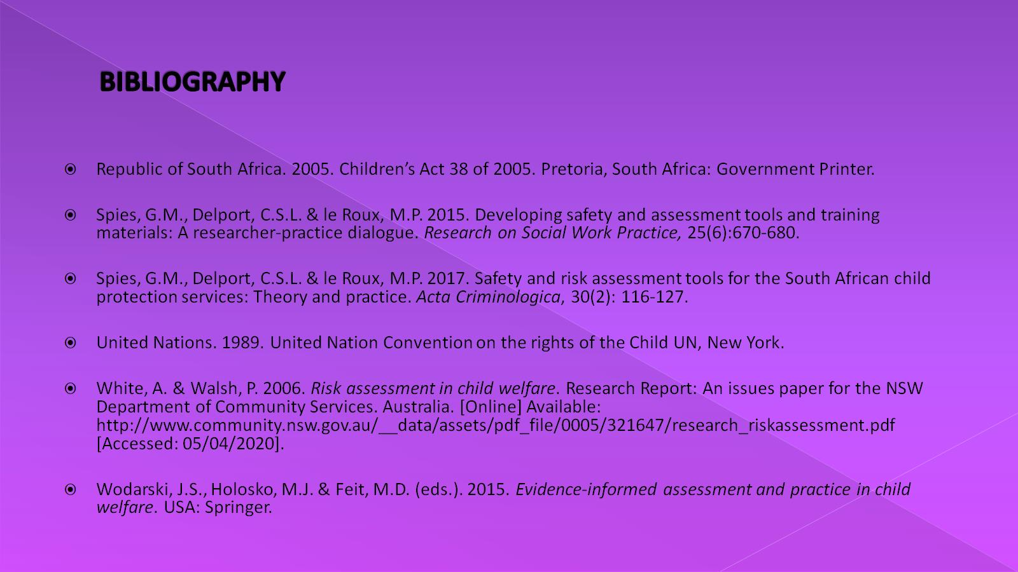
BIBLIOGRAPHY

Slide 46

“The happiness of any society begins with the well being of the families that live in it.”
--Kofi Annan

