Slide 1
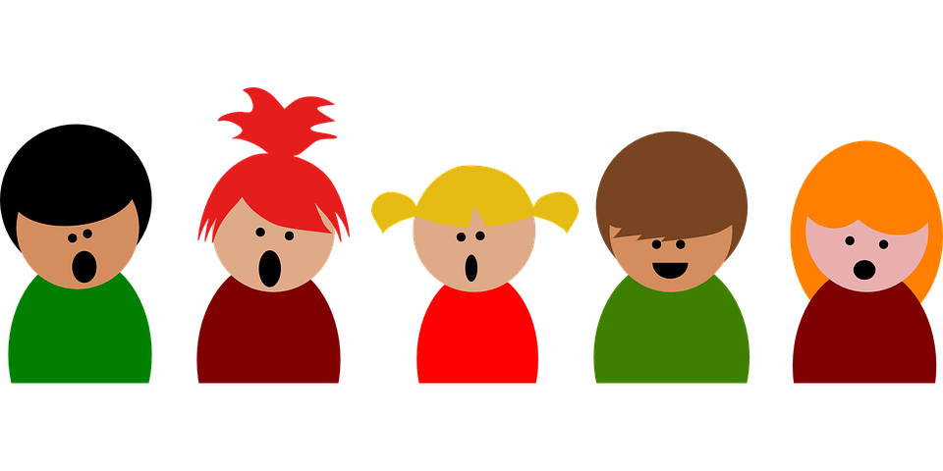
Hearing children’s voices in creating safe living spaces
Dr Lizane Wilson
Mrs Sylvester Ramotopo
Centre for Child-, Youth- and Family Studies, COMPRES, North-West University

Slide 2
Introduction
Child sexual abuse (CSA) is widely acknowledged as a complex public health and societal challenge, that have serious consequences for victims and their families.
Globally it is estimated that one out of two children, who are between two and seventeen years, are affected by some form of sexual violence every year (World Health Organisation [WHO], 2020).
In South Africa, the South African Annual Crime Report of 2020/2021 shows that there was 5.8% decrease in crimes committed against children, from the 5,8% decrease, attempted murder and common assault had the highest decline, followed by Grievous Bodily Harm (GBH) and murder. Sexual offences on the other hand showed a slight decrease compared to other crimes (SAPS crime report, 2021:16).

Slide 3
The Covid-19 pandemic also worsened the situation of violence against children (WHO, 2020:14). School closures during the lockdown affected more than 1.5 billion children while exposing them to potential sexual violence (Christakis, Van Cleve & Zimmerman, 2020:18).
Children in rural areas are often faced with numerous socio-economic challenges, abuse of their right to protection, and participation (Khanare & De Lange, 2017:2).
Children living in high-risk communities, such as the community selected for this study are more vulnerable because they are exposed to high levels of poverty, CA, substance abuse, community violence, lack of adult supervision and care, single parenthood, child headed households, unhealthy sexual boundaries, mental illness, and parents who are victims of sexual abuse (Artz et al., 2016:20; Meinck, Cluver & Boyes, 2017:2805).

Slide 4
Victims of CSA experience various mental, physical and social repercussions (Citak Tunc et al., 2018:2; Sanjeevi, Houlihan, Bergstrom, Langley & Judkins, 2018:627: Gray & Rarick, 2018:573: Hills, Mercy & Saul., 2016:4; Karakurt & Silver, 2014:29; Levine & Dandamudi, 2016:712).
Due to their dependence on adults for care and protection, children are particularly vulnerable to sexual violence. Therefore, it is important for caregivers, families, childcare professionals, and all members of society to protect children against all forms of maltreatment (Cheng, 2022:2474).
The Children's Act 38 of 2005 principal goal is to assure the care and protection of all children.

Slide 5
Failure to protect children remains a global concern because many of them continue to experience violence (Adel Ali Mohamed et al., 2022:2).
This global problem is an indication that children’s rights to protection are continuously violated (Adel Ali Mohamed et al., 2022:2).
The importance of preventing violence before it occurs. CSA prevention programmes are essential because they may empower children, their families, and the general community with more knowledge to encourage them to report the abuse.

Slide 6
Children’s right to participation is globally acknowledged as a basic human right (Correia, Aguiar, & Amaro, 2021:4).
Woodman, Roche, and McArthur (2022:5) adds that children’s voices are necessary for various other platforms including health and justice system at local and national governance levels.
Children’s participation in aspects affecting them is essential.

Slide 7
Aim of the study
The aim of this study was to explore and describe children’s perceptions of safety in relation to child sexual abuse prevention in a high-risk community in the North West Province.

Slide 8
Research methodology
Research design and -approach
Qualitative research approach and an exploratory descriptive
Population
Children aged 11-12 who attended primary schools in the identified high-risk community.
Sampling
Purposive sampling
Sample exclusion criteria
Children who received therapy for sexual abuse in the past; or where caregivers or educators indicate that the child has experienced sexual abuse in the past
Data collection
Focus group discussion with two activities.
One focus group discussion (FGD) per school were conducted
Total of 34 participants.
Data analysis
Thematic data analysis
Inclusion criteria
All children between the ages of 11 and 12 that attend the primary schools in the high-risk community
Children whose parents gave written consent

Slide 9
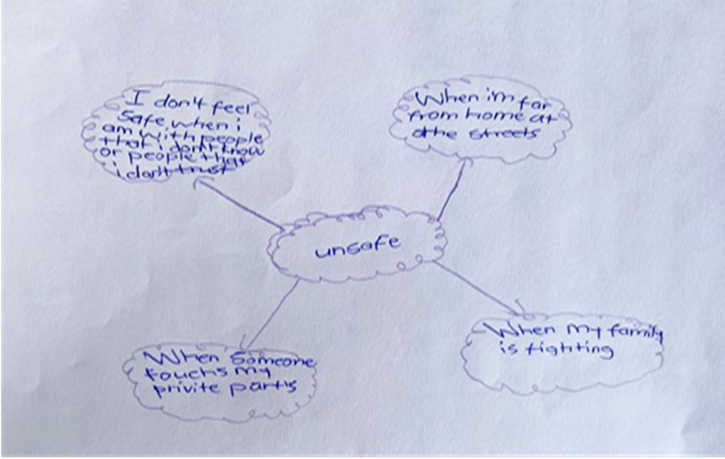
First objective – explore children’s perception of personal safety
Mind map:
Participants were provided with a pink and a white sheet, where they drew mind maps about what they see as safe and unsafe.
All participants were given an opportunity to reflect and discuss about current, and past experiences of what, when, where, and who makes them feel safe.
Participants were also asked about what touches in their body makes them feel safe.

Slide 10
THEME1: CHILDREN’S CONCEPTUALISATION OF PERSONAL SAFETY
Sub-theme | Category
1.1 Identified key role players who make children feel safe | Close family members
 | Extended family members
 | Other trusted individuals (Teachers, social workers, and the police)
1.2 Places identified as safe | At home (at my place, parents’ house, family yard)
 | The police station
 | At school
1.3 Situations that make them feel safe | When they are protected against an external threat
 | When they are with people, they can trust

Slide 11
THEME 2: CHILDREN’S CONCEPTUALISATION OF UNSAFE
Sub-theme | Category
2.1 Situations at home which makes children feel unsafe | Exposure to physical violence
 | When left alone in a place
 | When walking alone
 | When around strangers
2.2 Unsafe environments | When exposed to violence in the street
 | A potential threat outside of home
 | Isolated places
2.3 Description of unsafe people | Bullies make them feel unsafe
 | Someone that shouts at them
 | Some friends
 | People who are under the influence of substances

Slide 12
THEME 3: BODY SAFETY
Sub-theme | Category
3.1 Unsafe Touches | Being touched on the private parts
 | Being touched on other body parts
3.2 Responding to unsafe situations | Push them and go away/run to teacher
 | Tell the police
 | Tell someone they trust most
 | Tell parents
 | Tell teachers
 | Tell other family members

Slide 13
Second objective - to explore children’s perceptions of community safety in relation to CSA prevention
Community map of courage was used to identify with the children challenges and solutions in their community.
Participants were provided with green stickers to stick in areas where they felt safe and red stickers for areas where they felt unsafe.
Discussions were based on what they liked and disliked about their community, what they loved about their school and what they did not like, services they knew that are available to protect children, their thoughts on what could be done to improve safety for children in their community, and the role played by adults in protecting them.

Slide 14
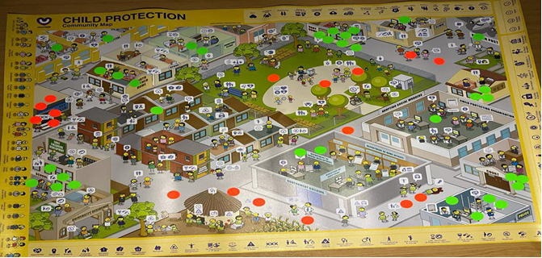

Slide 15
Findings objective 2
Theme | Sub-theme
Description of a safe community | Factors contributing to a safe environment
Description of an unsafe community | Unsafe streets Taverns and entertainment clubs Bushes and forests Other community areas
Children’s input on promoting a safer community | Protecting children at the family level Protecting children at school Protecting children in the community

Slide 16
Summary of findings:
Children’s conceptualisation of personal safety
Participants defined safe environments by referring to people, places, and situations that make them feel safe.
Children identified characteristics of, safe people, as those who provide care, support, protection, good listeners, and individuals who can protect them.
Moreover, safety was discussed in terms of places where they mostly felt safe. The places included, home, school, and the police station – these were identified as where children could be protected.
Nonetheless, it is noteworthy that certain people, places, and situations experienced by children as safe may put children at risk of CSA.

Slide 17
Children’s conceptualisation of unsafe
Being unsafe or feeling unsafe was associated with being exposed to physical violence, being left alone unattended, lack of parental care or supervision and walking alone. Furthermore, participants described unsafe people as adults who misuse their power or older children who are bullies, friends who engage in risky behaviours and pressurise them to be involved in risky activities. In addition, people who abuse substances were considered unsafe because of what they could potentially do to children under the influence of substances. These risk factors could put children at risk of CSA. Participants in this study demonstrated the need for adults to be actively involved in protecting them.
Personal body safety
The last theme of objective one, was related to personal body safety. It was evident from the findings, that participants had some knowledge of what constituted safe and unsafe touches. They were able to name different body parts and categorise them as “private”. For most participants, knowledge about personal body safety, was mainly acquired from parents and at school. However, participants responses to unsafe situations and unsafe touches, demonstrated a need for children to be educated about personal safety skills. Moreover, there is a need for caregivers to be equipped with knowledge and CSA prevention, including teachers and other childcare professionals.

Slide 18
Description of a safe community
Children described a safe community as one that constitutes safe people, people who have the best interest of children at hart, kind people who provide care, support, and love to children. They also described a safe community as one where they are free to move around and play, without fear.
Description of an unsafe community
The discussions with participants, showed that they perceived their community as unsafe. Participants revealed some of the risk factors in their community, such as unsafe streets which are hotspots for violence, substance abuse, taverns, and entertainment clubs. The current study confirmed that children’s rights are continuously undermined because, the existence of social ills in the community, makes it difficult for them to exercise their rights and move around freely and to actively participate in activities in their community. Children in this study constantly lived in fear.

Slide 19
Children’s input on promoting a safer community
At a family level, they suggested that parents should stop abusing substances because this hinders their ability to fully supervise them. Children also advised parents to stop shouting but listen and talk to children in a friendly manner.
At the school level, participants mentioned that teachers can be supportive by protecting children against bullying and by creating safe spaces for them to report CSA.
At the community level, it was clear that multi-collaboration between various stakeholders was important in protecting children.

