Slide 1
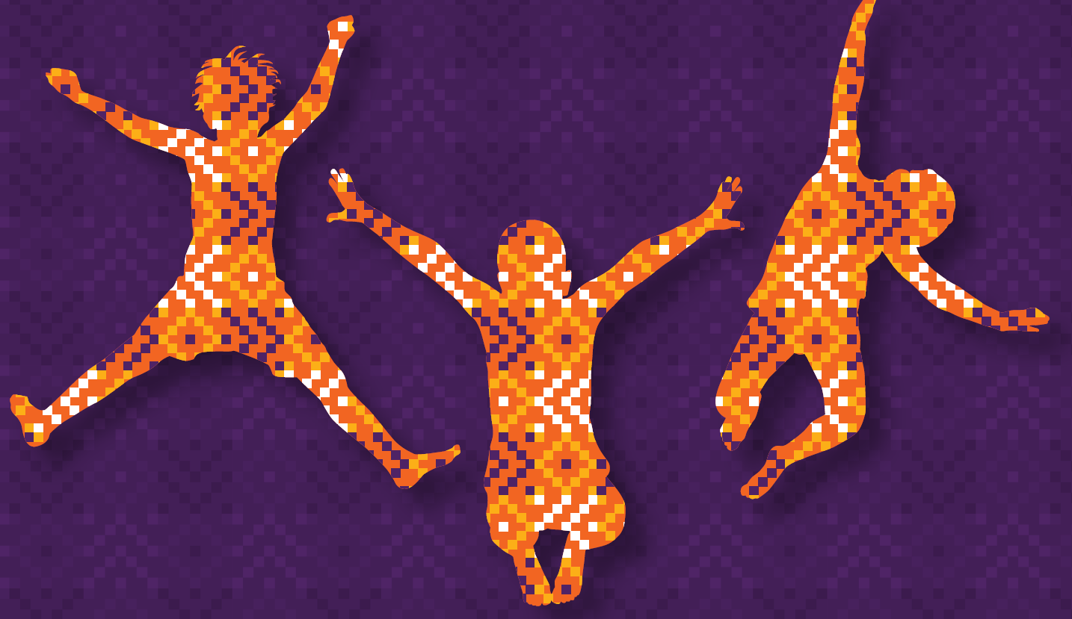









Community of Practice for Social
Systems Strengthening to Improve
Child Well-being
Developmental Social Work in Schools using a Community of Practice (CoP) model for early grade learners
Tania Sani
ASASWEI Conference 2023
26-29 September 2023

Slide 2
Factors driving poor social outcomes for children and families
Risk factors of poor outcomes are: poverty, hunger, poor access to basic and social services & caregiver and community stressors.
Despite children’s rights being protected to social assistance, basic education, primary health care and school feeding, many ‘fall through the cracks’ in the system.
This is due to poor coordination, a lack of seamless government, lack of organisation around child well-being outcomes instead of around activities and functions that operate in silos.
How to realise synergies across different social sectors is easier said than done. Implementation too is complex.
Other underlying challenges are: different policy and organisational mandates; inadequate funding and human resource systems; different reporting lines, operating procedures, work styles and cultures and knowledge systems, resistance to new ways of working; competition between different spheres of government & implementing agencies….
The CoP sets out to learn from real life practice experience, critical reflection, use of evidence to inform well-being assessments and intervention of children via the use of a customised digital tool and includes implementation, monitoring and evaluation.

Slide 3
Community of Practice (CoP) study: accelerating child well-being outcomes
CoP is an innovation community of researchers & practitioners to find breakthrough ideas, knowledge, solutions and practices to a complex and intractable social issue. We ask the following questions:
How to overcome fragmentation of service provision and the lack of functional cooperation between key social sectors to accelerate child well-being outcomes in SA?
How should integrated interventions be delivered across health, welfare and education sectors?
What lessons may we learn from the CoP to improve child well-being outcomes?
CoP is a multi- and trans-disciplinary collaborative intervention research study (funded by the NRF for 2 Phases) in different sub-fields:
  3 x SARCHi chairs, social work, sociology, psychology, educational psychology, educators, mathematics & language curriculum specialists, mental health, nutrition, primary health care, community nursing, public health and school health care services.
Meeting the multi-dimensional needs of children and their families in the foundation stages of their growth remains a national and a global priority reflected in the SDGs.
Its intention is to disrupt negative cycles of intergenerational disadvantage through a systemic , collaborative and partner driven intervention.

Slide 4
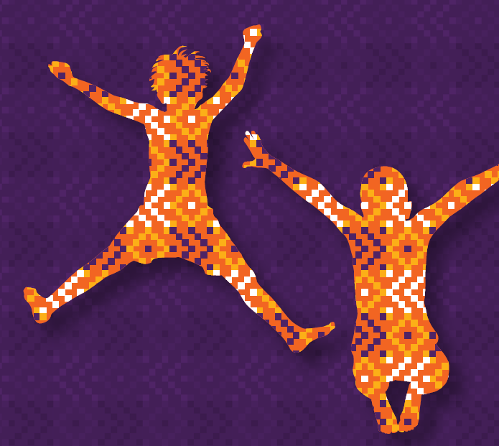
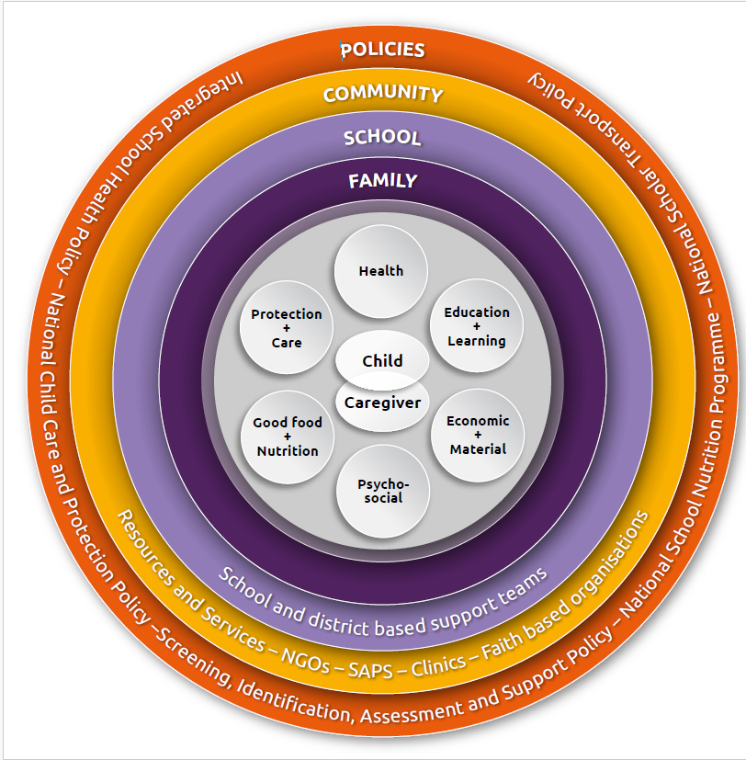
The CoP Model
Notes:
INTRO NOTES

Slide 5
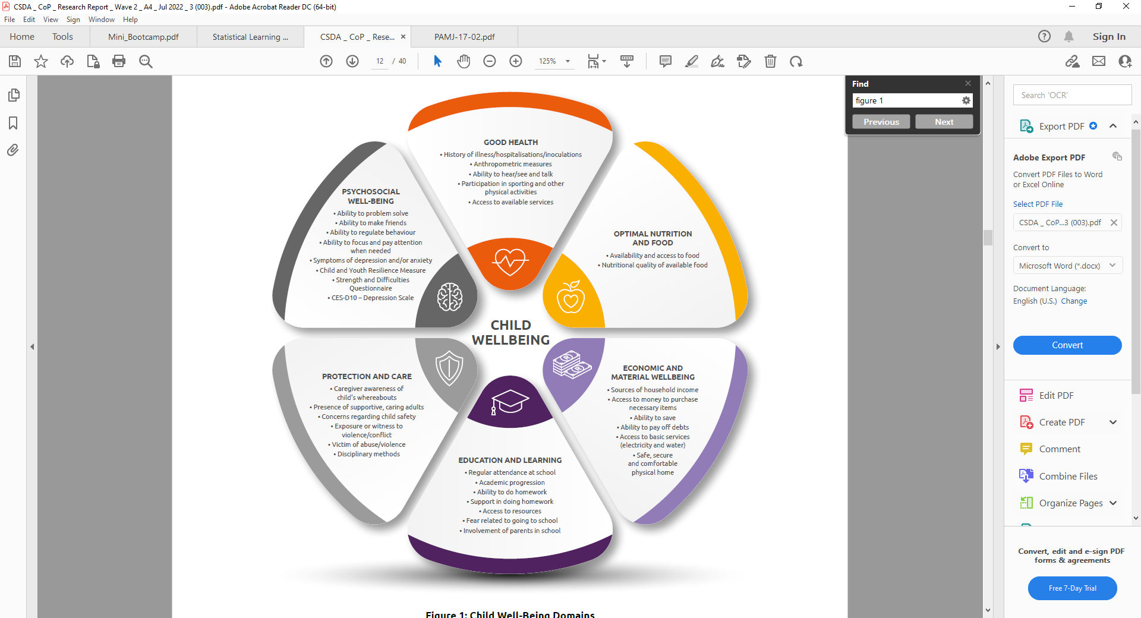
Child wellbeing is a multi-dimensional concept & requires a multi-systemic approach

Slide 6
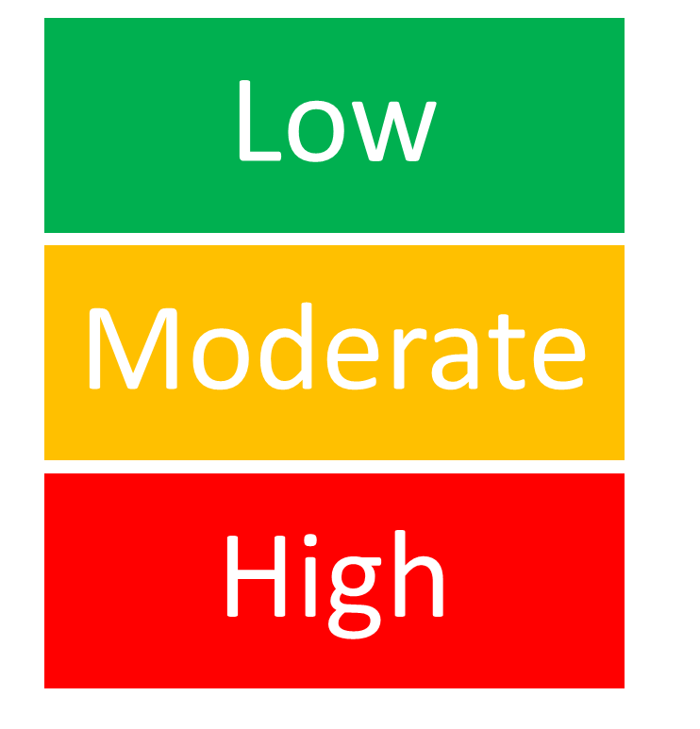
Digital Child Wellbeing Tracking Tool Developed & Tested
Section A
Demographic and social profile: child/family living circumstances (Respondent: Parent/Caregiver)
Section B
Child well-being domains (Respondent: Parent/Caregiver)
Section C
Parent/Caregiver health and well-being (Respondent: Parent/Caregiver)
Section D
Education and wellbeing domain (Respondent: Teacher)
Section E
Health domain (Respondent: Health Practitioner)
Section F
Subjective measures: (Respondent: Child)

Slide 7





CWTT Wave 1 High Level Findings
Material well-being of children and families compromised especially during the Covid-19 pandemic
65% of primary caregivers are unemployed
54% of caregivers were struggling to save money monthly and 27% were in debt
Only 35% had enough money to buy the things that they needed
55% of caregivers had depressive symptoms; this was much higher in some schools
Education - children lost 70% of teaching and learning time in 2020
96% of children attend school regularly (rotational timetable)
16% of children are not progressing with their schoolwork
A third are fearful to go to school
33% of children have difficulty learning

Slide 8
CWTT Wave 1 High Level Findings
Food insecurity and child and adult hunger
33% of children sometimes or often go to bed hungry
37% live in homes where there isn’t enough food
Child health
17% of children have health concerns that prevent them from going to school regularly
Although 96% of children have a ‘road to health’ vaccination card
A third had incomplete vaccinations
Child safety
67% of children have been exposed to violence, 75% of caregivers had safety concerns and 8% are victims of abuse.

Slide 9
Risk Assessment of children per domain

Slide 10
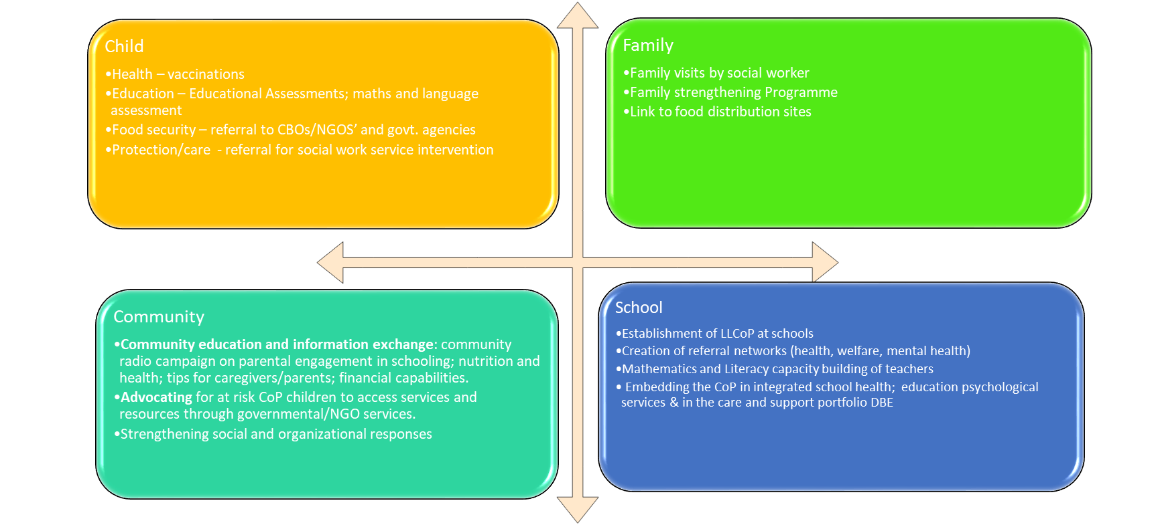
Multi-level Interventions by Social Workers

Slide 11
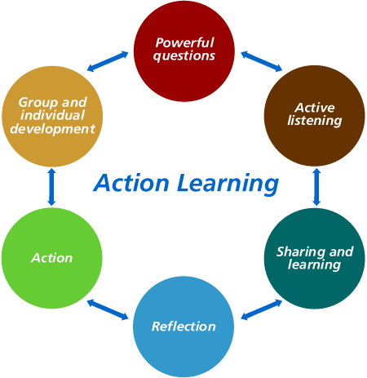
Placement of social workers in schools
The selection and placement of 5 agile & motivated CoP social workers in schools (2021 – 2023)
5 experienced DSD Gauteng School social work unit social workers (2023)
Community based
Research sites: five schools in Doornkop, Alexandra, Malvern, Meadowlands, Ivory Park
Pre-service and in-service training and development of social workers
“Action Learning” (Action-Reflection-Learning-Planning)
Weekly on-site & online supervision and coaching
Ongoing documentation and discussion of learnings from the field with the team

Slide 12
Two Intervention Phases
2021 – Intense seven month intervention with 5 CoP social workers
2023 - Short Term Solutions Focused intervention over 4 months with 5 CoP & 5 DSD social workers
  On-going support and monitoring of children & families at risk (vulnerable) in collaboration with schools
  Regular contact (home visits & phone) with and support of families in need by social worker
  Where required, social workers linked caregivers and children to specialist community support services eg: GDE ISS, DSD, community based counselling, and monitored the progress

Slide 13
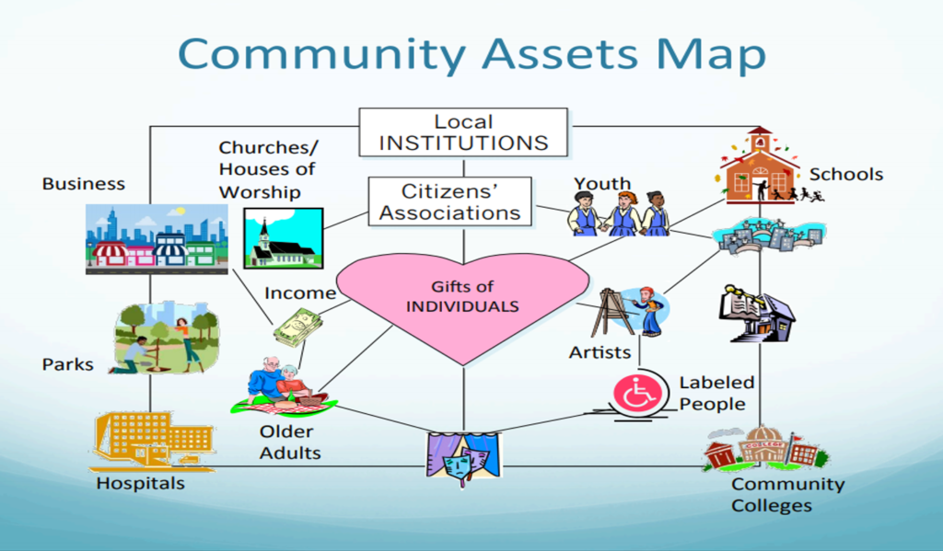
Community Assets Mapping
Social workers conducted a community mapping exercise when they first started working for CoP, and this process enabled them to identify key community stakeholders, particularly important during COVID.
Shared information with LLCoP groups, and added to it during the course of the intervention work

Slide 14
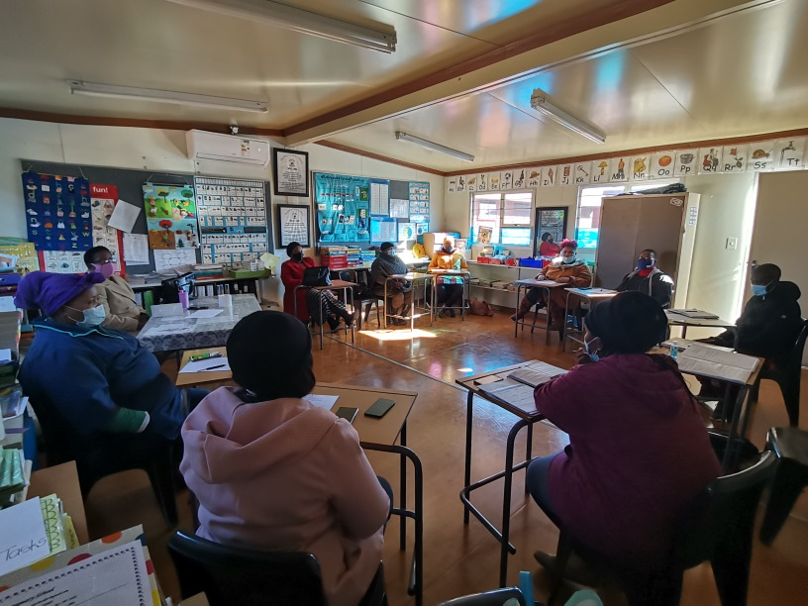
Interventions at a School Level
Establishment of Local level CoPs (LLCoP) to address the challenges children, caregivers and teachers face
  A LLCoP group was established in each school
    The LLCoP groups proved to be very effective platforms for teachers, social workers, health workers, educational psychologists, NGOs and SGB members to connect with each other and to share information on children and families who had been identified as being “at risk” in the study
    Develop individualized intervention plans with team
    Provide support and referral networks for teachers and schools

Slide 15
Interventions at a School & Family Level
Ensuring children are accessing the National School Nutrition Programme during schools time and on they are days when not at school
Appropriate referrals for children and families at risk of hunger and food insecurity and linking them to community resources that distribute food parcels
  DSD SSW facilitated access to children and families in need of:
    Food parcels
    Fresh vegetables
    School uniforms

Slide 16
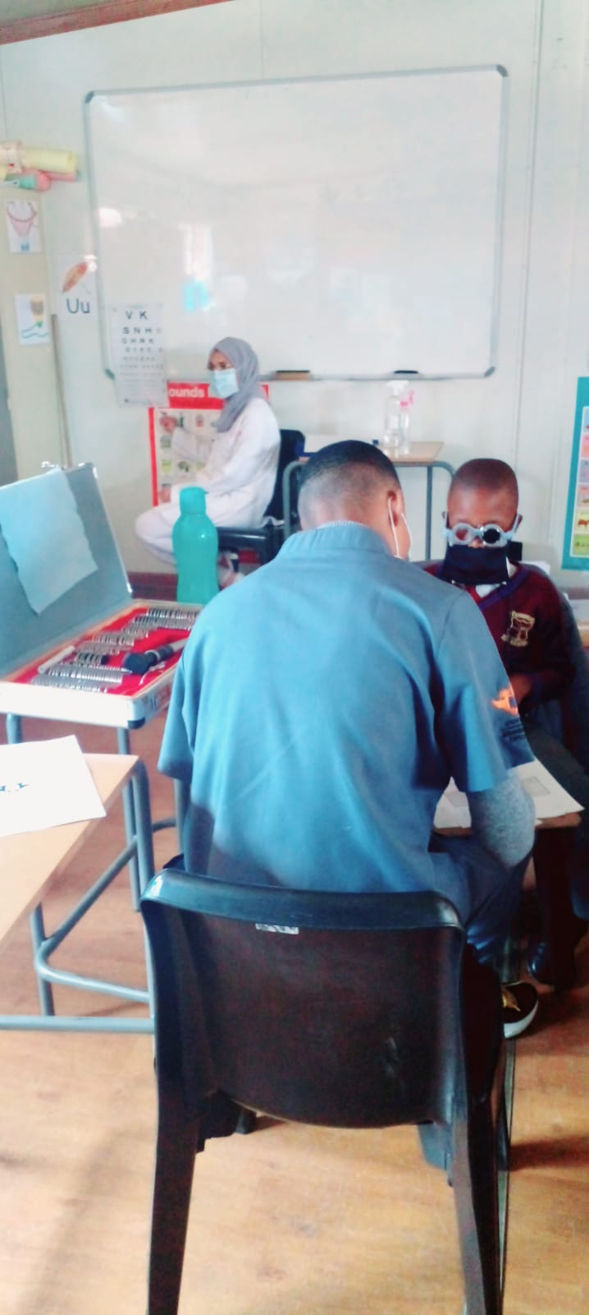
Interventions at a School, Family & Community Levels
Provision of health education and coordination with local clinics and families
  Children in the sample were brought up-to-date with missing vaccinations
  Relationships and collaboration with the local health departments and community health providers were fostered to ensure that children with speech and hearing difficulties, are appropriately assisted eg: UJ Optometry clinic, Wits University Audiology clinic, Spec Savers

Slide 17
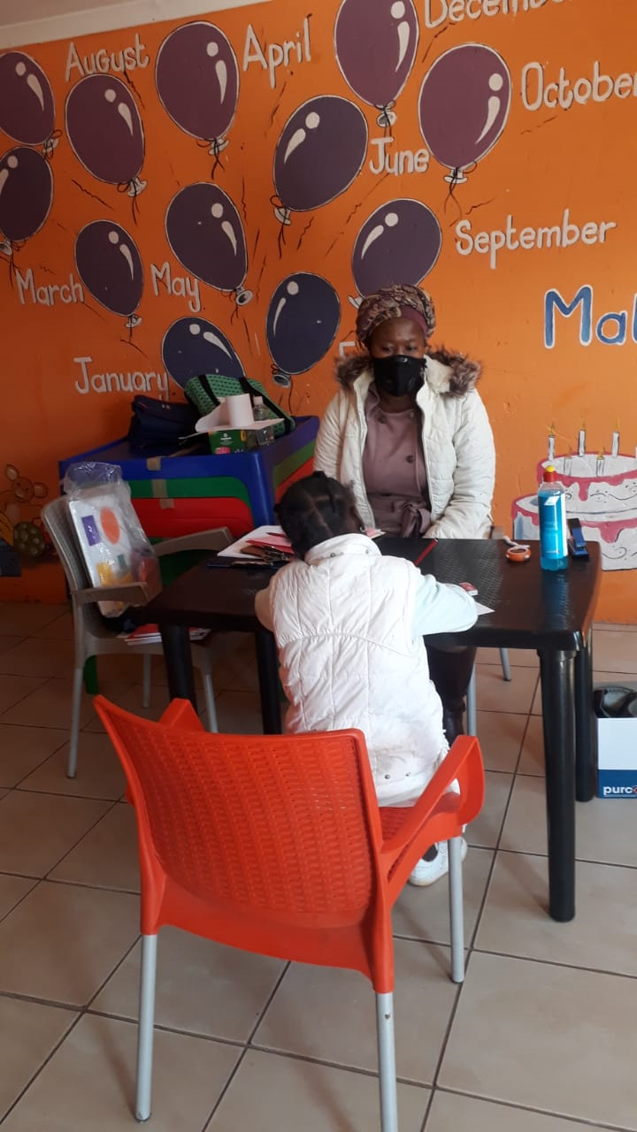
Interventions at a Child & Family Level
Assessment of educational and psychosocial wellbeing of children at risk
  Based on our findings and in consultation with teachers at each school, children (6 per school) in need of a full psycho-educational learning assessment were assessed by qualified educational psychologists.
  Social workers facilitated parental feedback sessions as well as communication between the caregivers, educational psychologists, and teachers to better support the child.

Slide 18
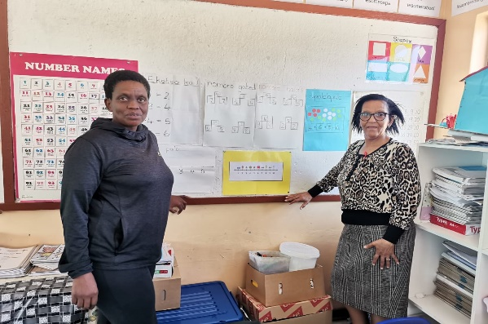
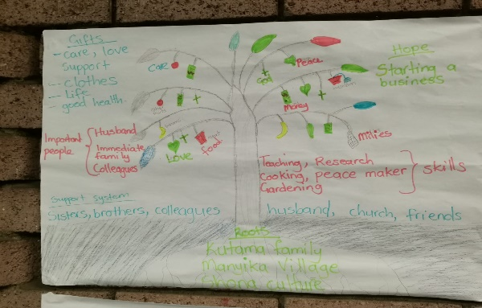
Interventions at a School Level
Teacher workshops
  Maths and Language to improve learning support to FF children (Prof Henning & team)
  Improve teachers’ knowledge on how to refer children at risk to DSD support services (Form 22)
  Resiliency workshops for teachers
  Positive discipline, learning barriers, caregiver involvement by CoP education psychologists
  DSD GP SSW unit psycho-educational programmes eg: anti-bullying

Slide 19
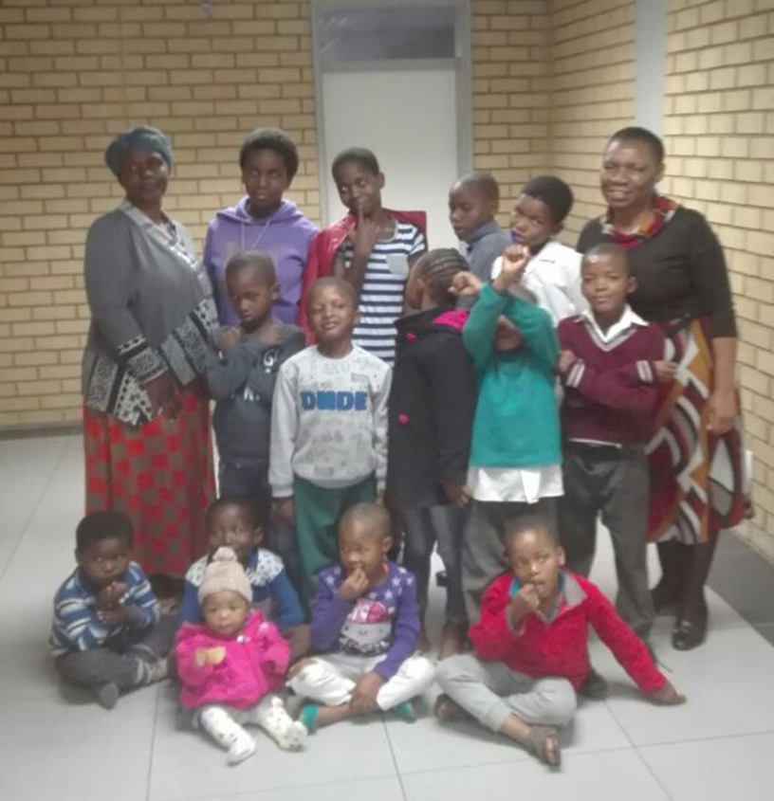
Interventions at a Family Level
Family participation in the Sihleng’Imizi Family Strengthening Programme
  1 group per school, facilitated by a CoP social worker and qualified child care worker
  25 families (households) recruited from CoP sample
  The programme is a weekly 2 hour group, run for 14 weeks
  The whole family is invited to take part – there are 5 – 7 families in each group
  Parts of the programme include everyone, some parts split adults and children
  Children have a dedicated child care worker who facilitates specific activities

Slide 20

Interventions at a Family Level
Referral of caregivers with depression to community based & telephonic mental health services
  Caregivers with high levels of depression were followed up 12 months later, to find out if they experienced symptoms of depression, and if they wanted to speak to a counselor (SADAG)
  2023 - followed up with all caregivers indicating symptoms of depression

Slide 21


Interventions at a Community Level
Family strengthening Radio Campaign
  A one month community radio programme was initiated in two of the five communities (Alex FM & Voice of Tembisa) where the schools are based focusing on: (a) promoting parental involvement in children’s schooling; (b) nutrition and healthy food practices; (c) tips for caregivers to manage stress and difficult behaviours in children; and (d) money matters.
  The same material and audio clips were shared on the CoP portal

Slide 22
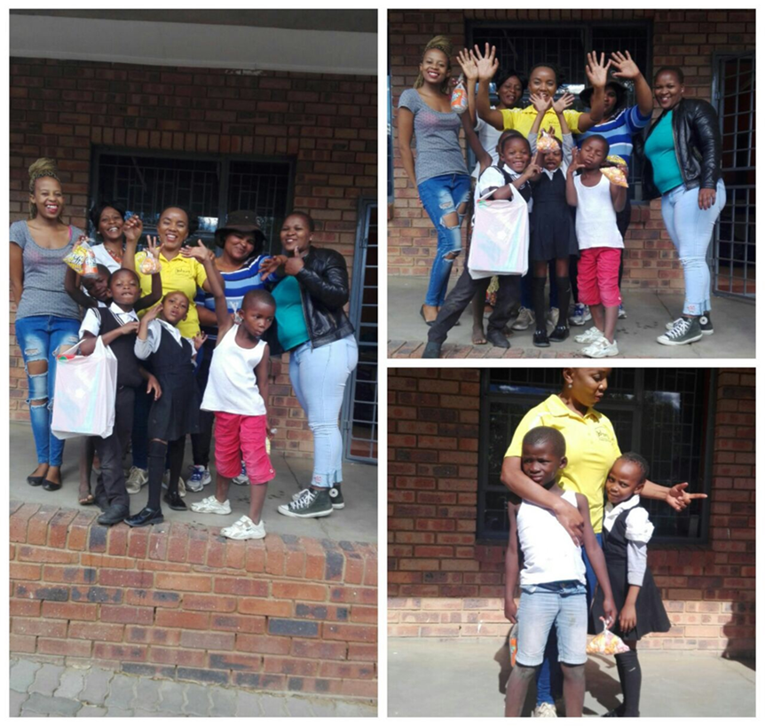
Conclusions
CSG on their own do not offer sufficient levels of support to vulnerable families
CSGs combined with well-coordinated, integrated and complementary support services and interventions, provide a more holistic approach to addressing child wellbeing outcomes
The CoP School-Child-Family-Community model provides an opportunity to find school based, systemic solutions to ensure improved child and family wellbeing outcomes

Slide 23
THANK YOU
CoP portal - communitiesforchildwellbeing.org

