Slide 1
The intersection of culture, tradition, and delayed disclosure of child sexual abuse: insights from the Vhavenḓa Tribe
Livhuwani Ramphabana, PhD
University of KwaZulu-Natal – Social Work Discipline
2023 ASASWEI Conference
27 – 29 September

Slide 2
A brief context of CSA
It is a global social and health problem
It brings about several ramifications on child victims
The prevalence cannot be accurately comprehended due to underreporting
It is consequential to understand the dynamics of underreporting from cultural perspectives
In a unique context, CSA unfolds within a complex web of cultural norms and behaviors
The intersection of culture, tradition, and delayed disclosure of child sexual abuse: insights from the Vhavenḓa Tribe

Slide 3
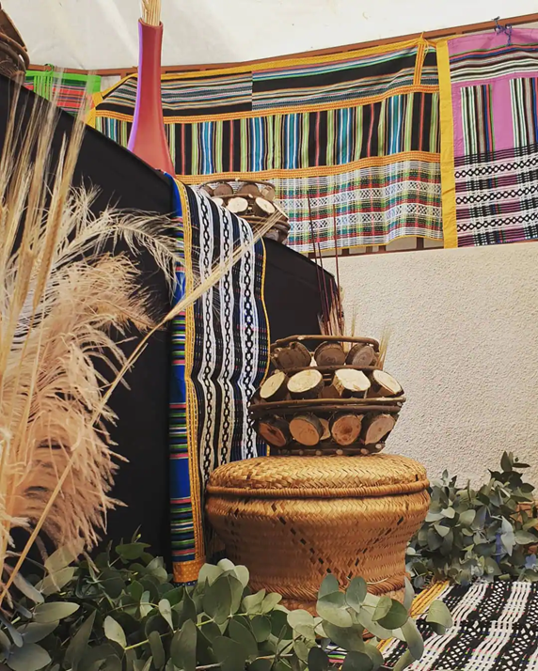

An overview of the Vhavenda Tribe
Location
Language
Famous character
Traditional leadership
The intersection of culture, tradition, and delayed disclosure of child sexual abuse: insights from the Vhavenḓa Tribe

Slide 4

Complexity of disclosure
Disclosure is a complex and multi-tiered process
Child parent/caregiver (traditional leadership) authority (success of disclosure)
Only the success of disclosure affords child victims an opportunity to receive necessary professional support

Slide 5
Purpose of the study
To understand the intersection of culture, tradition, and delayed disclosure in the context of the Vhavenḓa tribe
- The study was guided by the Afrocentric theory

Slide 6
Methodology
Design: exploratory
Setting: Vhembe District, Rural
Sampling: 4 adult survivors of CSA, 7 caregivers of survivors of CSA, 4 social workers, and 2 traditional leaders
Gatekeepers permission: TREC UL, DSD, DoE, and traditional leaders
Interviews language: Tshivenda and English

Slide 7
Findings of the study
Thematic analysis was done
Four themes emerged:
  Traditional mechanisms to handle disputes
  Arranged hook-up and marriage
  Family negotiations
  Using idioms and proverbs as defense and coping mechanisms

Slide 8
  1. Traditional mechanisms to handle disputes
Restitution and compensation
“It is actually insane that the chief wanted me to consider negotiating with the family of the person who sexually abused my child. All I needed was the help from the chief to call police to intervene, not to negotiate or settle the matter without involving the police.” Caregiver
Shortcomings of traditional leaders in handling CSA cases
“The majority of traditional leaders do not seem to understand the weight of such cases because in some situations they act as mediators when cases are reported to them.” Social worker

Slide 9
2. Arranged hook-up and marriage
This practice used to be prevalent previously in the context of Vhavenda
Its implications on the child cognition
“The person who abused me was the very same person whom my mother had been forcing me to be in an affair with. It took me time to talk about it because I felt it would not make any change because my mother would not support me.” Victim

Slide 10
3. Family negotiations
- Families only report the abuse incidents only when they disagree
If the elders strongly recommend not disclosing the incident, then professionals will not know about it
Sometimes it depends on the gravity of the abuse: contact vs non-contact
“Most of cases that come to our offices, you would find out that the abuse happened some time ago but delayed by the process to negotiate within families.” Social worker

Slide 11
4. Using idioms/proverbs as defence and coping mechanisms
U shavha u dzhena ṋari usina mmbwa
Muhulwane u kanda mupfa a tshi u vhona
Vhathu ndi ṋanga dza kholomo vha a kuḓana
Mmbwa yaḽa iṅwe ai noni

Slide 12
Conclusions and implications
It is important to embrace culture and traditions, but that should be within the human rights principles and legal ambits
Social workers should diligently work with traditional leaders to confront practices that perpetuate abuse and delay the disclosure
Social workers should provide capacity-building training for TLs on how to handle CSA (what their roles are and not)

Slide 13
…………….. Conclusions and implications
Promote collaboration amongst key stakeholders to have a coordinated response to CSA
Strengthen local child protection agencies in rural areas

Slide 14
Closing remarks:
Let us work together to make our cultures more responsive to the children’s needs for protection against abuse.

Slide 15
I thank you

