Slide 1
Online Support for Youth at Risk: Reaching Out Through Technology
Nir Wittenberg, Phd
School of Social Work
Ariel University, Israel
International Social work Conference
September 2023

Slide 2
Table of Contents
01
02
03
04
Background:
Technology's Impact
on adolescents
Crafting Effective Digital Interventions with youth
Online Support for At-Risk Youth:
Methods and Findings
Discussion
and Implications
for Practice

Slide 3
Literature Review
Adolescence is a period characterized by a steep rise in interpersonal conflicts, emotional distress and dangerous behavior (Arnett, 1999; Samenta, Campione-Barr & Aaron Metzger, 2006)
Despite this, many youths either avoid seeking help, or conduct a restrained relationship with formal help providers, and report fear of exposure and stigma (Dubow, Lovko, & Kausch, 1990; Offer et al., 1991; Rickwood & Braithwaite, 1994).
Given the obstacles hindering help seeking and receipt, the online world offers unique opportunities for collecting information, support, and circles of belonging (Barak, 2007;Mesch & Talmud, 2010).

Slide 4
Literature Review
Youth and those struggling with face-to-face prefer digital communication (Denby et al., 2016; Mishna et al., 2012).
Increased effectiveness and efficiency, less no-shows rate, improved communications, easier scheduling and stronger client-worker bonds (Breyette & Hill, 2015).
App-based communication provides immediacy, boosting youth's connection to social workers (Mackrill & Ebsen, 2018).

Slide 5
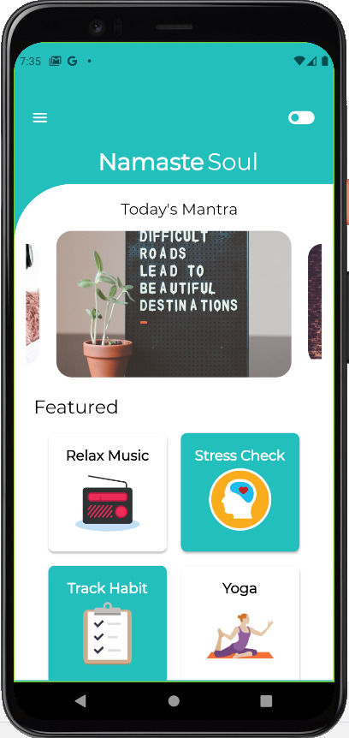
Literature Review: Digital Technology Examples for Youth
Meta-analysis of 1,706 young people found App interventions improved symptoms of depression, especially the Apps: DeStressify and Stop, Breathe & Think (Leech, Dorstyn, Taylor & Li, 2021).
Remote psychotherapy is as effective as in-person for anxiety, depression, ADHD, and conduct problems (Venturo-Conerly et al., 2022), aiding limited resources in low- and middle-income countries.
Reaching out and building bonds - social media helps spot signs of distress and offers guidance (Rosenberg, Ophir & Billig, 2021).

Slide 6
Aims of the Study
This study explores how the internet serves as a source of assistance and support for Israeli youths dealing with personal issues, crises, and distress.
The aim was to analyze anonymous online help seekers, the help-receiving process, and their level of satisfaction with it.
What roles do online support channels play for adolescents concurrently engaged in face-to-face professional interventions?

Slide 7
Research setting
Two mental health support sites operated BY NGO offering free assistance in Hebrew (as well as Russian and Arabic).

Slide 8
Method
A mixed methods approach with 602 youths aged 12-25.
Qualitative: Grounded Theory approach (Strauss & Corbin, 1990, 1998).
Online survey (n=394)
online interview with web support-assisted youths (n=8)
messages in support groups (n=176)
one-on-one chat logs (n=24)
messages in support groups (n=176)
Interview with the supporters and administrators (n=23)

Slide 9
Results
38% of the survey respondents also sought professional offline help.
only 8% of the respondents shared the matter of their online support with their parents.
Life Satisfaction of participants was averaged at 5.9. As the frequency of online seeking help increased, life satisfaction decreased.
Of those using online help, 67% expressed high levels of satisfaction from the help received, and only 16.5% reported low levels of satisfaction.

Slide 10
Results
The findings of the qualitative analysis revealed five main themes:
Isolation experiences joined by sever and continuous
emotional stress.
“There is a huge pit inside me that feels like it will never be filled. And a huge emptiness”.
“In my home I don't remember receiving warmth and love, although nothing was missing materially, but mentally I did not receive warmth and love from my parents”
Notes:
Lack of support from parents and informal systems:

Slide 11
Results
The findings of the qualitative analysis revealed five main themes:
Psychological aspects of online communication.
“There are topics that I will share on the Internet and that I will hide from my therapist, because sometimes it is not pleasant to say exactly what bothers you when someone knows you, it is sometimes embarrassing. On the net it is anonymous, and no one knows you”.

Slide 12
Results
3. Limitations of the web as an assistive device.

Slide 13
Results
The findings of the qualitative analysis revealed five main themes:
4. Various actions and interactions for help-seeking.

Slide 14
Results
The findings of the qualitative analysis revealed five main themes:
5. The interpretation assigned to online assistance and its impact

Slide 15
five main patterns:
Self-reliance – participants with a negative stance on receiving help and prefer to adopt practices which reinforce their self-control;
Problem-solving –focus on specific information for advice and decision-making.
Self-discovery - online writing examines various aspects of identity, revealed to other online viewers.
Belonging and social engagement –require social support and an emotional dialogue, specifically in a group setting.
Need for a therapeutic relationship –experience severe emotional distress and require unique psychological support by significant adult.
.

Slide 16
Thank you!
For contact:
Nir Wittenberg
Nir.post@gmail.com

