Slide 1

INTERGRATING DIGITAL TOOLS INTO TRADITIONAL SOCIAL WORK SETTINGS
TITLE: GENDER BASED VIOLENCE COMMAND CENTRE RESPONSE - TO MAINSTREAMING DIGITAL AND ASSESSMENT TOOLS IN SOCIAL WORK PRACTICE
Date: 11 SEPTEMBER 2025
Time: 15H30 – 17H00
Venue: EBW G3

Slide 2
PURPOSE
The aim of this presentation is to showcase how the Gender-Based Violence Command Centre (GBVCC) demonstrates the role of digital tools in strengthening social work practice, as a model developed by the National Department of Social Development to curb, prevent, and respond to the scourge of gender-based violence in South Africa.

Slide 3
GENDER BASED VIOLENCE IN SA
“Three women are murdered in South Africa, daily — often by someone she knows. Gender-based violence is not only a social crisis, it is a national emergency.“
"Imagine a woman trapped in her own home, her cries for help silenced by fear. In that moment of crisis, a single call or text to the Gender-Based Violence Command Centre can be the difference between life and death.“
"South Africa has one of the highest rates of gender-based violence in the world. It is a crisis that demands not only compassion, but innovation — and that is where the Gender-Based Violence Command Centre steps in."

Slide 4
INTRODUCTION
Social work as a profession has historically relied on face-to-face interactions, counselling, and community-based interventions. However, as society evolves in the digital age, so too must the tools and approaches of social work. Technology has opened new possibilities for providing timely, accessible, and responsive services—particularly for vulnerable groups in crisis.

Slide 5
GBVCC as a Case Study
The Gender-Based Violence Command Centre (GBVCC) is a flagship initiative of the National Department of Social Development, designed as a 24/7, technology-driven intervention to provide immediate support to victims and survivors of gender-based violence. Its mandate is clear: to curb, prevent, and respond to incidents of GBV through professional social work services delivered in real time.
What makes the GBVCC particularly significant is that it represents a pioneering government-led innovation that blends social work expertise with digital technology. At its inception, the Department of Social Development partnered with the private sector—most notably Vodacom, a leading telecommunications provider—to design and implement the infrastructure for the Centre. This collaboration ensured that victims and survivors could access services through multiple digital channels, including toll-free lines, SMS, USSD, video-calling, website and online platforms, making support both accessible and immediate.
The GBVCC stands as an important model of how public-private partnerships can transform service delivery in the social sector. It demonstrates how the state can leverage corporate capacity, infrastructure, and innovation to address one of the country’s most pressing social challenges, while embedding professional social work as the backbone of the response.

Slide 6
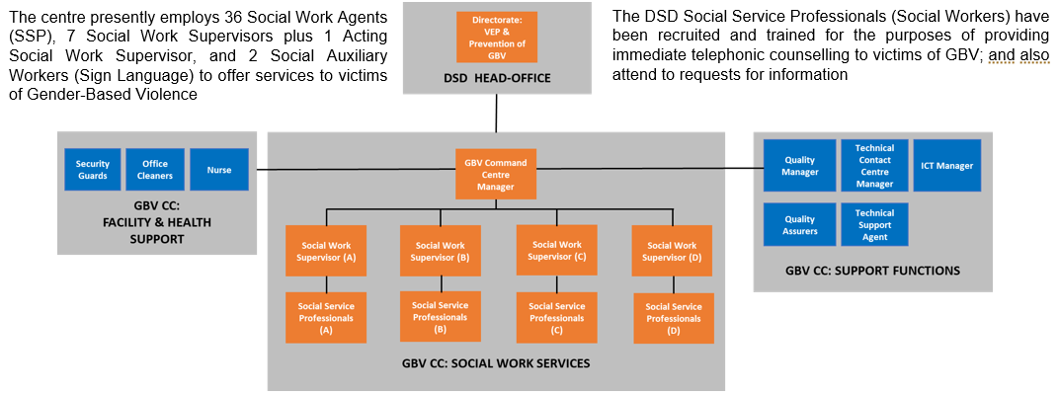
GBV CC Organogram & Human Resources

Slide 7
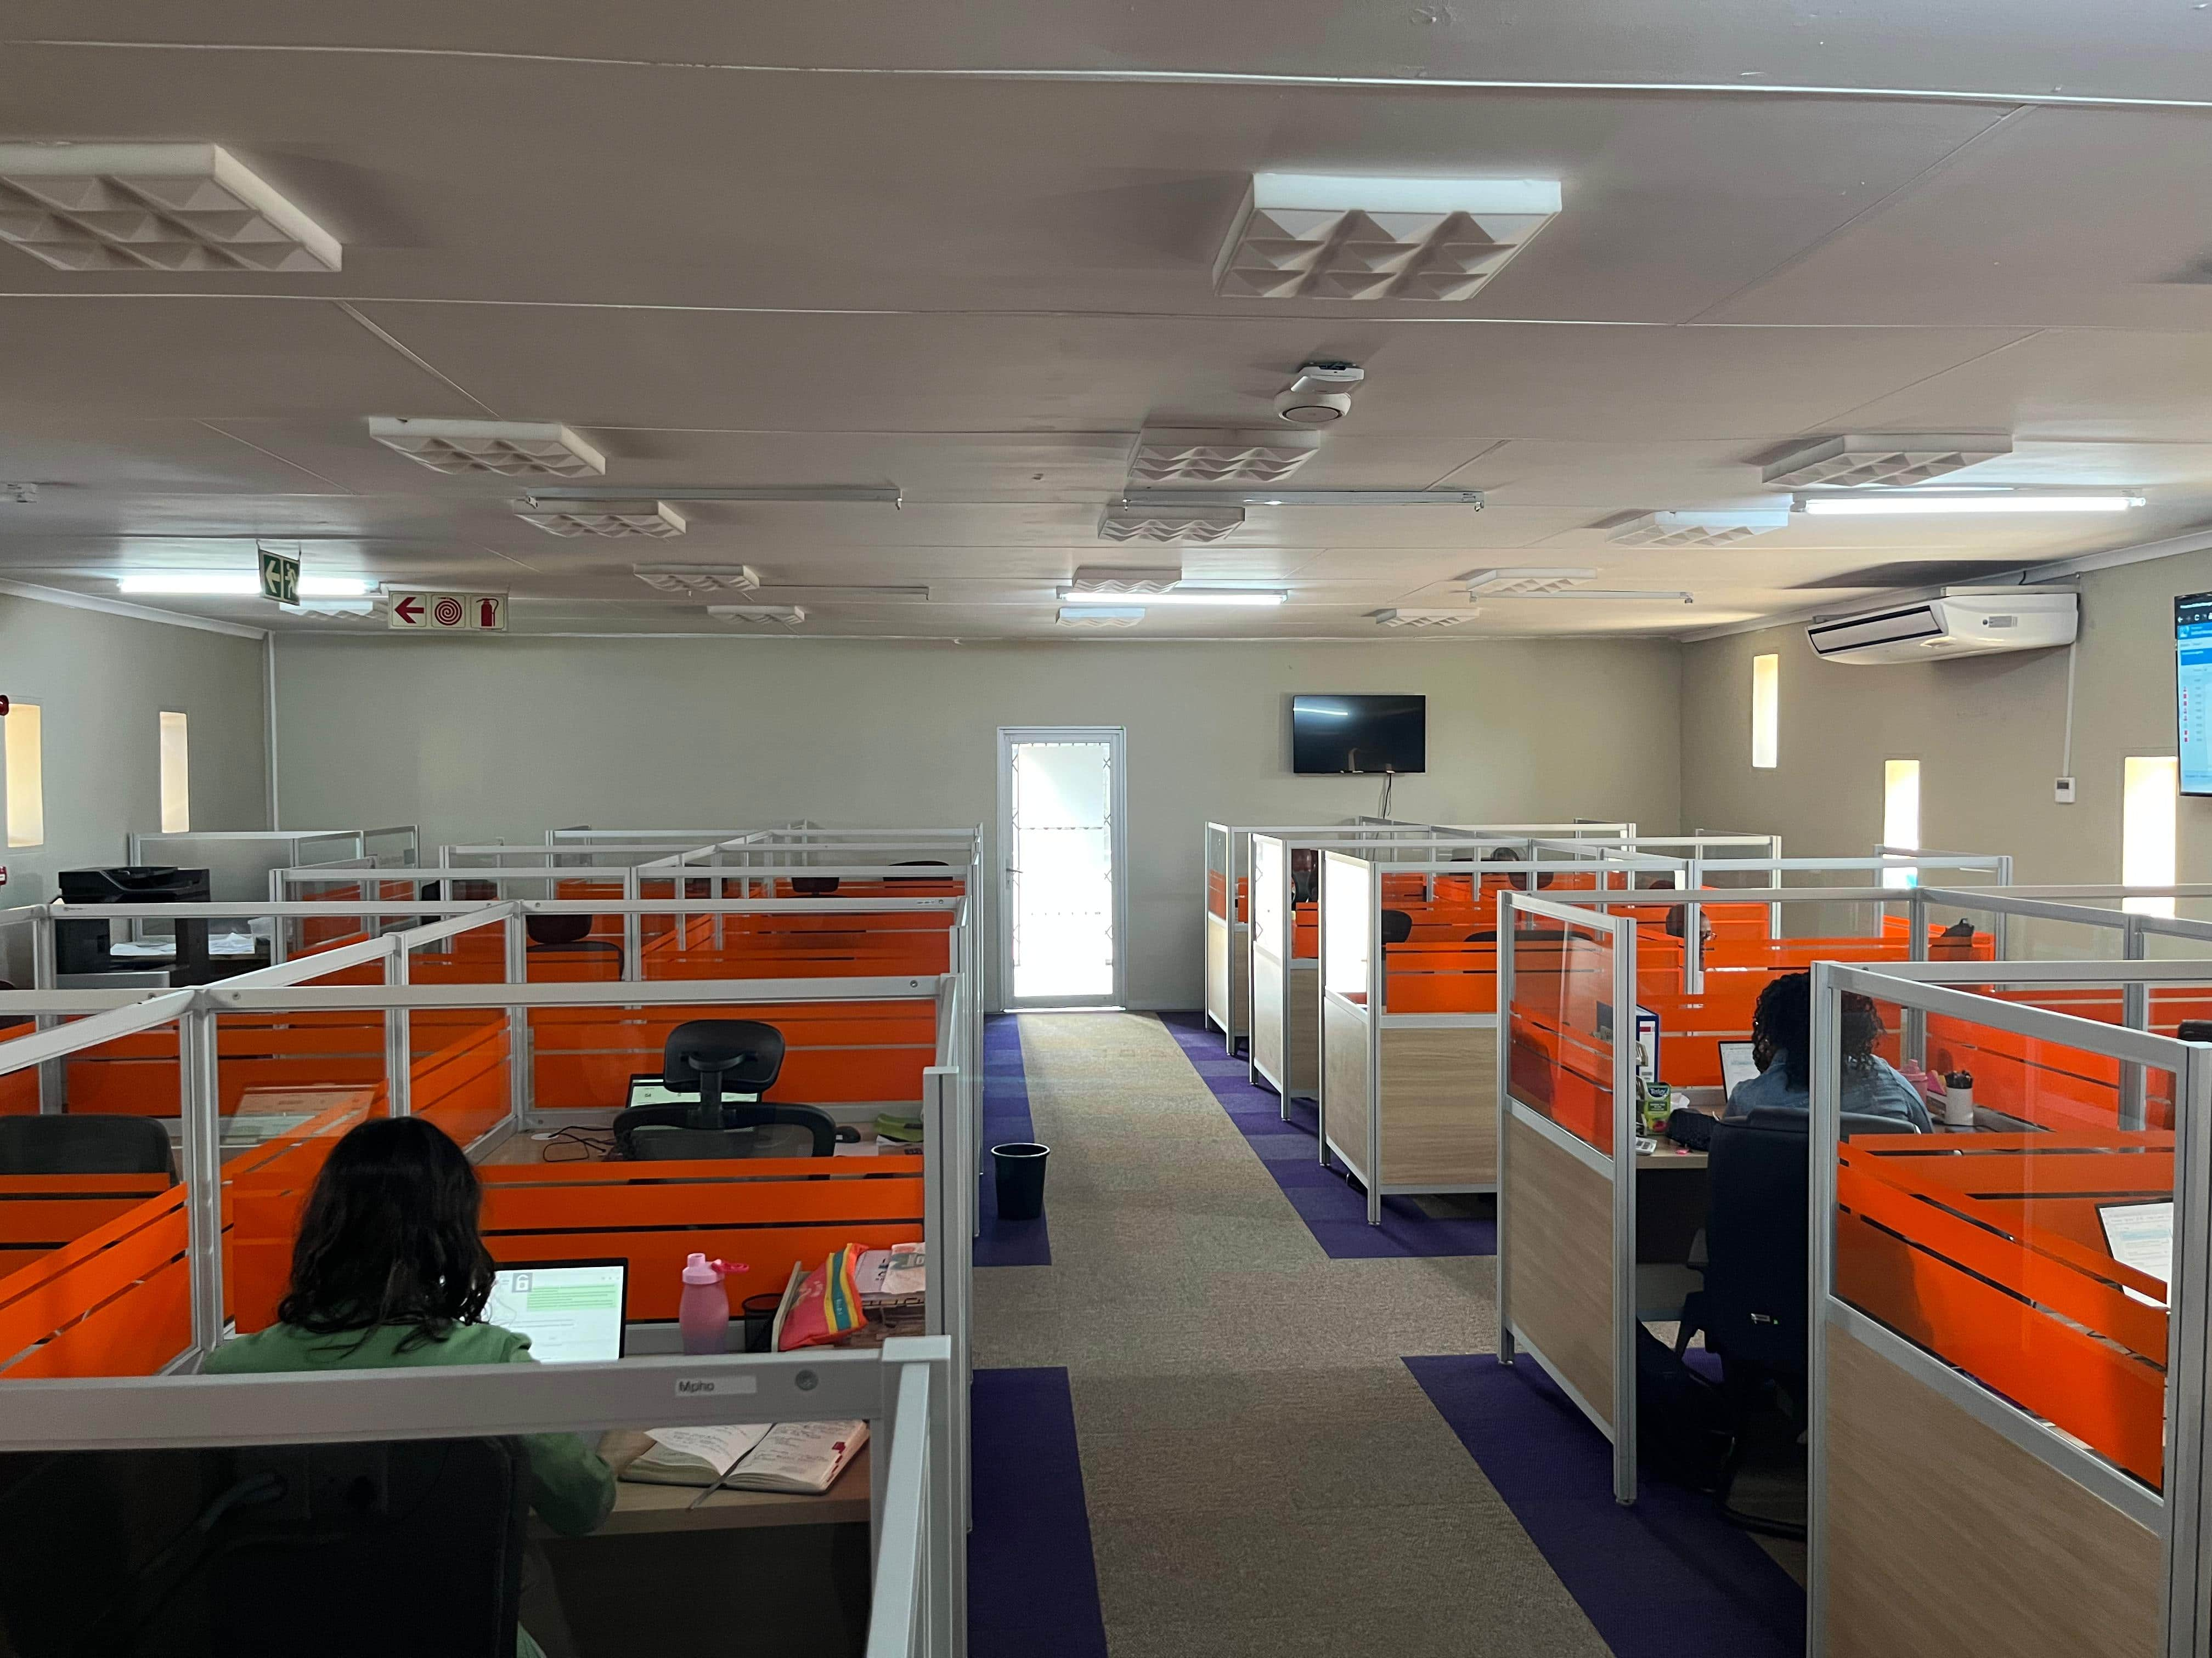
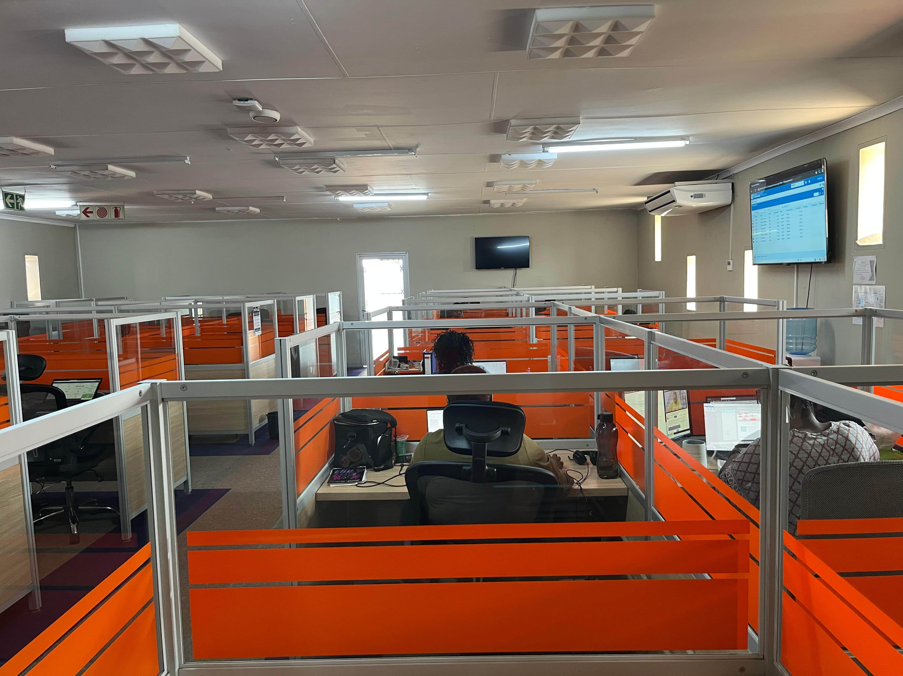
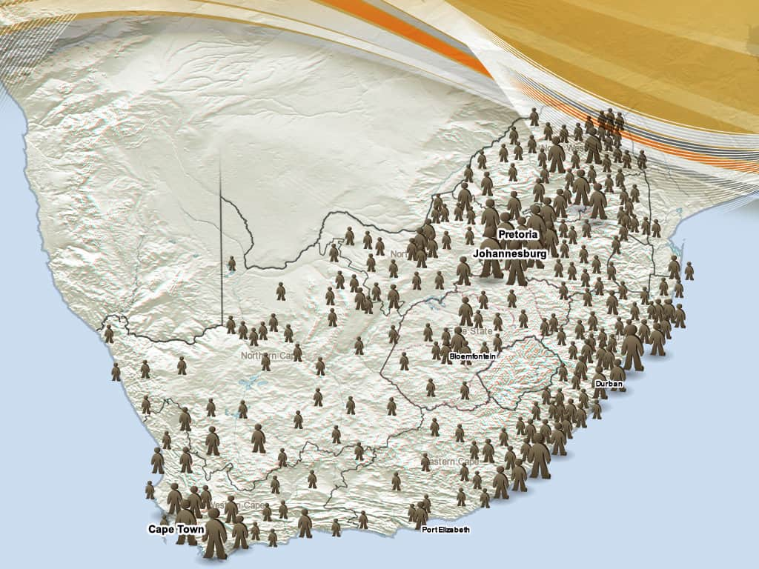
GBVCC LOOK & FEEL
30 seats

Slide 8
KEY FOCUS AREAS
Effectiveness – System Theory
Inclusivity – Anti-Oppressive Practise
Quality Assurance – Accountability Theory
Data Generation – Knowledge to Action
Capacity – Learning Organisation Theory
Ethics – Deontology Theory

Slide 9
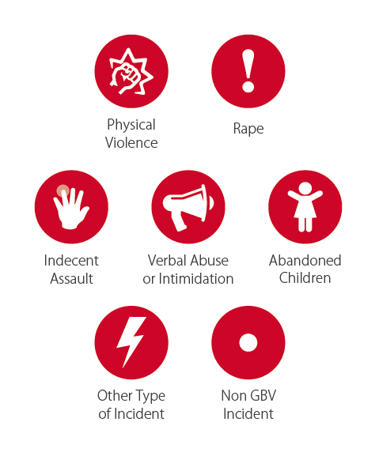
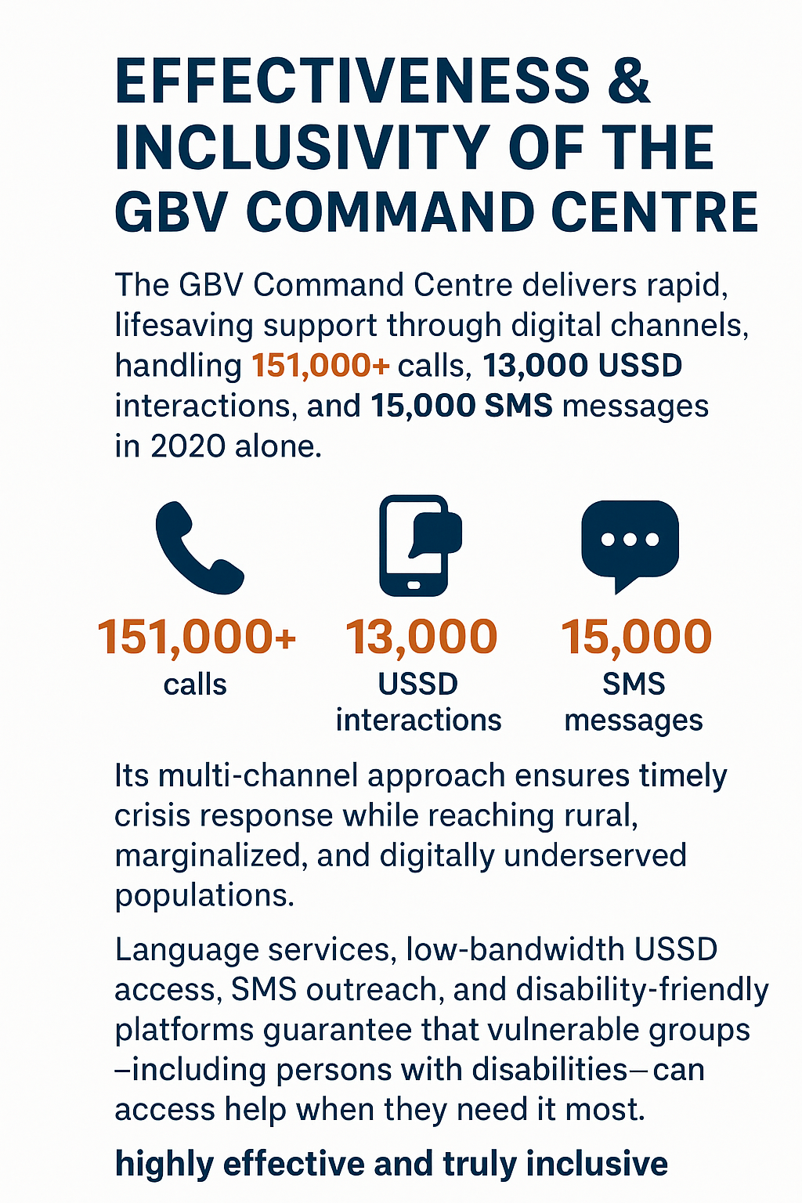
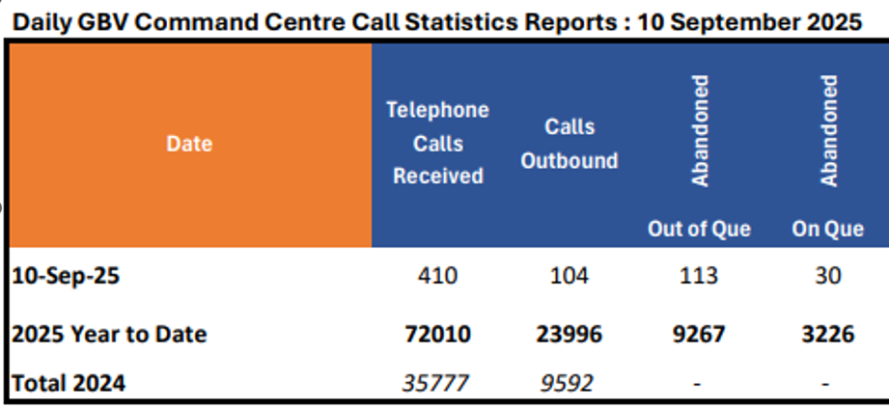
KEY FOCUS AREAS: Effectiveness & Inclusivity

Slide 10
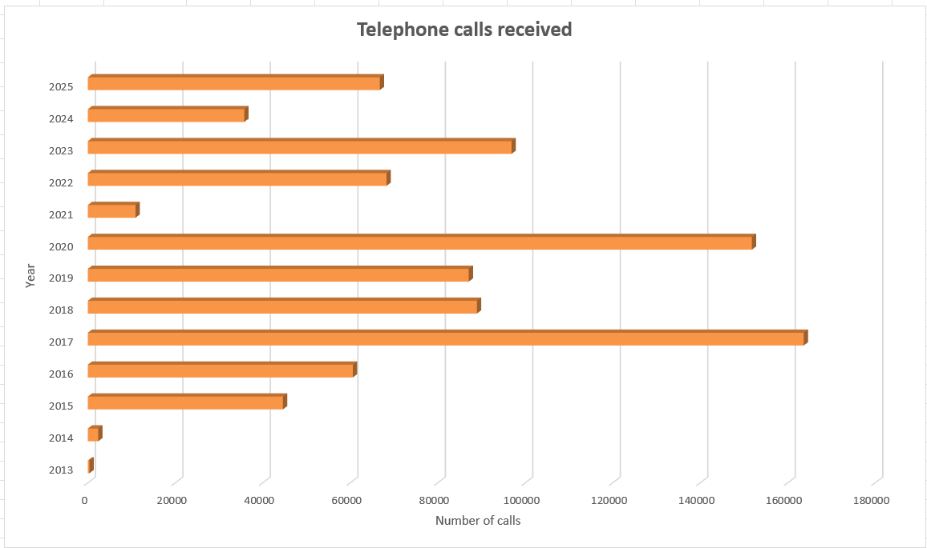
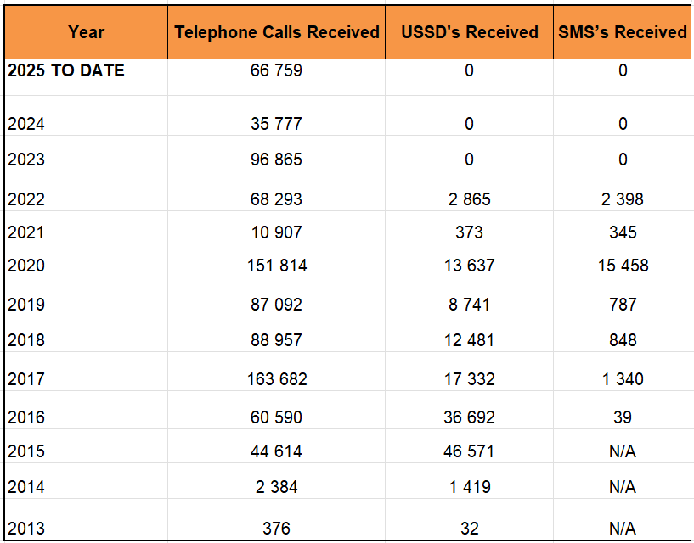
KEY FOCUS AREAS: Effectiveness & Inclusivity

Slide 11
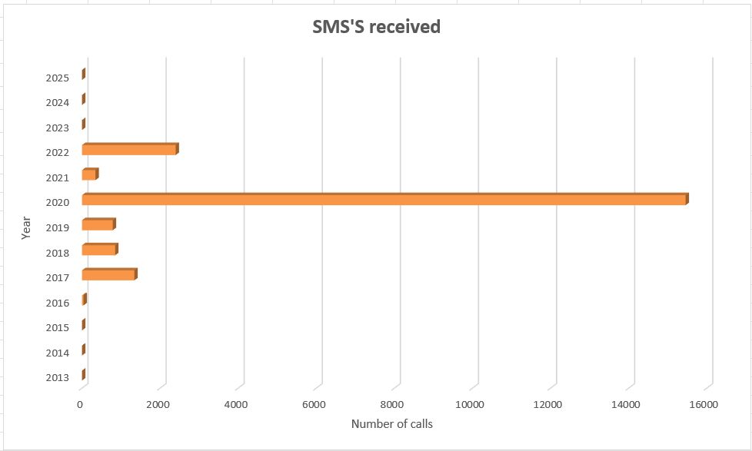
KEY FOCUS AREAS: Effectiveness & Inclusivity

Slide 12
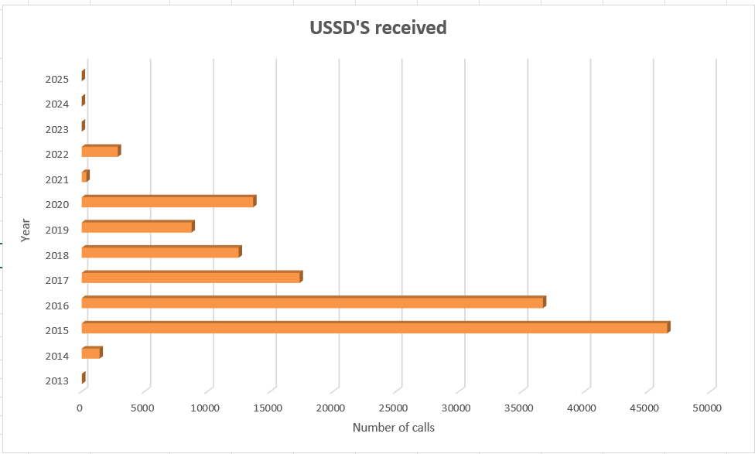
KEY FOCUS AREAS: Effectiveness & Inclusivity

Slide 13
KEY FOCUS AREAS:Quality Assurance
Quality Assurance
Systems Supporting Reliable, Accurate & Ethical Service Delivery
CRM & Telephony Systems: Ensure accurate case recording, routing, and follow-up.
Workflows: Defined processes for Emergency, Non-Emergency, Information Requests, and Cancellations support consistency and contact centre best practise.
Standard Operating Procedures (SOPs)
Monitoring & Accountability Tools
24/7 Monitoring & Tracking: Data systems and call recordings ensure real-time oversight.
After-Call Surveys: Enable immediate feedback, corrective action, and further interventions.
Performance Benchmarks: Queuing times, abandoned call rates, and quality standards are continuously monitored.
Audits & Coaching: Regular call reviews, performance feedback, and process and systems skills coaching reinforce adherence and quality.
Notes:
Explain systems in place to ensure reliable, accurate, and ethical service delivery.
Reference monitoring tools and accountability measures.

Slide 14
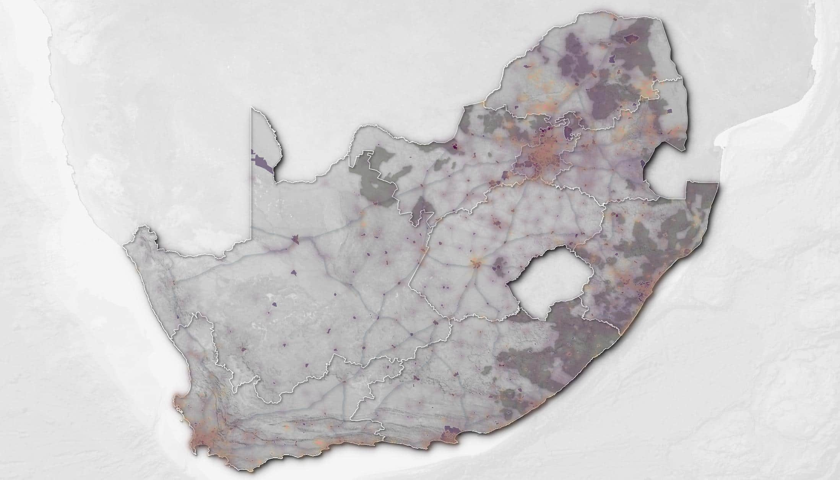

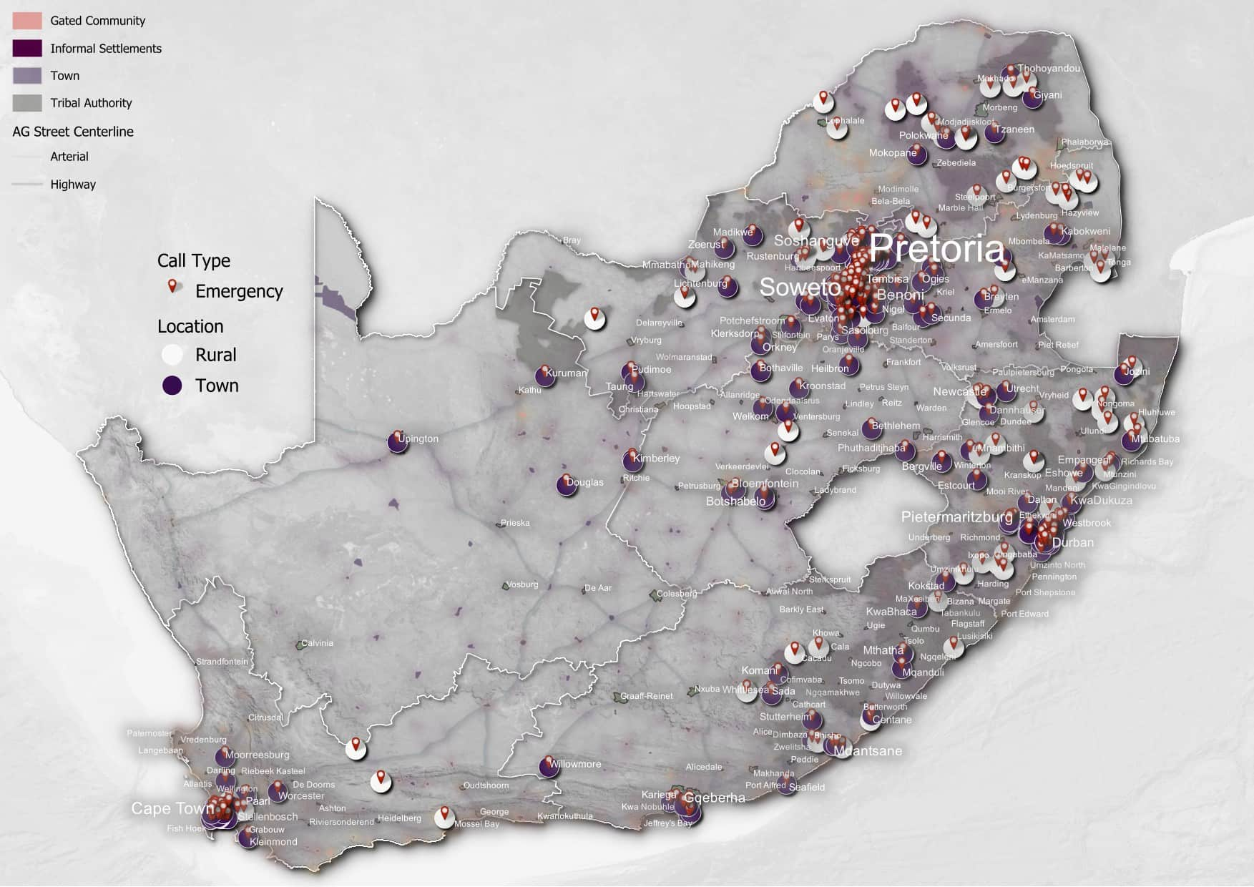
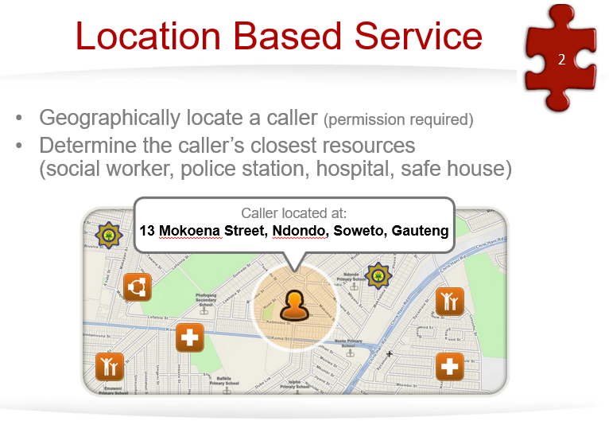
KEY FOCUS AREAS:Data Generation
Emergency: Towns and Rural
 | Emergency
Town | 399
Rural | 114
Grand Total | 513
Notes:
Illustrate how real-time dashboards and reports guide interventions, inform policy, and connect with stakeholders such as SAPS and CSOs
Present a graph or chart summarizing trends (2013–2025).
--- GBV emergency calls differ in frequency and nature between gated communities and informal settlements, influenced by varying social dynamics, privacy levels, and reporting behaviors. Image source: Microsoft 365 content library

Slide 15
Incident Type | Emergency | Non-Emergency | Grand Total
Abduction | 2 | 8 | 10
Anger Management | 1 | 33 | 34
Behavioural Problems | 4 | 135 | 139
Bullying | 4 | 37 | 41
Child Abandonment | 1 | 22 | 23
Child Abuse | 92 | 469 | 561
Child Custody/Visitation | 2 | 224 | 226
Child Maintenance |  | 77 | 77
Community Violence (Mob Justice) | 1 | 10 | 11
Counselling Divorce |  | 8 | 8
Counselling Marriage |  | 64 | 64
Counselling Trauma |  | 36 | 36
Economic Abuse | 3 | 24 | 27
Elder Abuse | 14 | 84 | 98
Emotional Abuse | 21 | 599 | 620
Forced Prostitution | 1 | 1 | 2
Hate Speech |  | 6 | 6
Human Trafficking | 1 | 2 | 3
Mental Health |  | 35 | 35
Neglect of Person with Disability | 1 | 11 | 12
Other Type of Incident | 102 | 1559 | 1661
Physical Assault | 233 | 889 | 1122
Pornography |  | 1 | 1
Rape (Including Sexual Assault of LGBTIQ+) | 4 | 26 | 30
Sexual Abuse | 11 | 177 | 188
Social Grant/SRD | 1 | 45 | 46
Stalking | 2 | 25 | 27
Statutory Rape | 11 | 23 | 34
Substance Abuse | 1 | 87 | 88
GBV (Gender Based Violence) Ticket Report
Incident Type
Notes:
Illustrate how real-time dashboards and reports guide interventions, inform policy, and connect with stakeholders such as SAPS and CSOs
Present a graph or chart summarizing trends (2013–2025).
--- GBV emergency calls differ in frequency and nature between gated communities and informal settlements, influenced by varying social dynamics, privacy levels, and reporting behaviors. Image source: Microsoft 365 content library

Slide 16
KEY FOCUS AREAS: Capacity – Learning Org. Theory
1. Initial Induction and Foundational Training
GBVCC role: New staff receive orientation on gender-based violence (GBV), trauma-informed care, referral pathways, and crisis management.
QA role: Ensures training aligns with national standards, ethical guidelines, and confidentiality requirements.
2. Ongoing Professional Skills Development
GBVCC:
Regular workshops on case handling, victim support, and psychosocial interventions.
Training in using digital platforms (case management systems, hotlines, and reporting apps).
QA:
Monitors service quality through call reviews, case audits, and feedback loops.
Identifies skill gaps and recommends targeted refresher courses.
3. Digital and Data Literacy
GBVCC: Training staff to use helpline systems, data entry tools, and reporting.
QA: Ensures accuracy, compliance with POPIA (data privacy), and ethical data handling.
4. Performance Evaluation and Feedback
GBVCC: Supervisors conduct regular debriefing sessions to prevent burnout and provide peer learning opportunities.
QA: Collects feedback from clients and reviews service outcomes to measure effectiveness and improve standards.
5. Professional Growth and Career Development
GBVCC: Encourages staff to attend conferences, webinars, and networking sessions on GBV and social work.
QA: Provides certification pathways, continuous professional development credits, and recognition of excellence in service.
The GBVCC focuses on capacity building and survivor-centered service delivery, while Quality Assurance ensures consistency, compliance, and professional growth. Together, they create a cycle of training, monitoring, and development that strengthens both staff skills and service quality.

Slide 17
KEY FOCUS AREAS: Ethics
Dual Accountability: Social Work Ethics vs Call Centre Standards
GBV CC Social work ethics focus on protecting the dignity, rights, and well-being of victims and survivors. Key principles: confidentiality, non-maleficence, empowerment, and informed consent.
Call centre standards (ISO, COPC, etc.) emphasize operational efficiency, quality assurance, customer experience, and compliance with technical protocols (e.g., data security, recording standards, response times).
Separation of roles:
Social workers: Provide psychosocial support, counselling, referrals, and safeguard ethical standards of care.
Quality assurers and technical staff: Monitor adherence to call centre regulations (e.g., call handling, performance metrics, system uptime, information security).
The challenge — and strength — lies in integrating these two accountability frameworks without compromising survivor/victims' rights.

Slide 18
CONCLUSION
The Gender-Based Violence Command Centre (GBVCC) stands as a powerful example of how social work adapts and thrives in the digital age. By merging professional ethics with technological innovation, it has shown that government-led digital platforms can deliver timely, survivor-centered, and inclusive services. The experience affirms that social work, far from being displaced by technology, is in fact strengthened by it — made more effective, data-driven, and impactful in addressing the complex realities of GBV.
Key Takeaways by Focus Area
Ethics: The GBVCC demonstrates that digital tools can be applied without compromising social work values — confidentiality, informed consent, and survivor dignity remain central.
Data Generation: Reliable data from calls and cases not only strengthens case management but also informs national policy and evidence-based GBV interventions.
Quality Assurance: Integrating ISO-aligned call centre standards with social work ethics creates a dual safeguard, ensuring services are both technically sound and ethically grounded.
Capacity & Effectiveness: Investment in continuous training and digital infrastructure has enabled social workers to respond swiftly, reduce turnaround times, and provide trauma-informed support even outside office hours.
Inclusivity: Through multilingual support, SMS/USSD access, and disability-friendly services, the centre ensures no survivor is excluded due to geography, language, or digital divides.

Slide 19

The GBVCC confirms that social work in the digital age is not diminished but amplified — technology enhances professional values, extends reach, and strengthens trust between citizens and the state.
THANK YOU!

